Slide 1
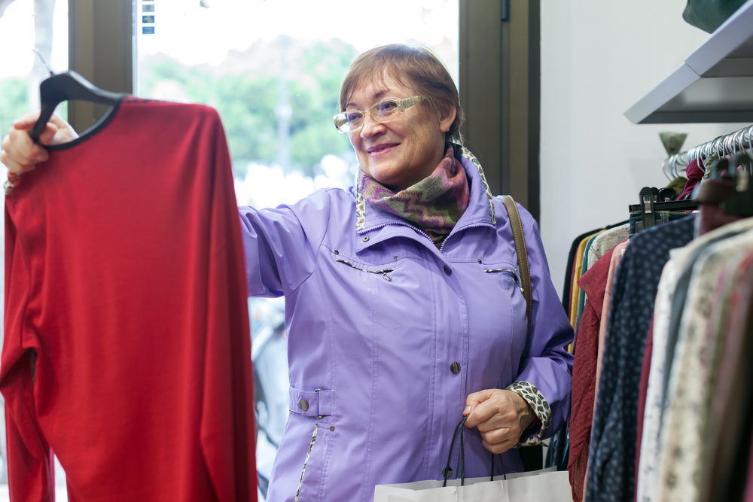
Let’s learn about clothing and shopping!

Slide 2
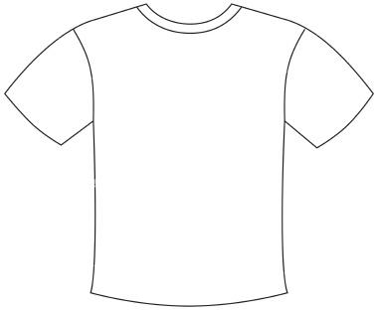
SIZES OF CLOTHES
Small Medium Large Extra Large
S
M
L
XL

Slide 3
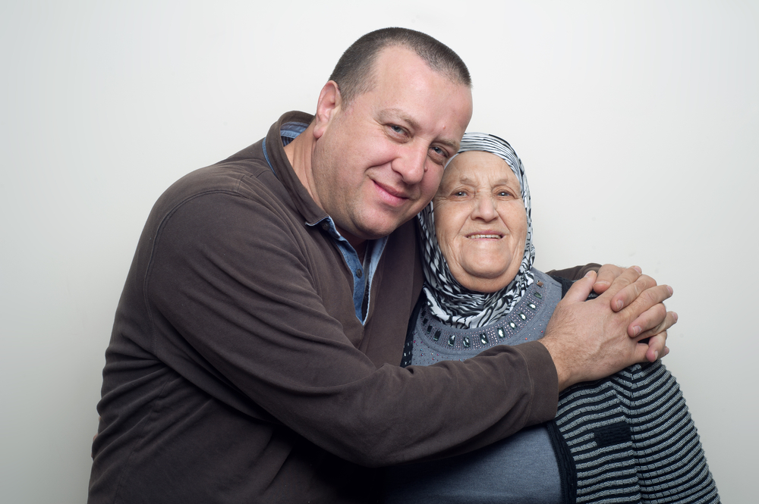
What is it? What size is it? How much is it?
A Sweater or Sweaters
Size Large
$25.00
Size:
L
$25

Slide 4
What is it? What size is it? How much is it?
A Shirt or Shirts
Size Medium
$18.00
Size:
M
$18

Slide 5
What is it? What size are they? How much are they?
A Pair of Shoes
Size 9
$40.00
Size:
9
$40

Slide 6
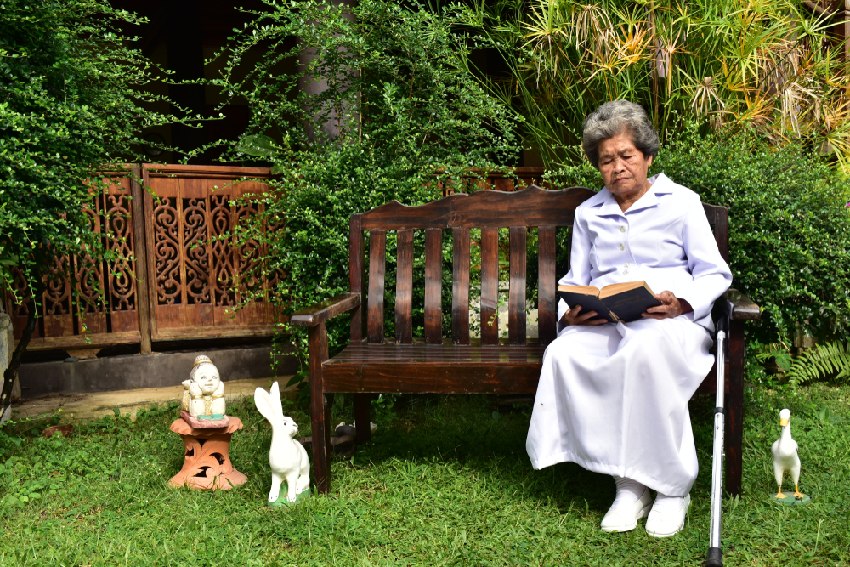
What is it? What size is it? How much is it?
A Dress
Size Small
$35.00
Size:
S
$35

Slide 7
What is it? What size is it? How much is it?
A Tie
Size: One Size
$15.00
Size:
One Size
$15

Slide 8
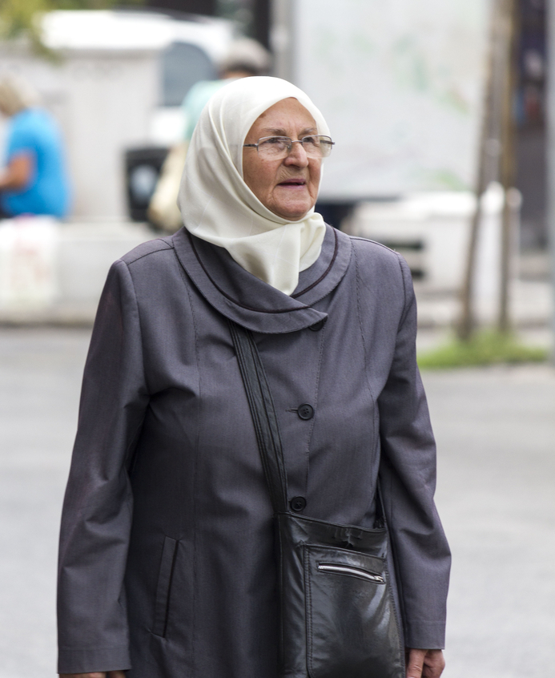
What is it? What size is it? How much is it?
A Coat
Size Extra Large
$39.00
Size:
XL
$39

Slide 9
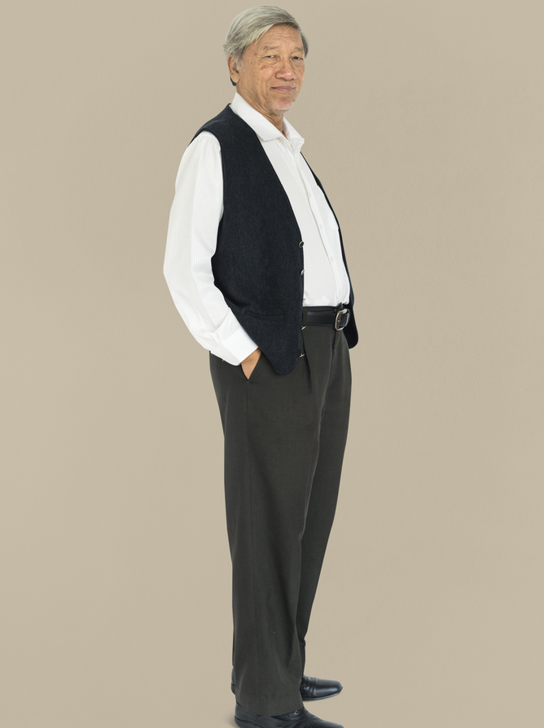
What is it? What size are they? How much are they?
A Pair of Pants
Size 36 (waist) x 34 (length)
$28.00
Size:
36 x 34
$28

Slide 10
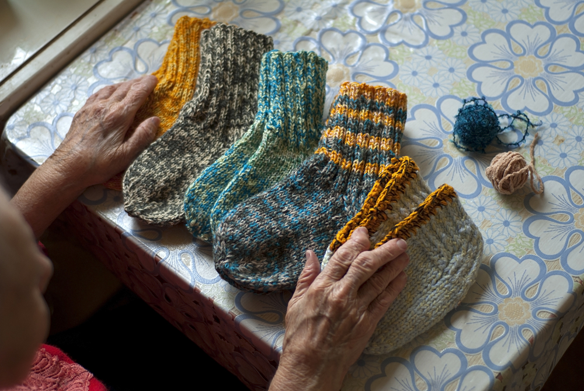
What is it? What size are they? How much are they?
A Pair of Socks
Size Medium
$10.00
Size:
M
$10

