Slide 1
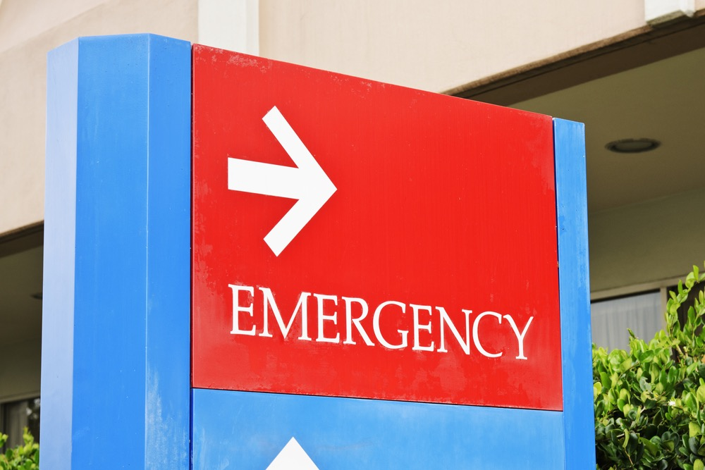
Let’s Learn Words About Emergencies!

Slide 2
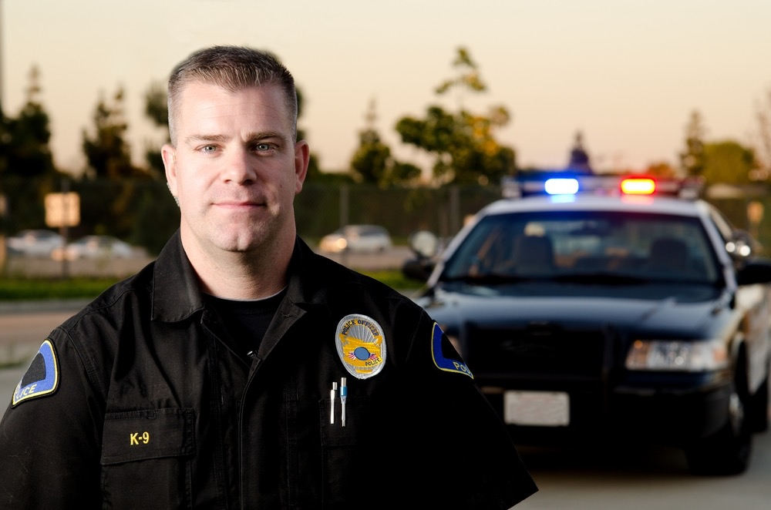
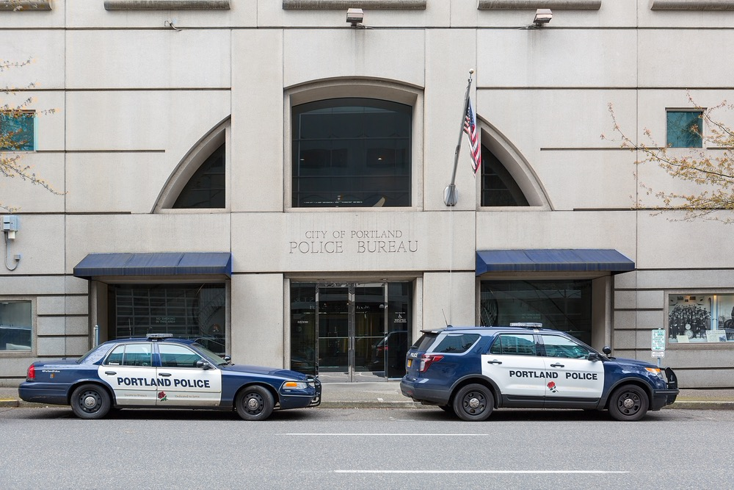
Police Officer, Police Car
Danger

Slide 3
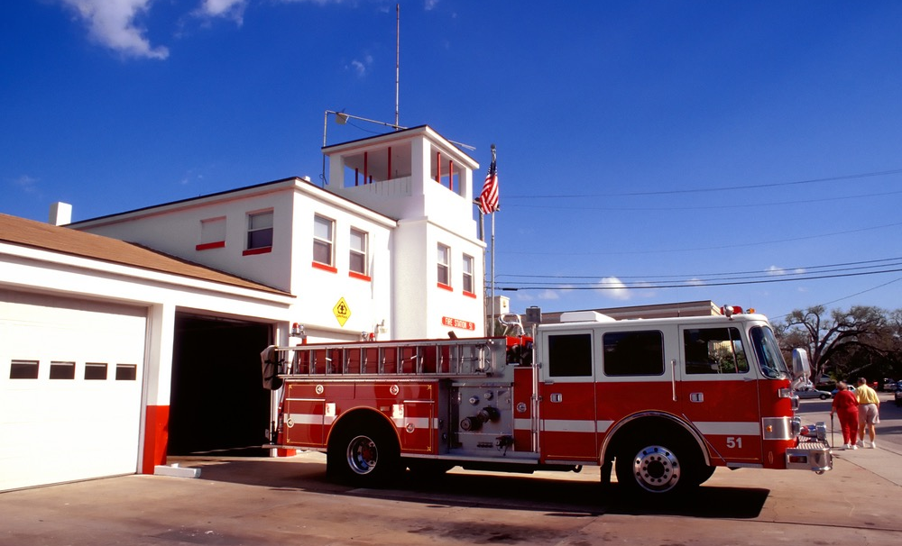
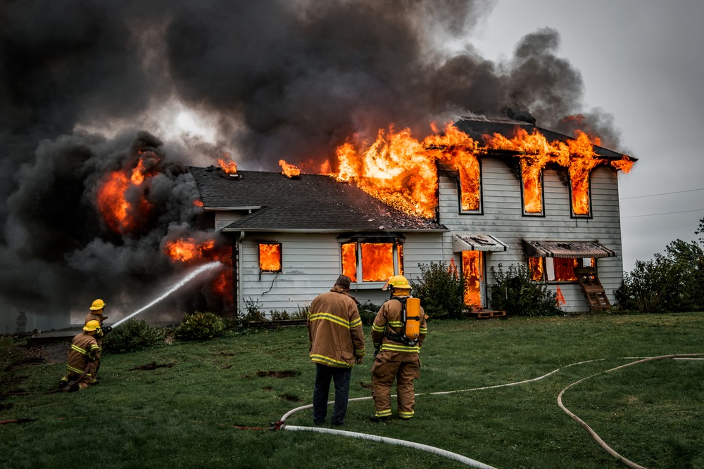
Firefighter, Fire Truck
Fire

Slide 4
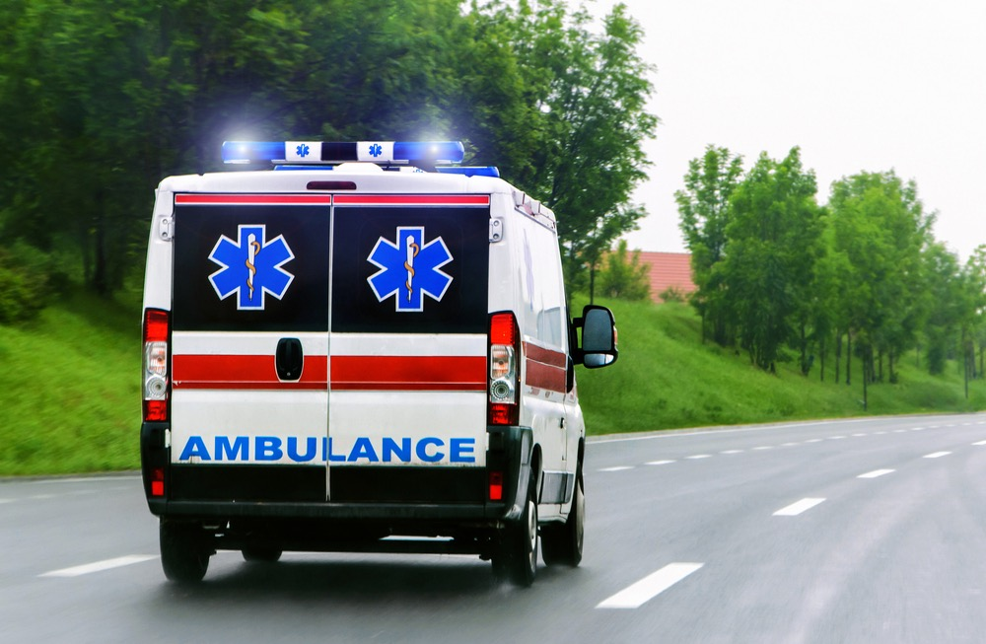
Ambulance
Very sick or hurt

Slide 5
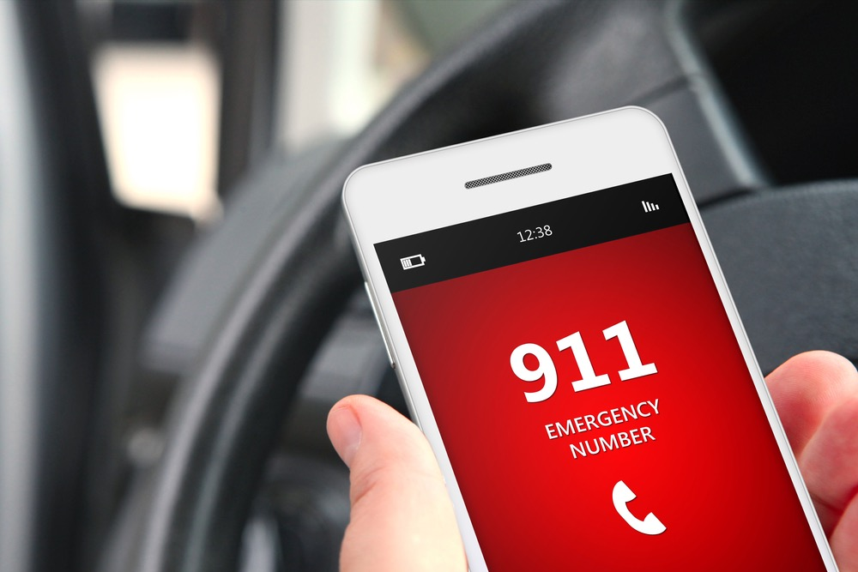
Call 911 right away for an emergency

Slide 6
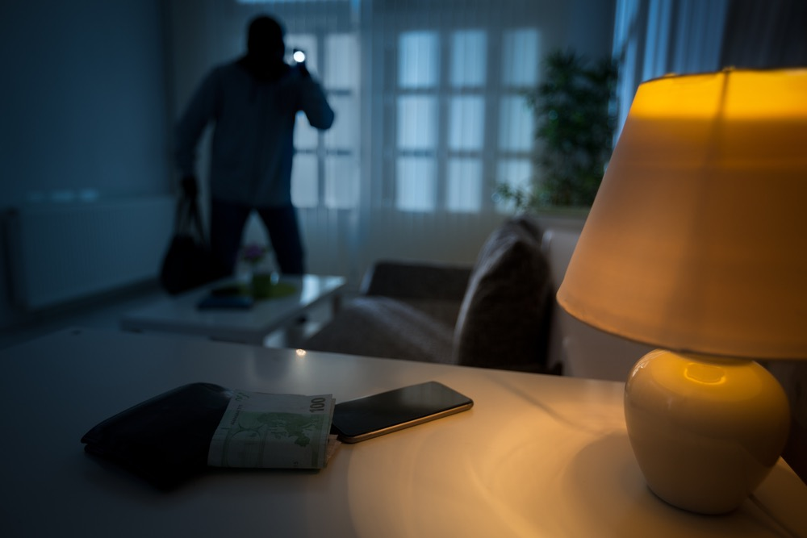
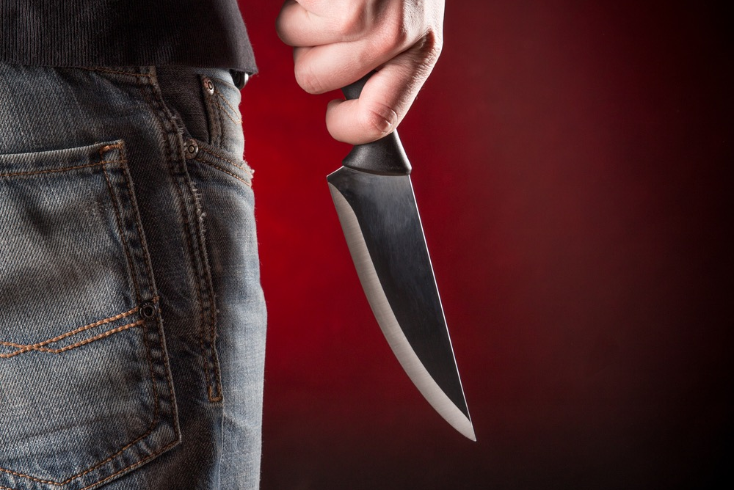
What is Your Emergency?
I’m in danger.
There is a thief.
Someone has
a knife (or gun).

Slide 7
What is Your Emergency?
There is a fire.

Slide 8
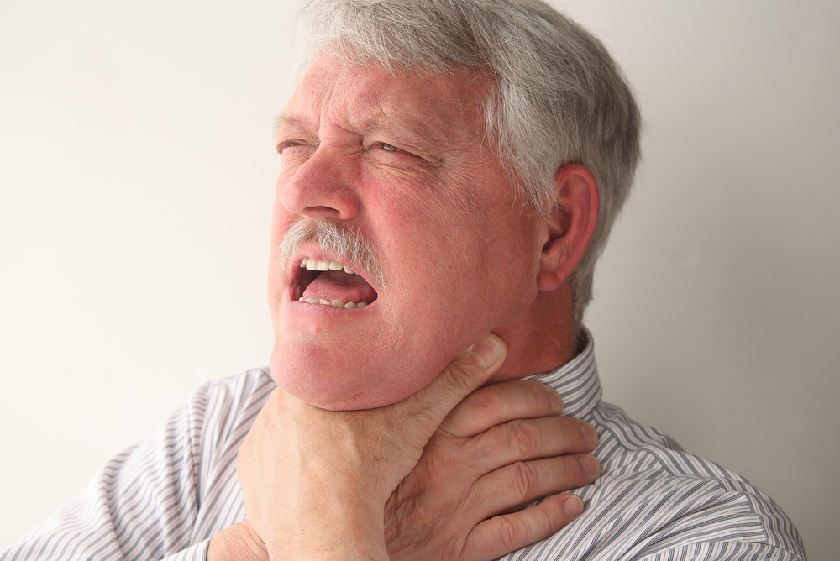
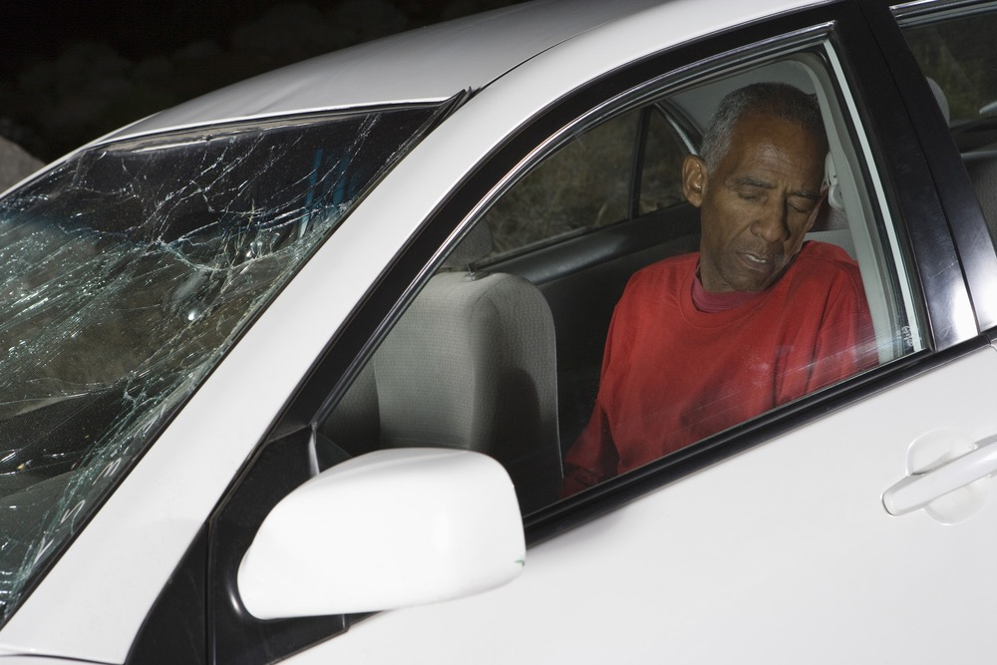
What is Your Emergency?
Someone is hurt or very sick.
_________ fell down.
________ is choking.
There was a car accident.
Their chest hurts.

Slide 9
Other Information to Know:
What is your name? How do you spell that?
What is your address?
I don’t speak English. I speak ____________.

Slide 10
What happened to the man?
Who called 911?
When did it happen?
Where were they?
Why did she call 911?
911 video

