Slide 1
Let’s learn
Fitness & Exercise
Words!

Slide 2
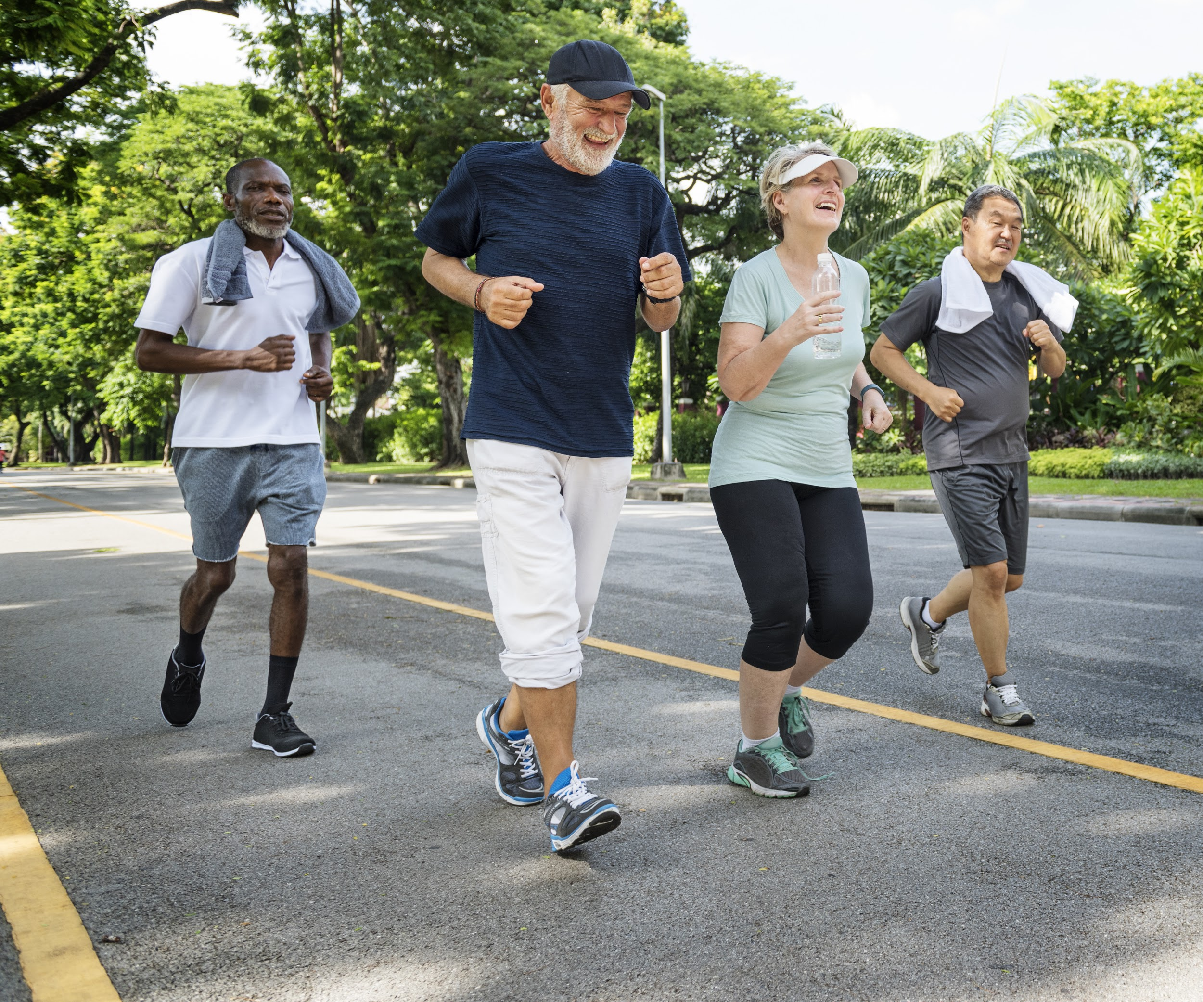
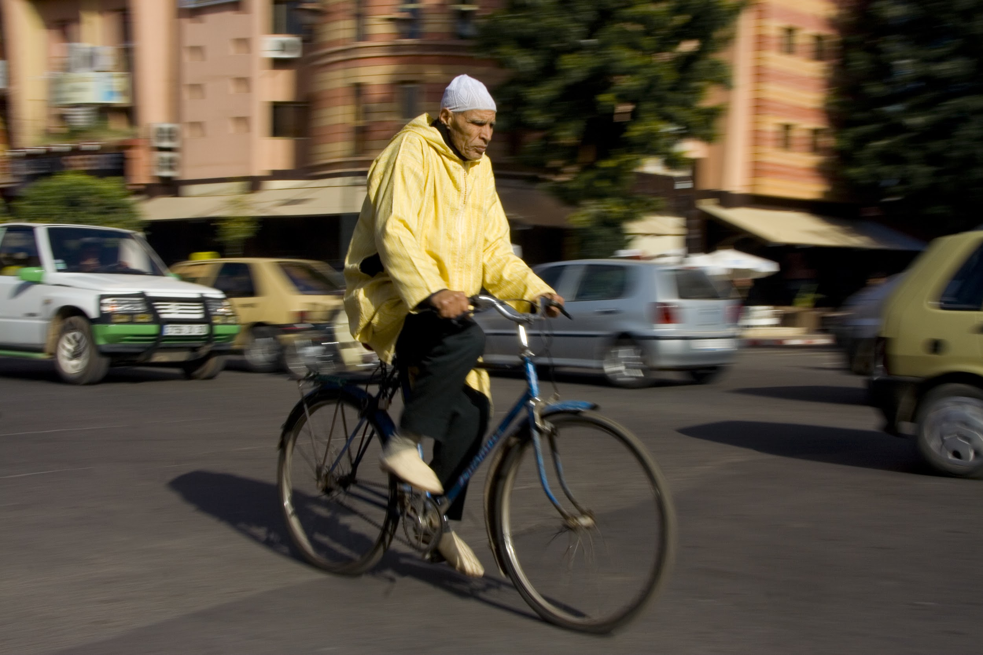
JOGGING
BIKING

Slide 3
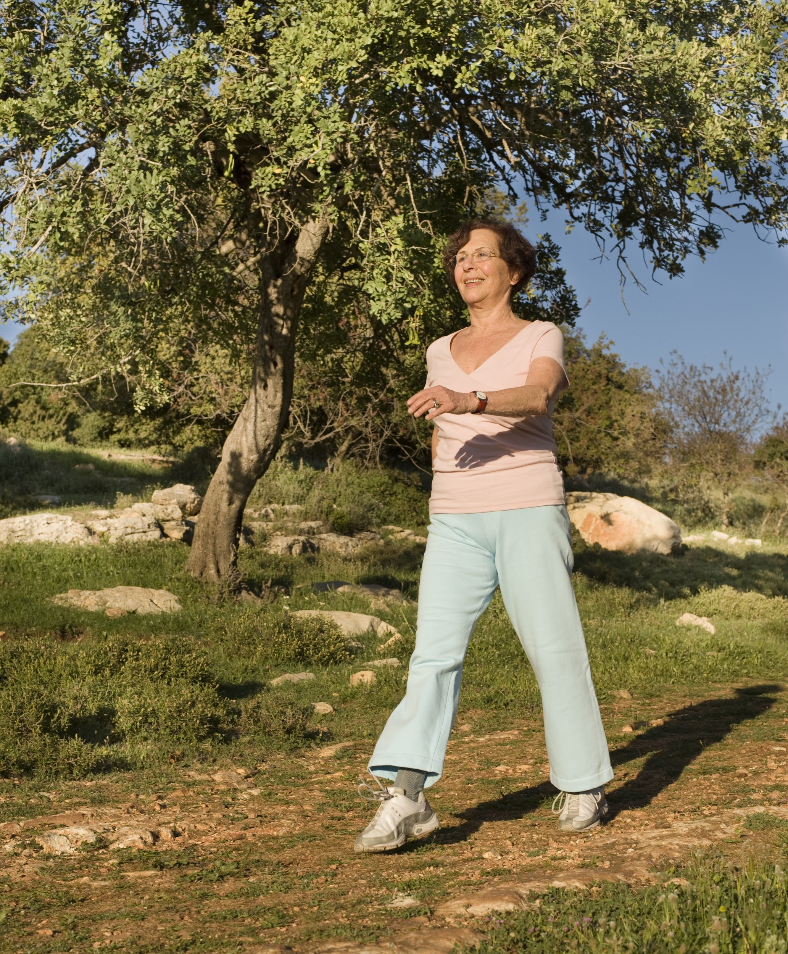
HIKING
WALKING

Slide 4
LIFTING WEIGHTS
STRETCHING

Slide 5
SOCCER
FOOTBALL

Slide 6
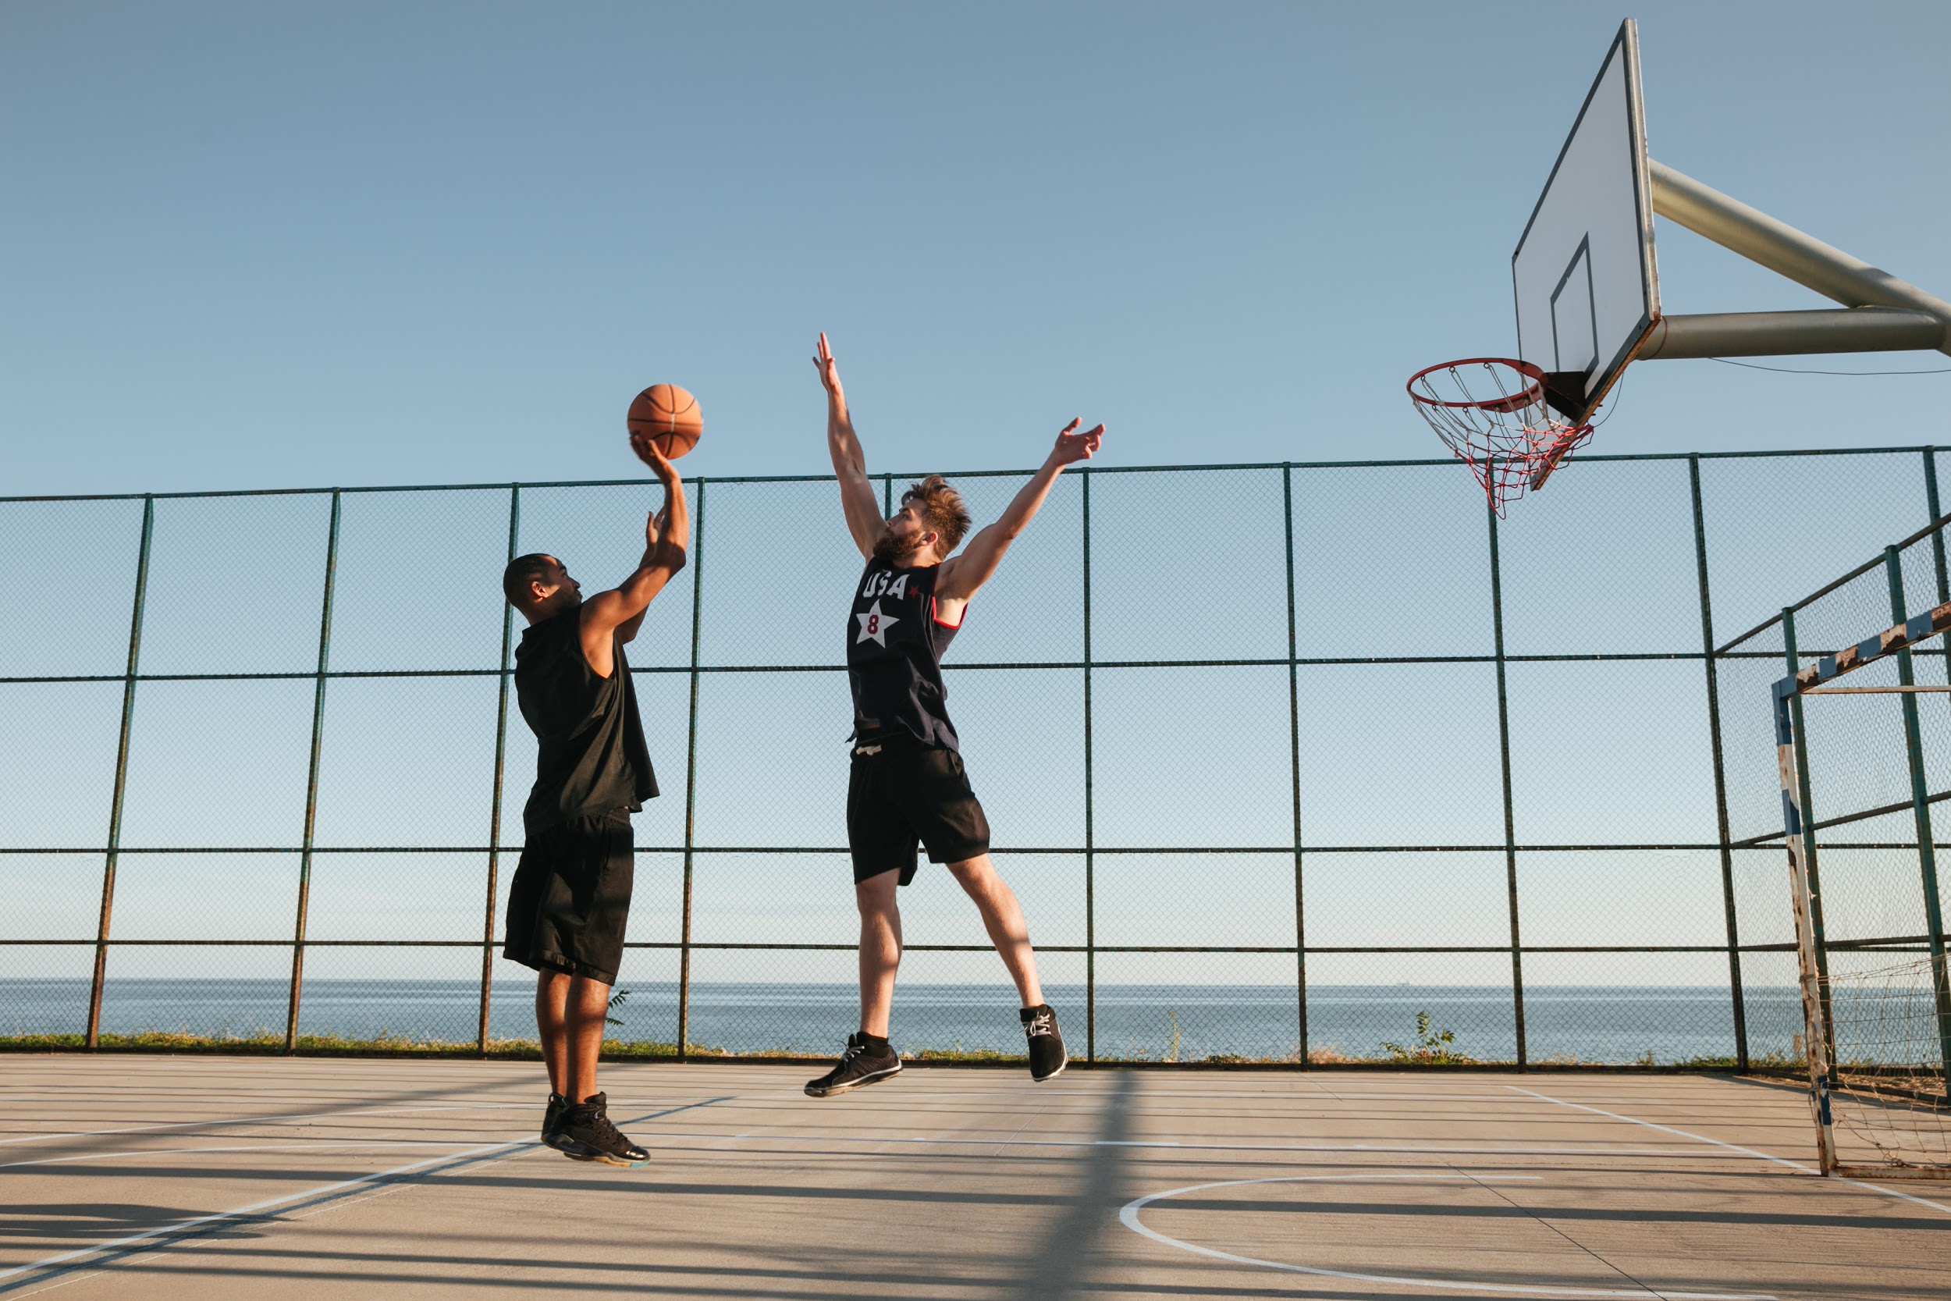
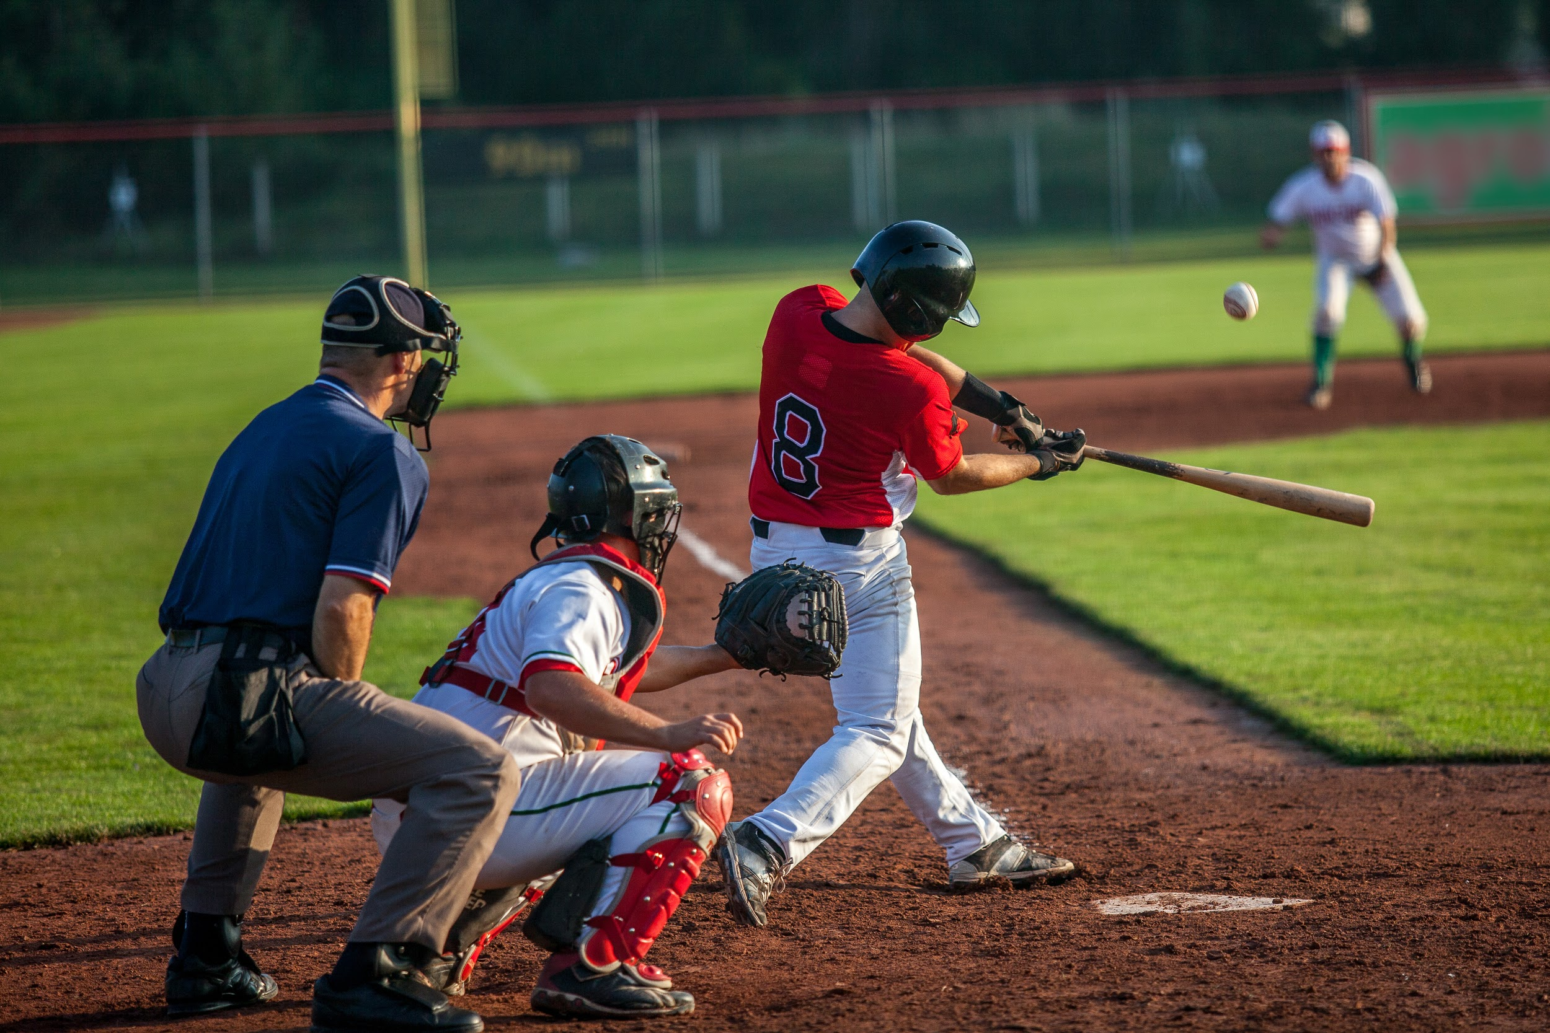
BASKETBALL
BASEBALL

Slide 7
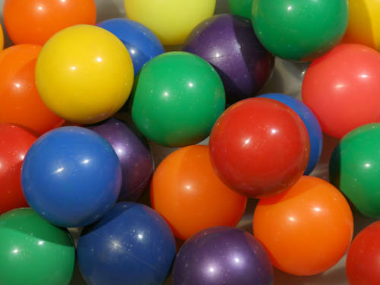
EXERCISE
BALLS

Slide 8
FISHING
SWIMMING

Slide 9
DANCING
TENNIS

Slide 10
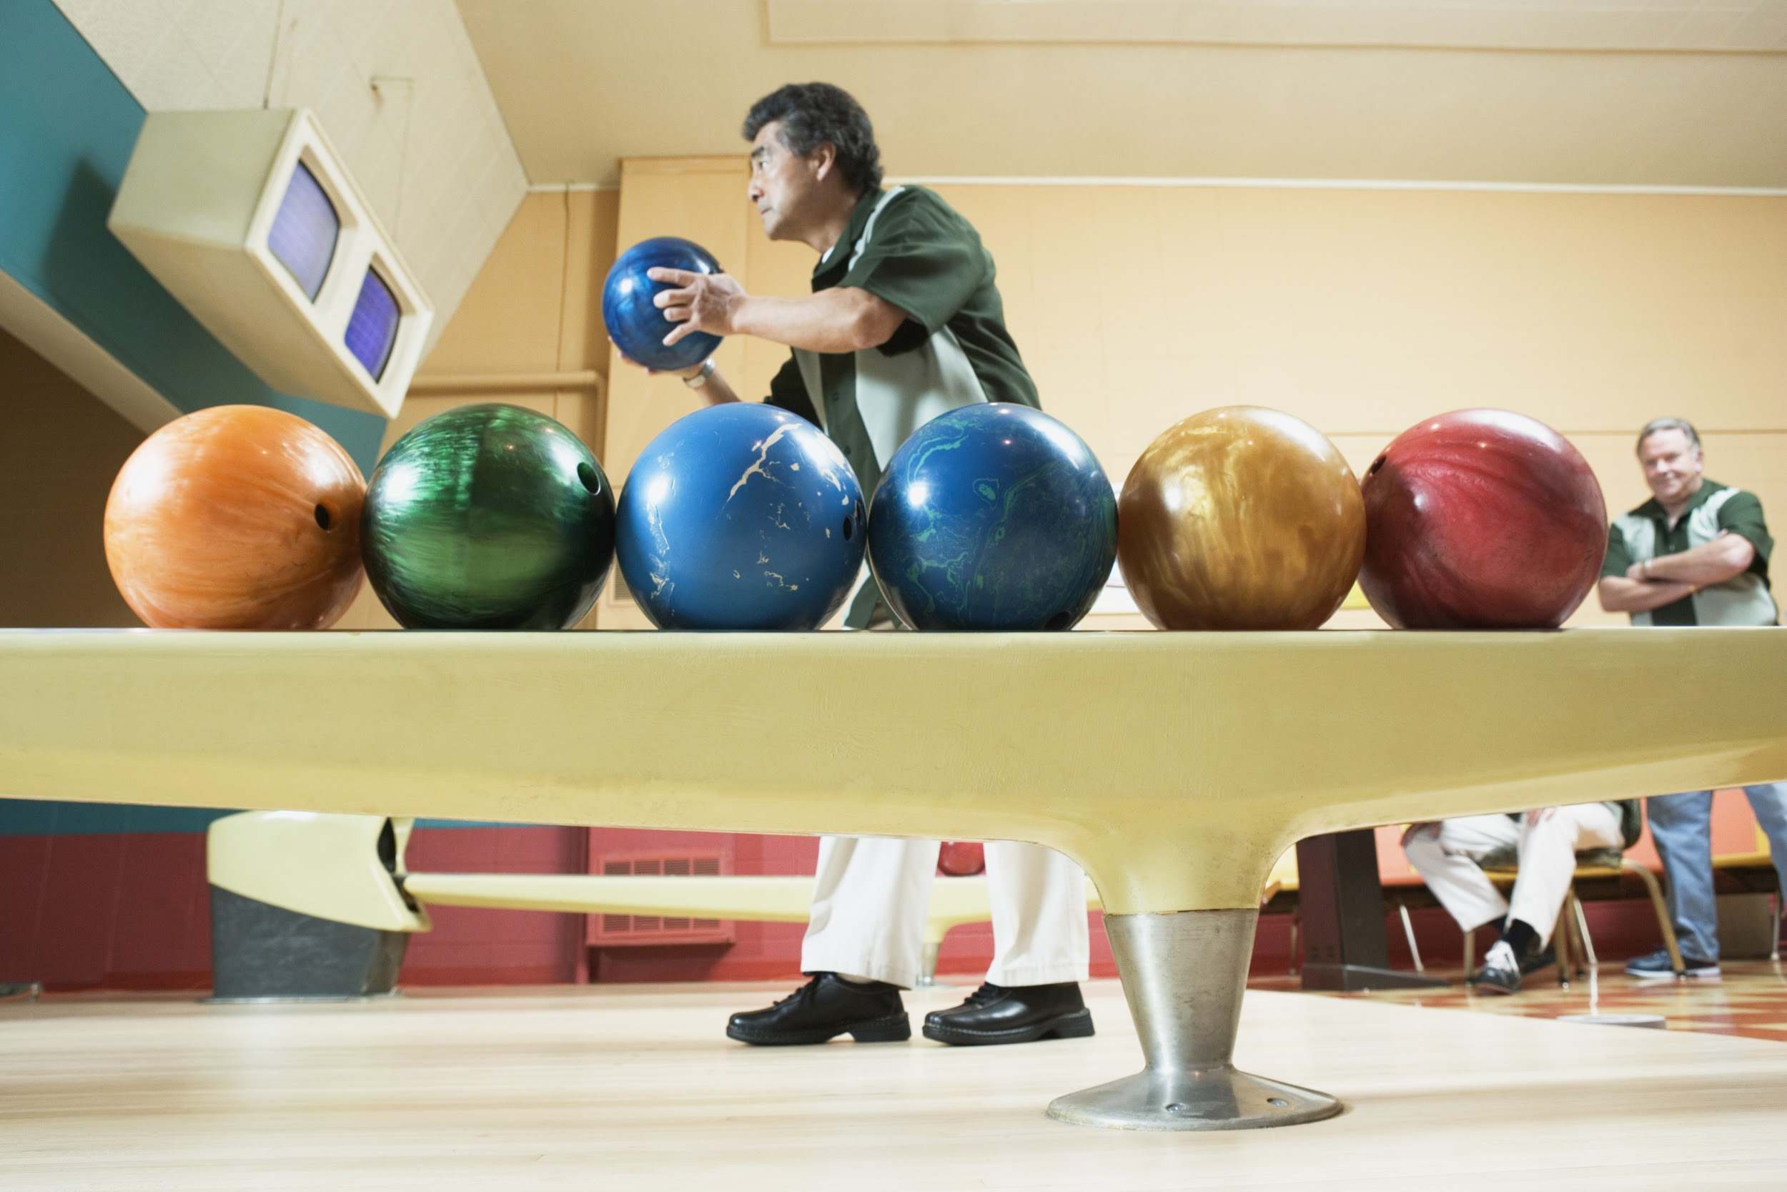
GARDENING
BOWLING

Slide 11
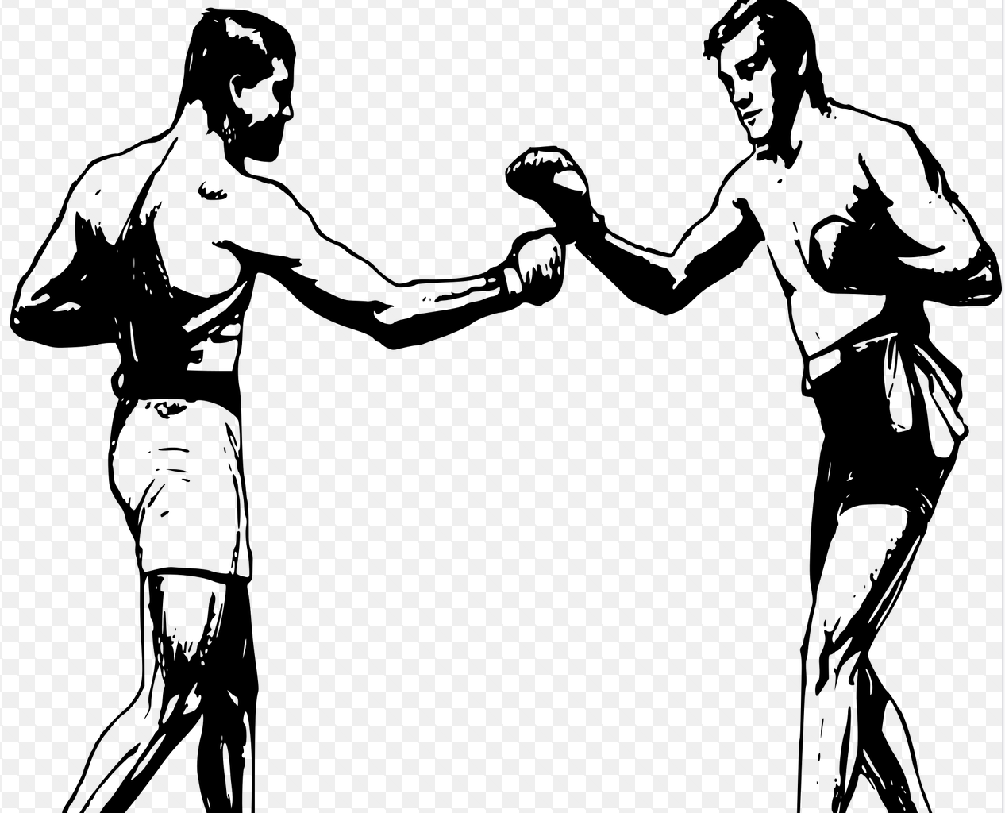
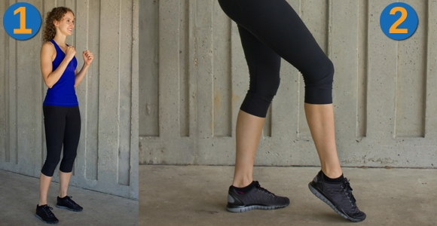
PUNCH
TAP
KICK

