Slide 1
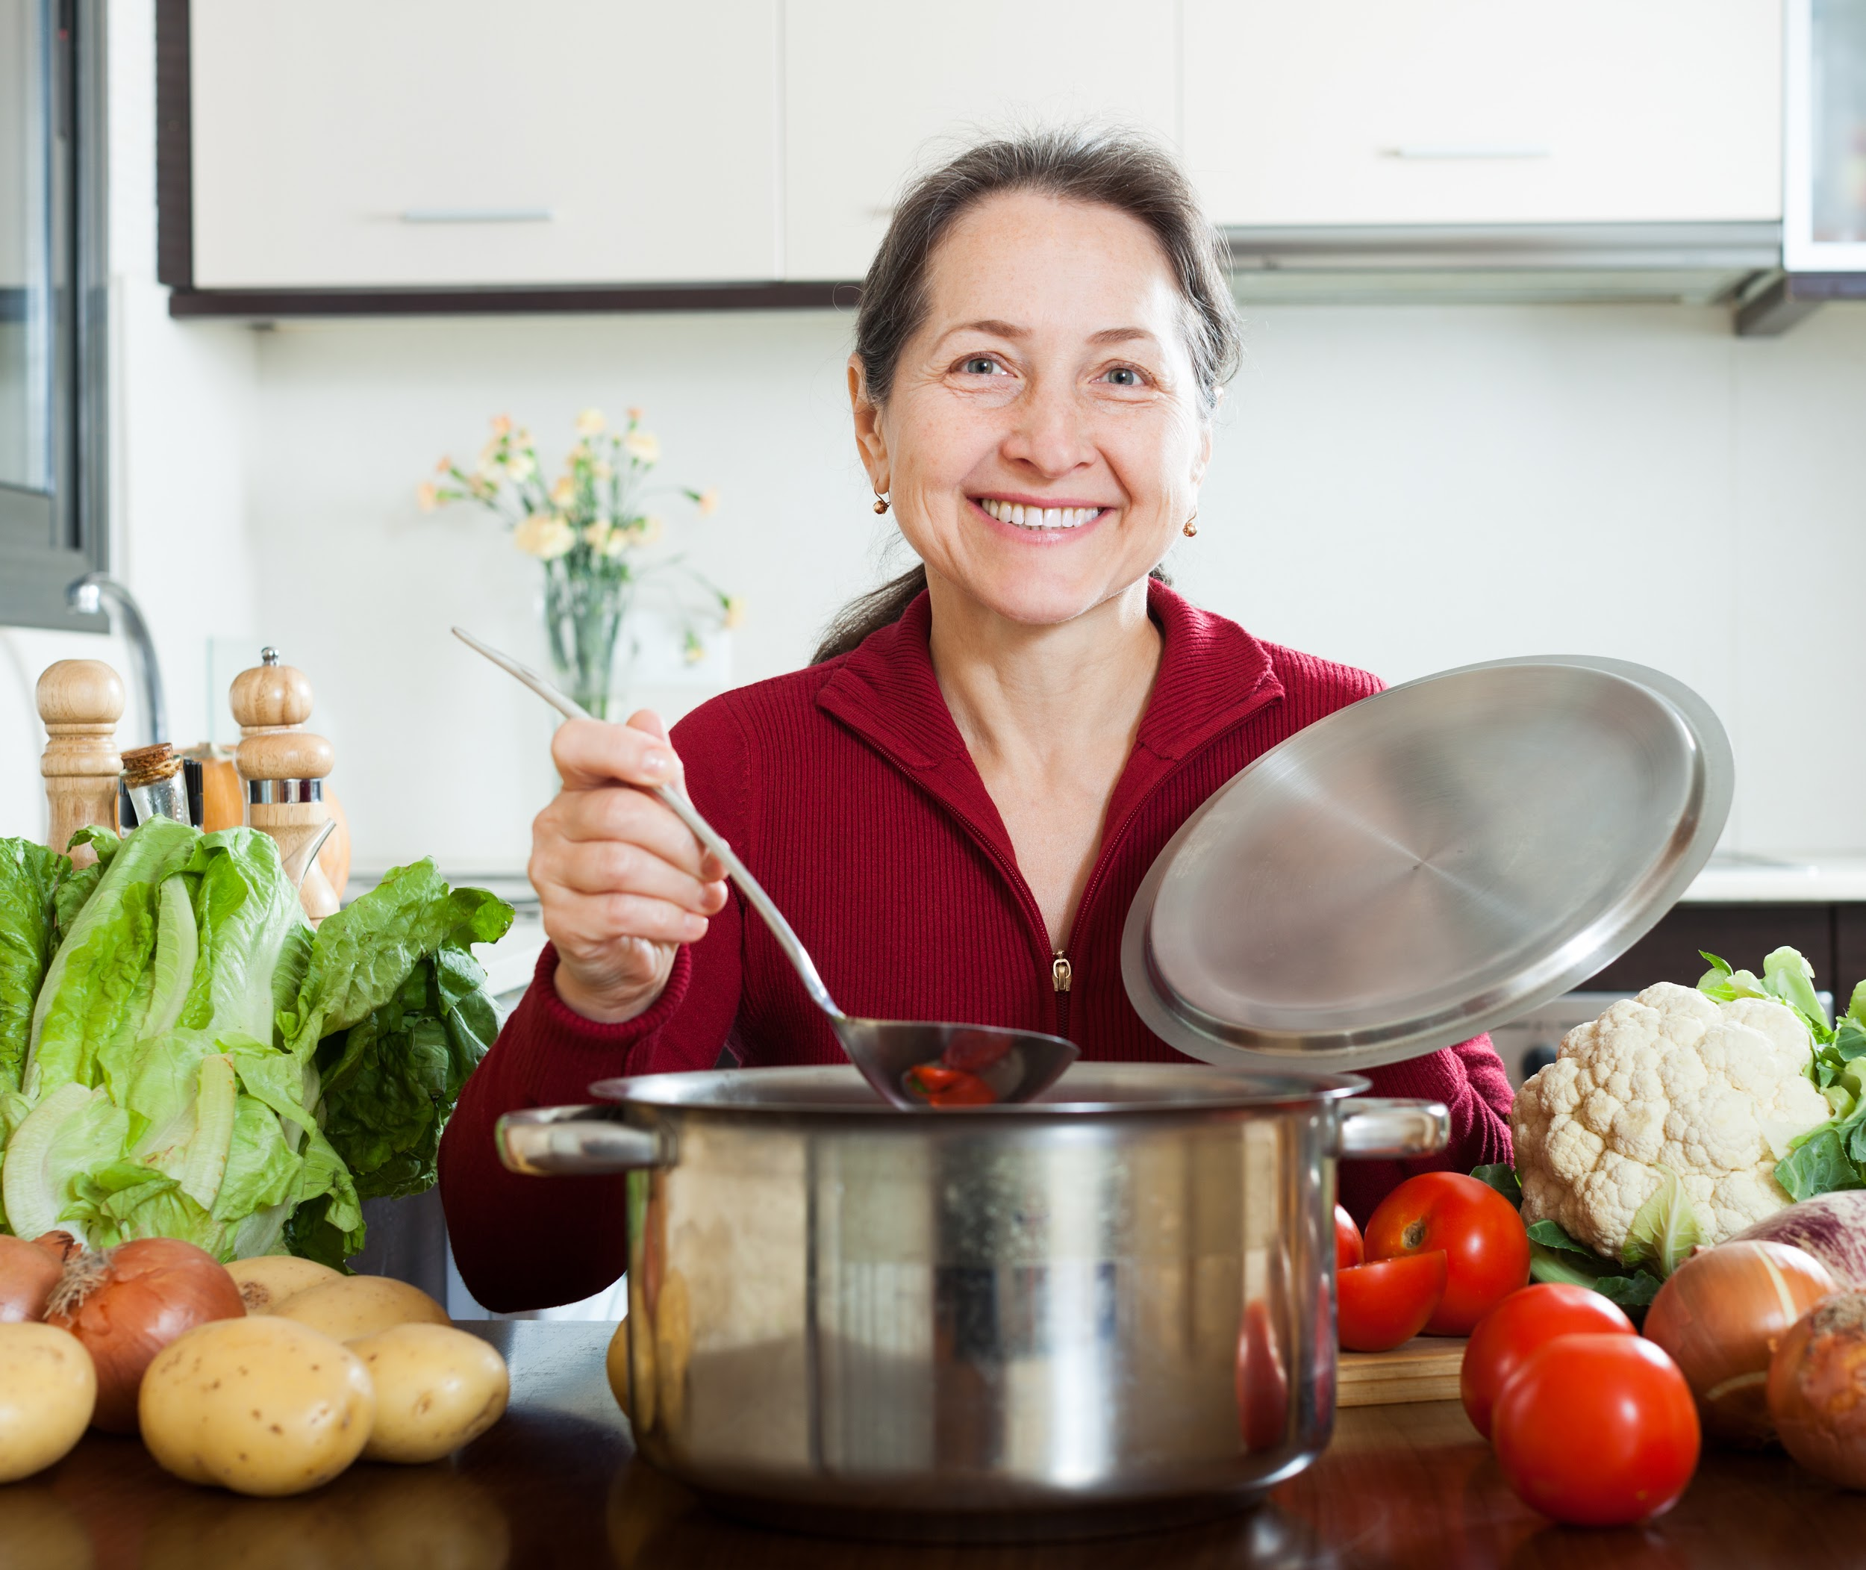
Let’s learn words
about kitchens & cooking!

Slide 2
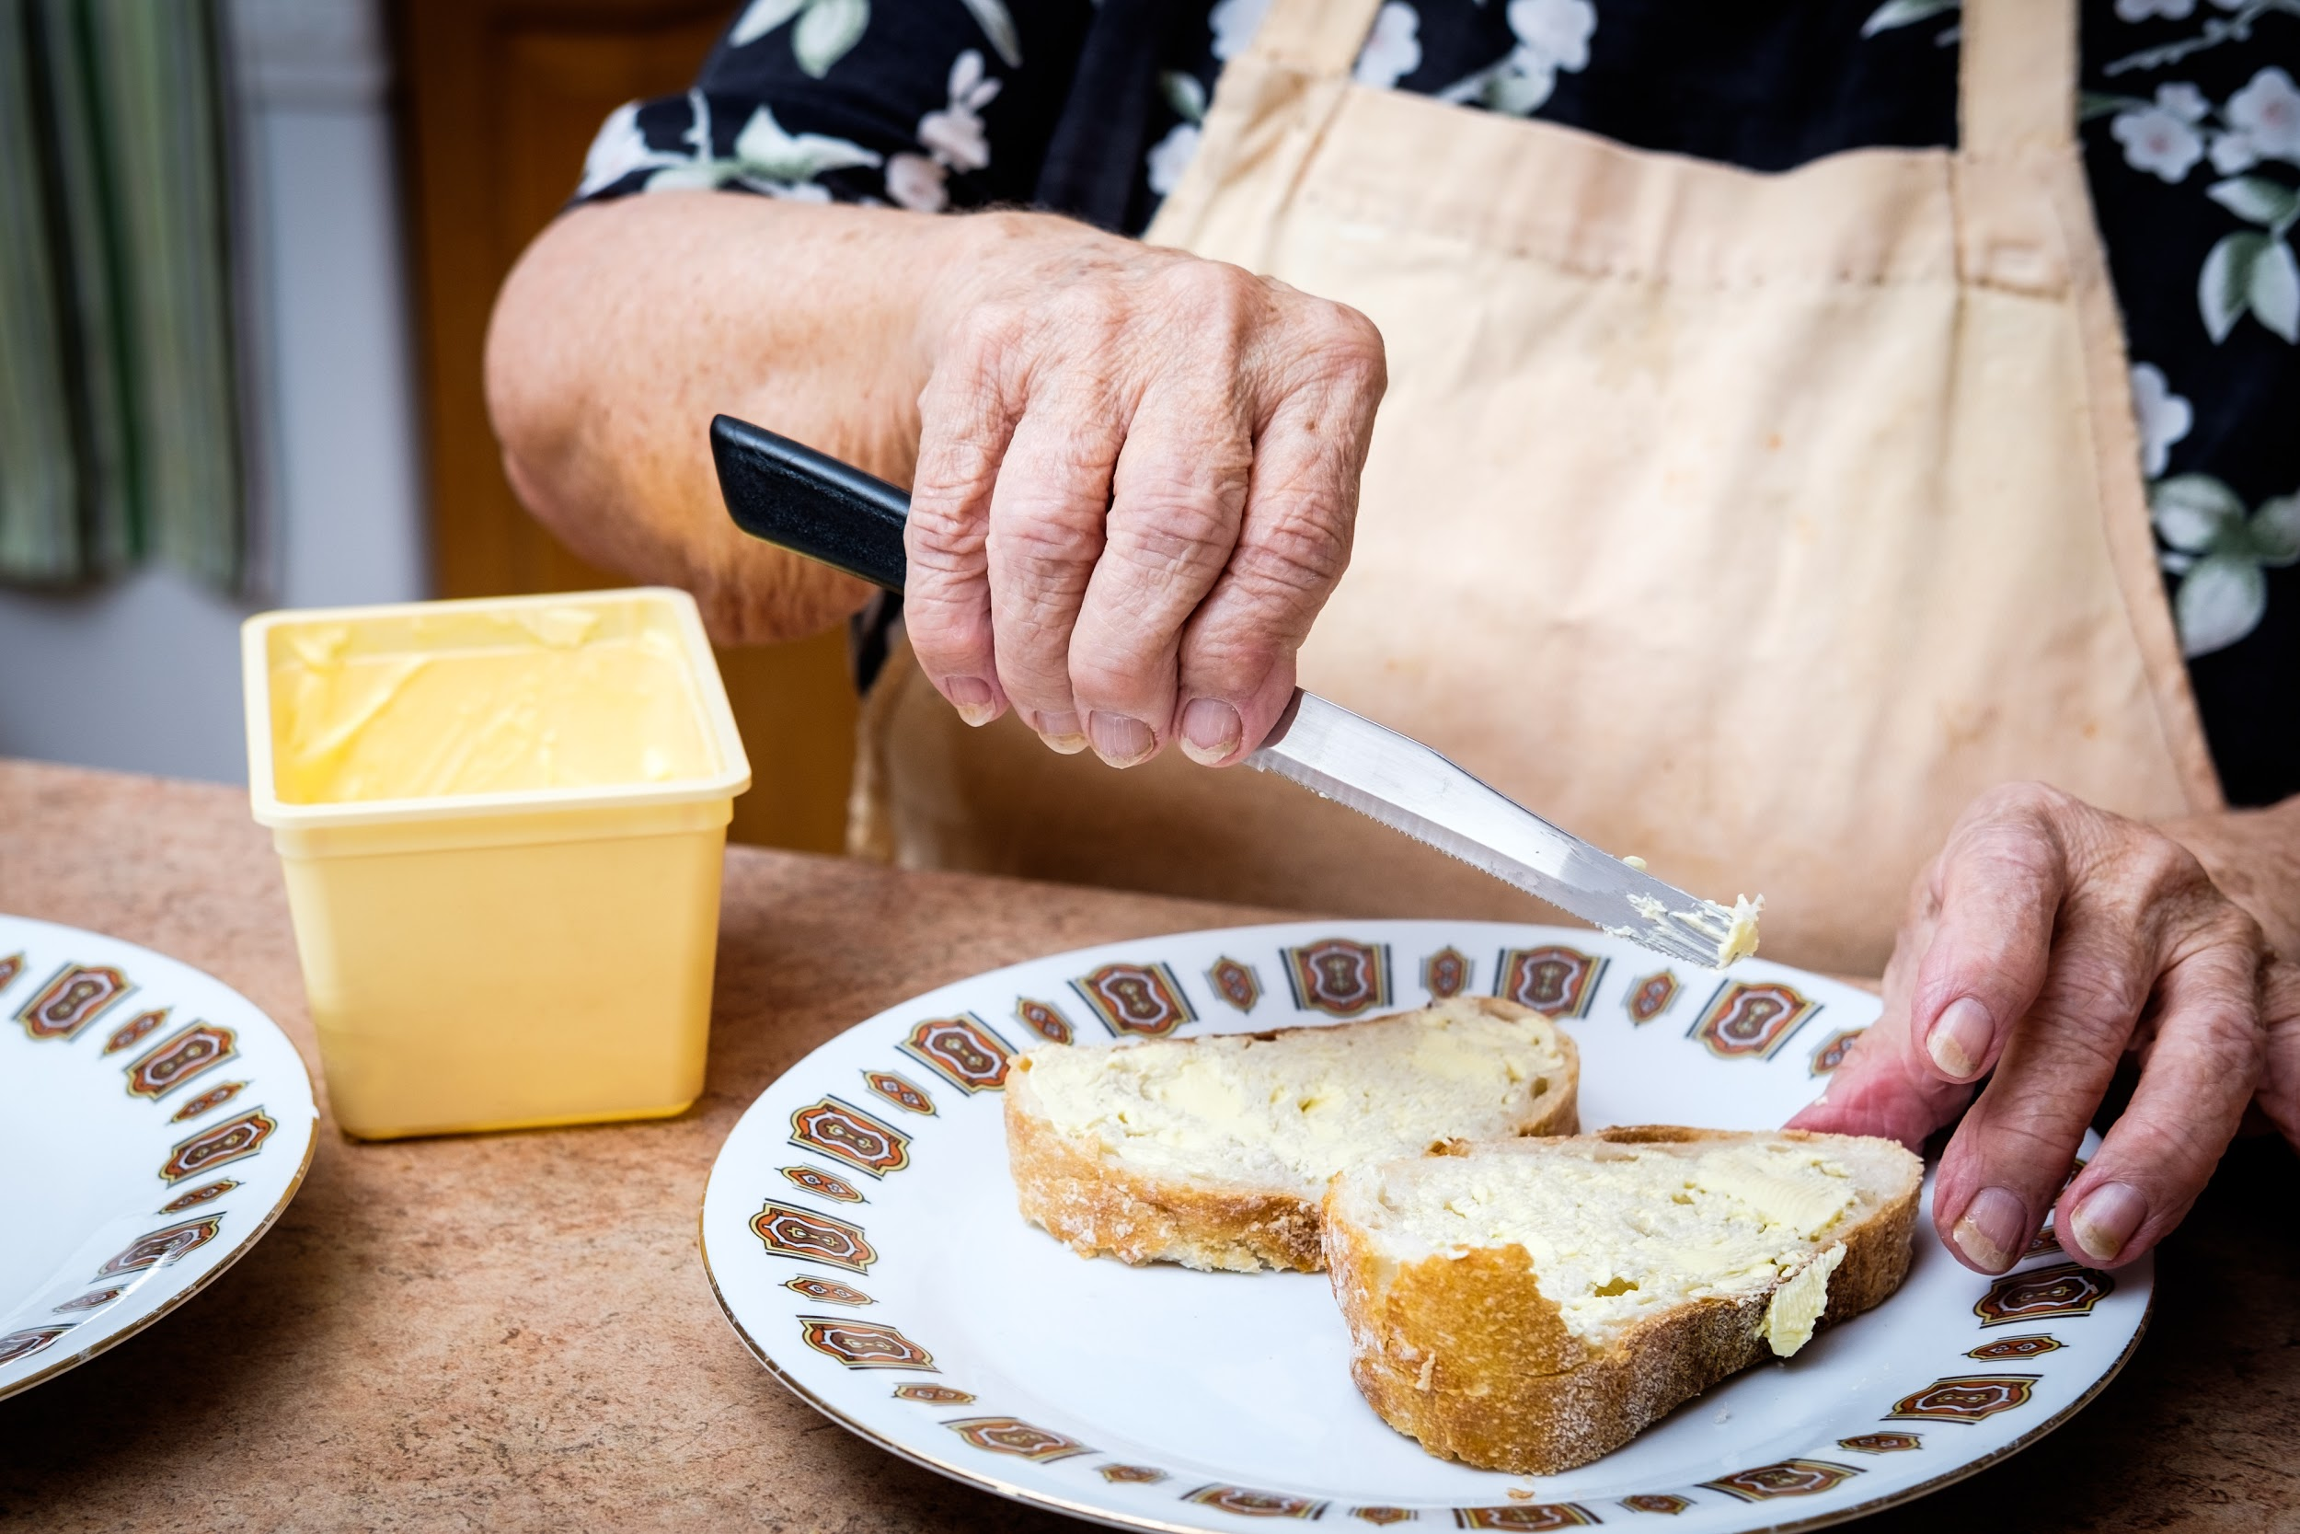
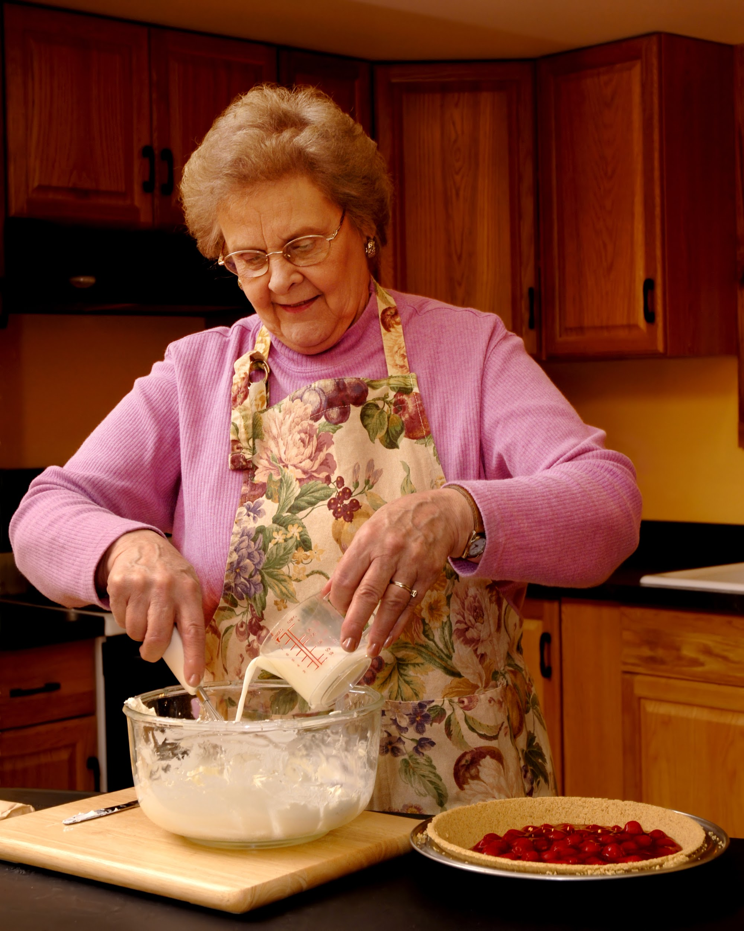
COOKING VERBS
SPREAD
CHOP
POUR

Slide 3
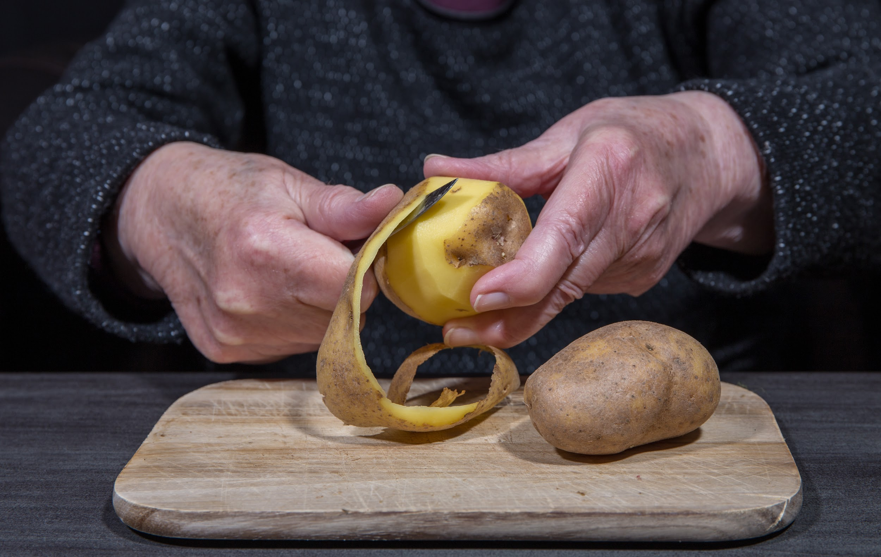
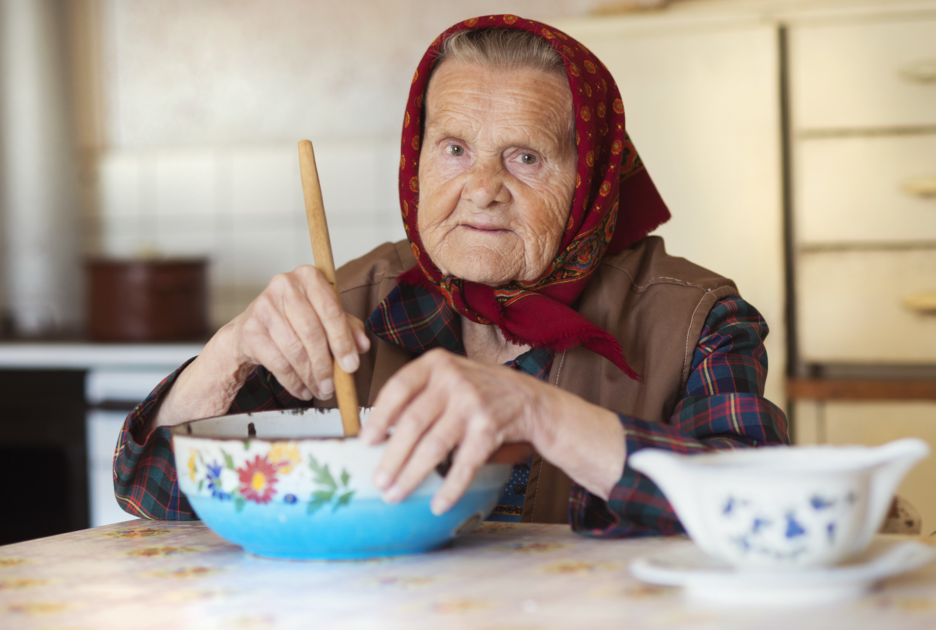
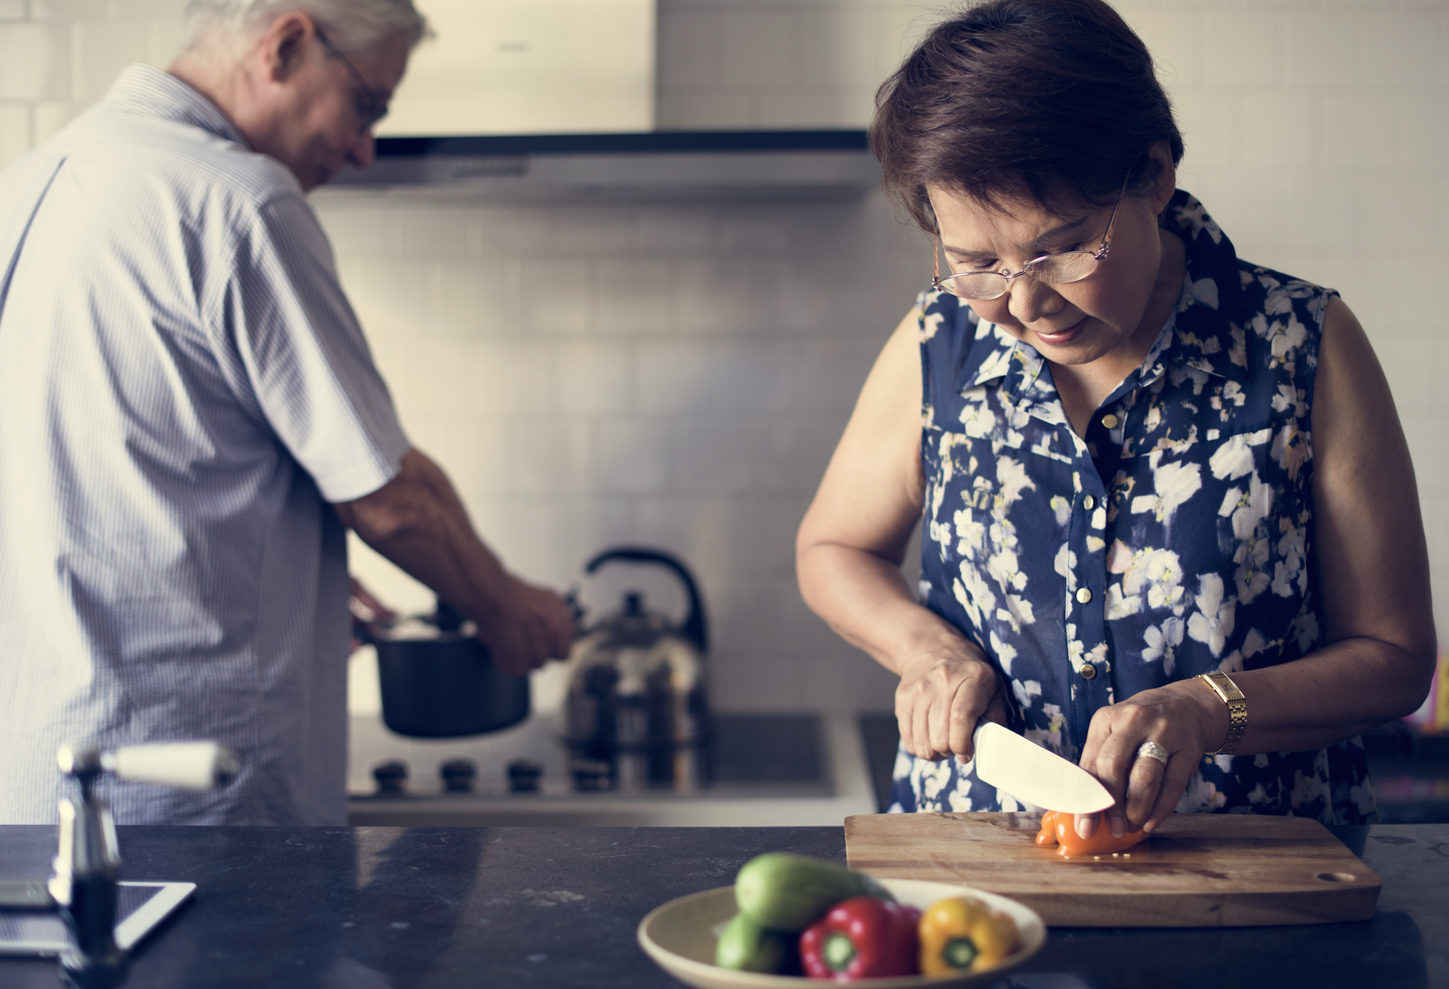
COOKING VERBS
PEEL
MIX
SLICE

Slide 4
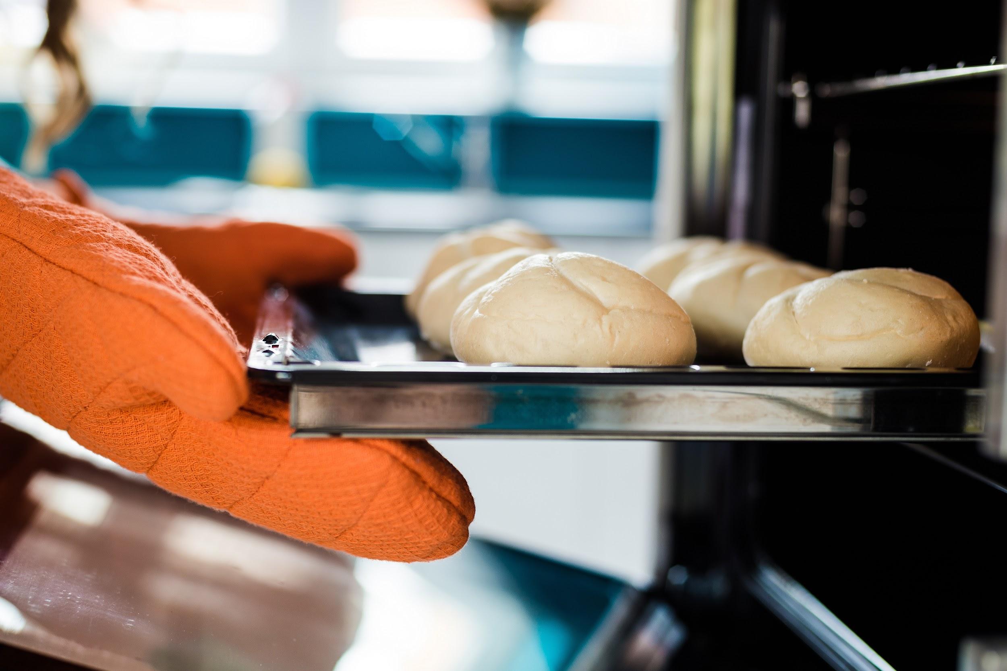
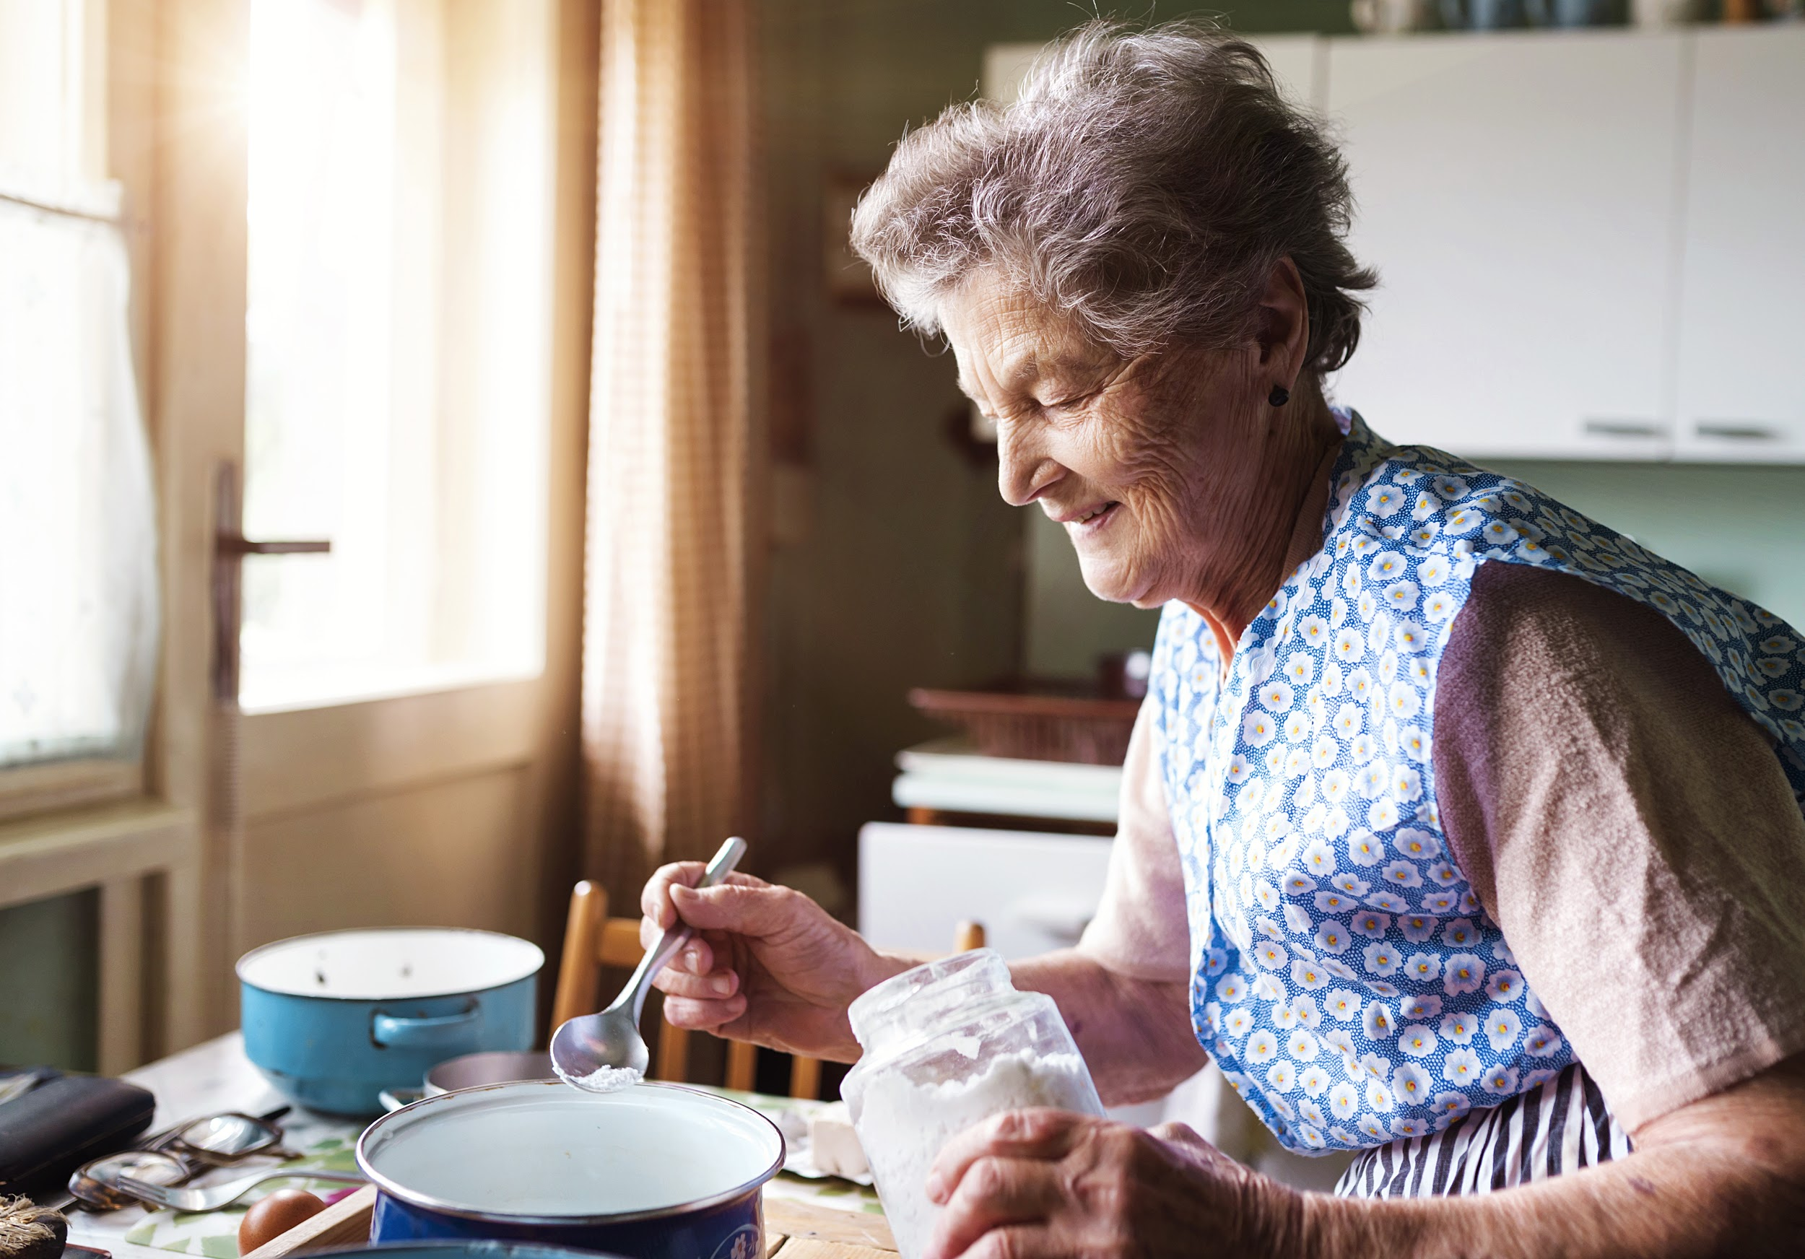
COOKING VERBS
BAKE
MEASURE
SLICE

Slide 5
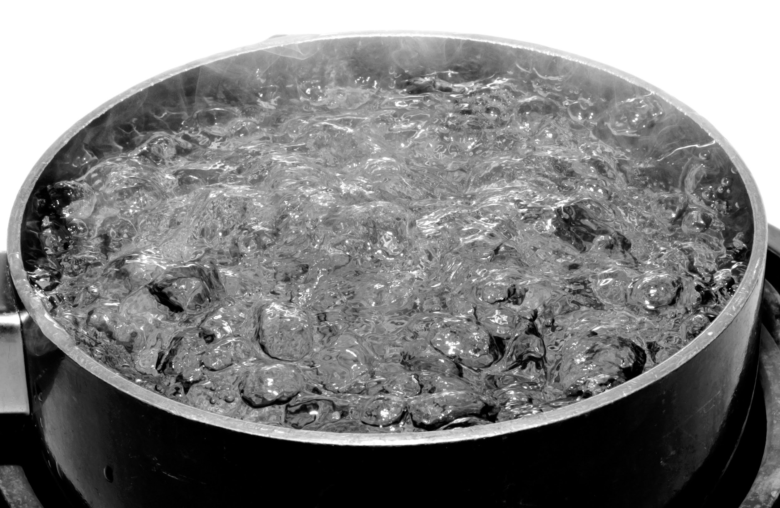
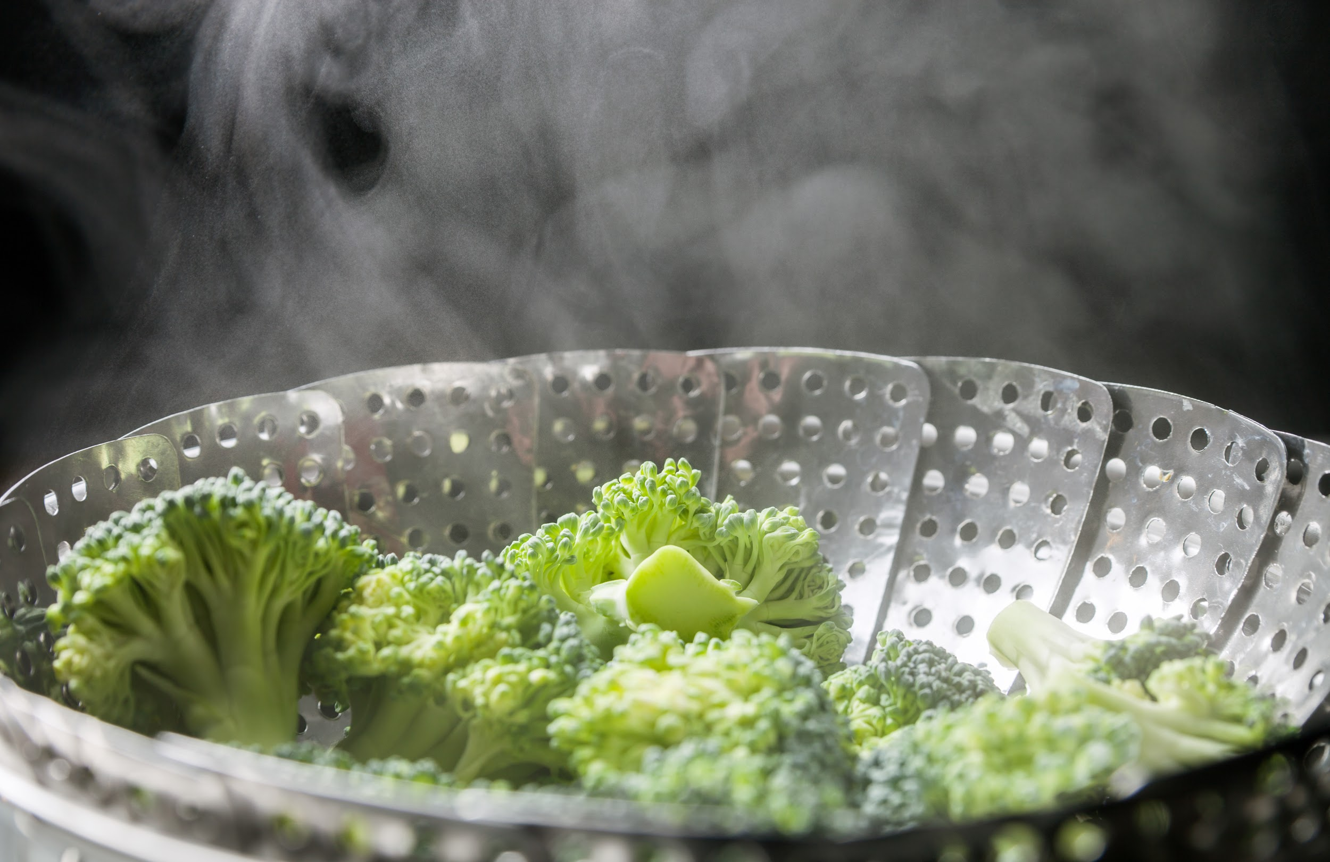
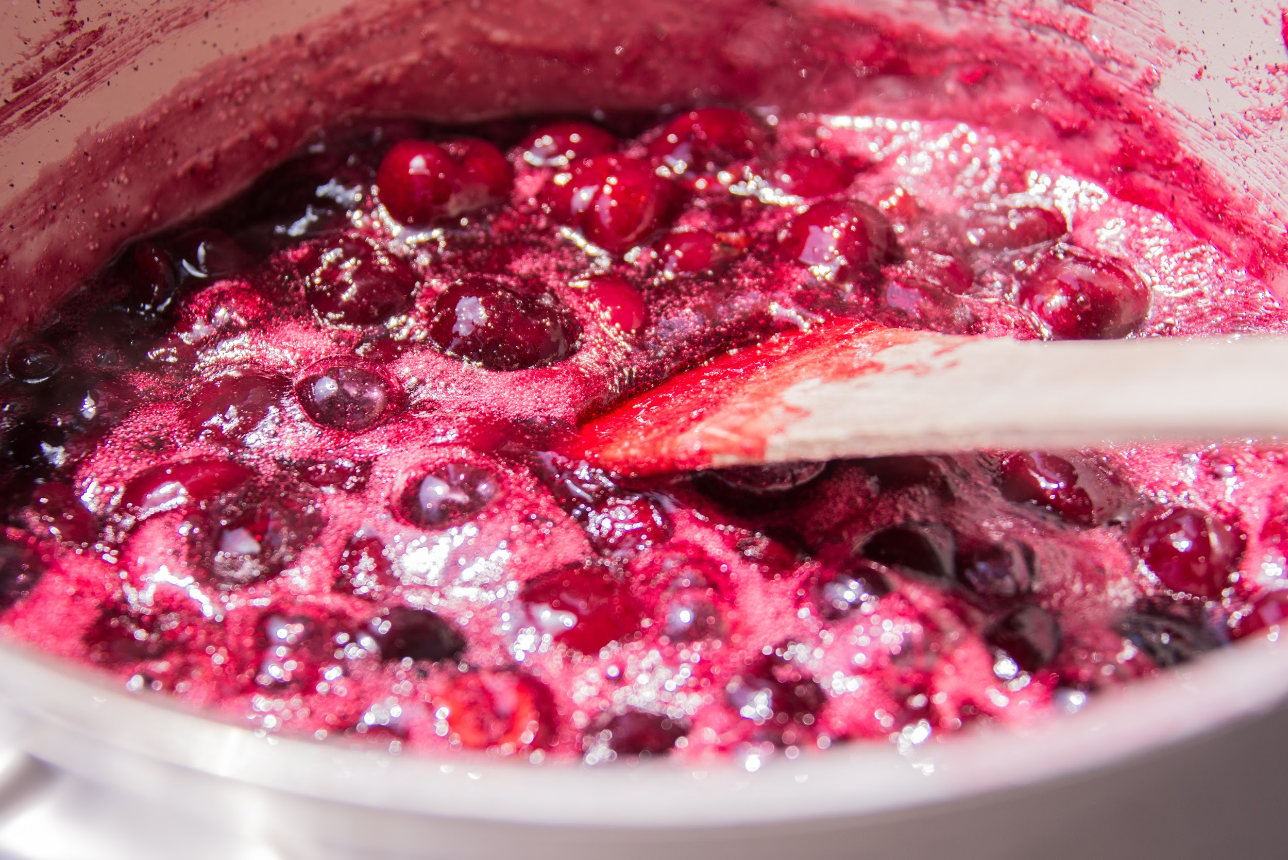
COOKING VERBS
BOIL
STEAM
SIMMER

Slide 6
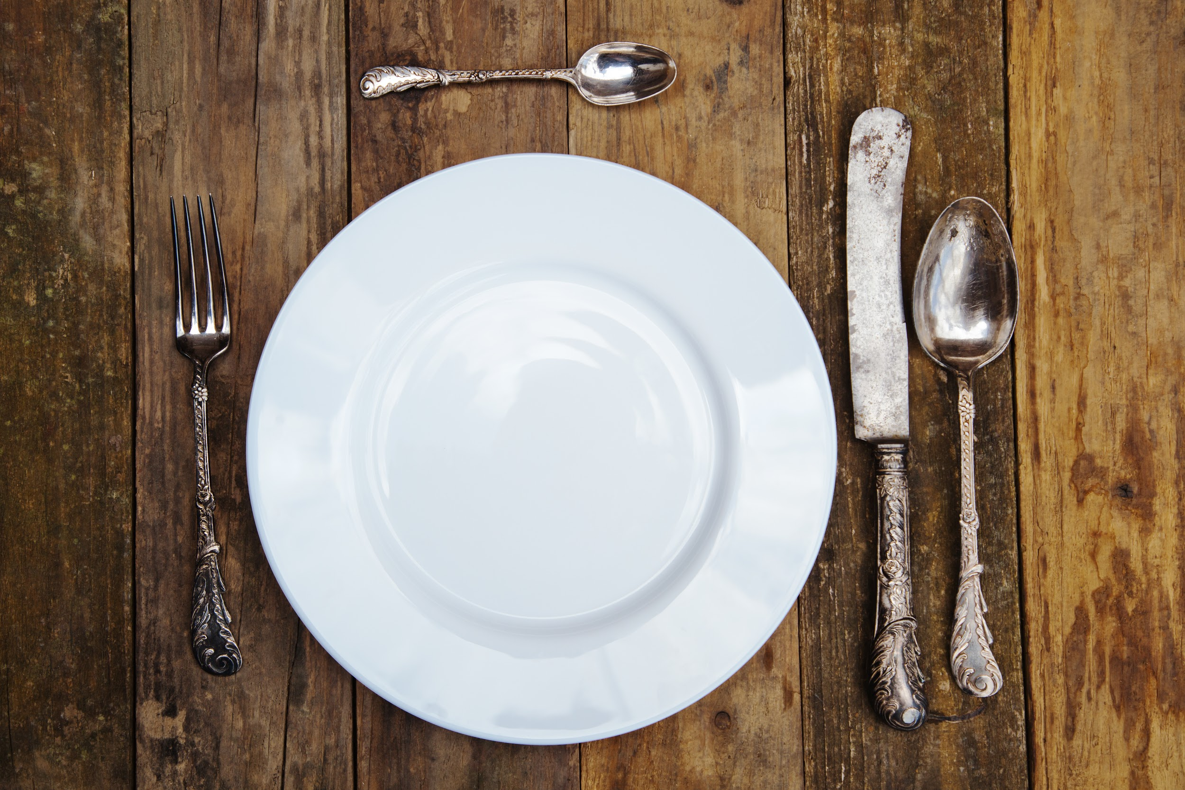
SET THE TABLE
PLATE
SPOON
FORK
KNIFE

Slide 7
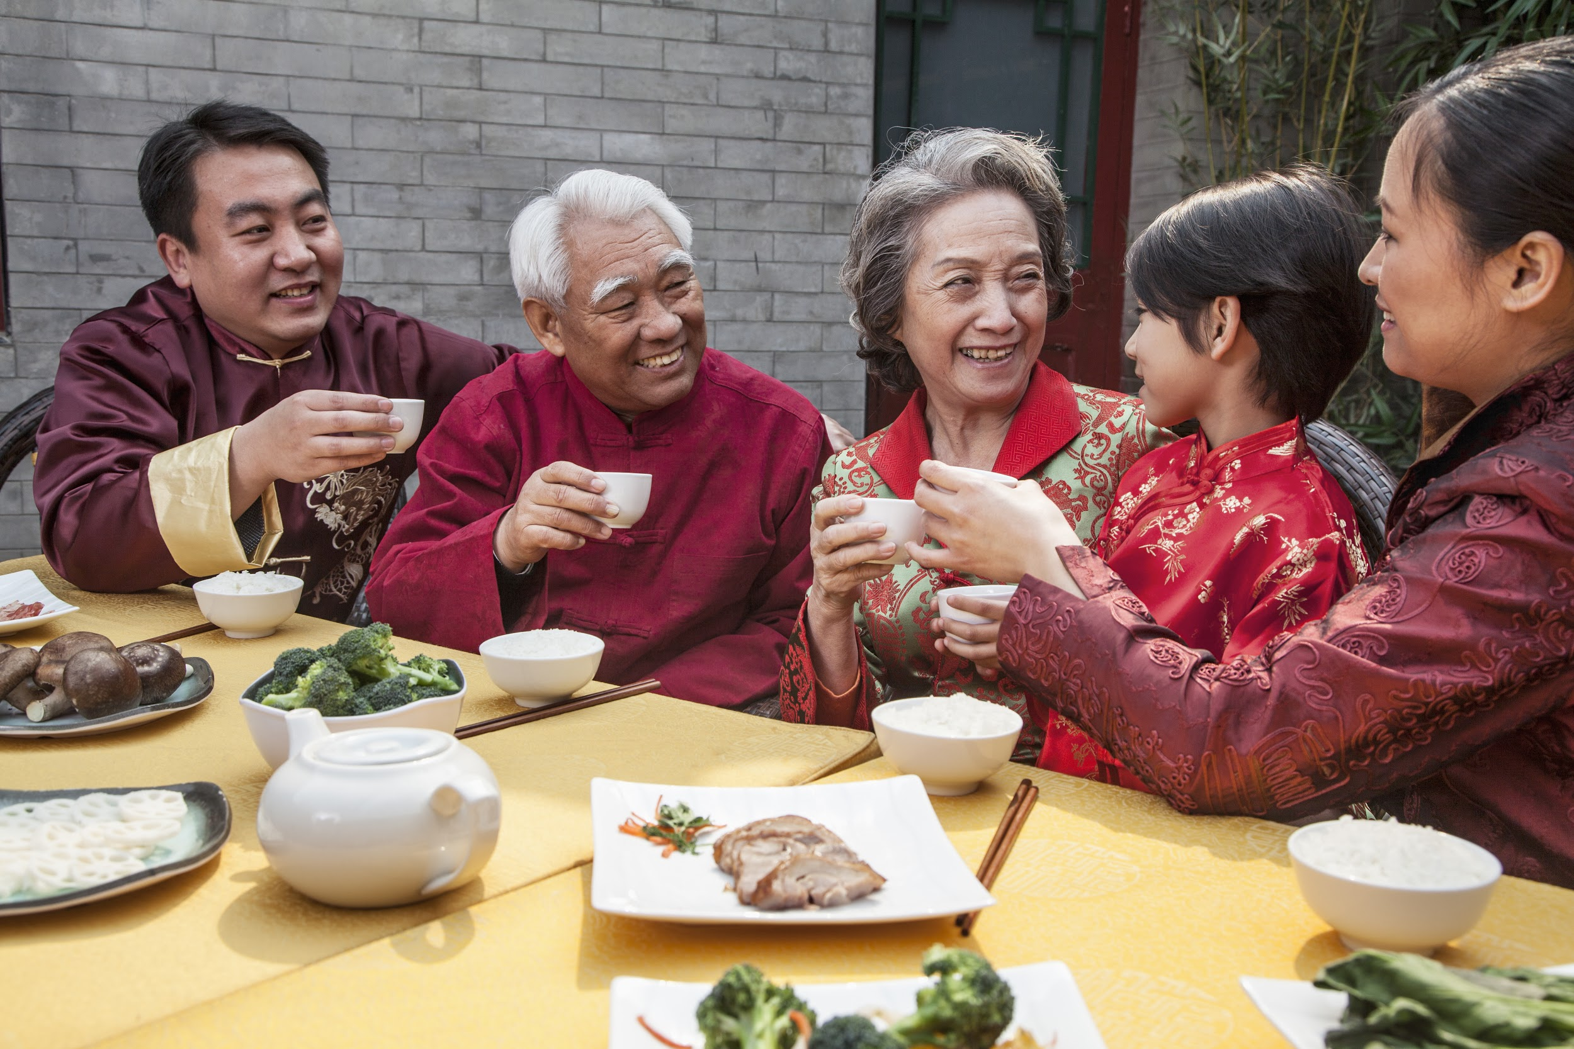
SET THE TABLE
CUP
BOWL

Slide 8
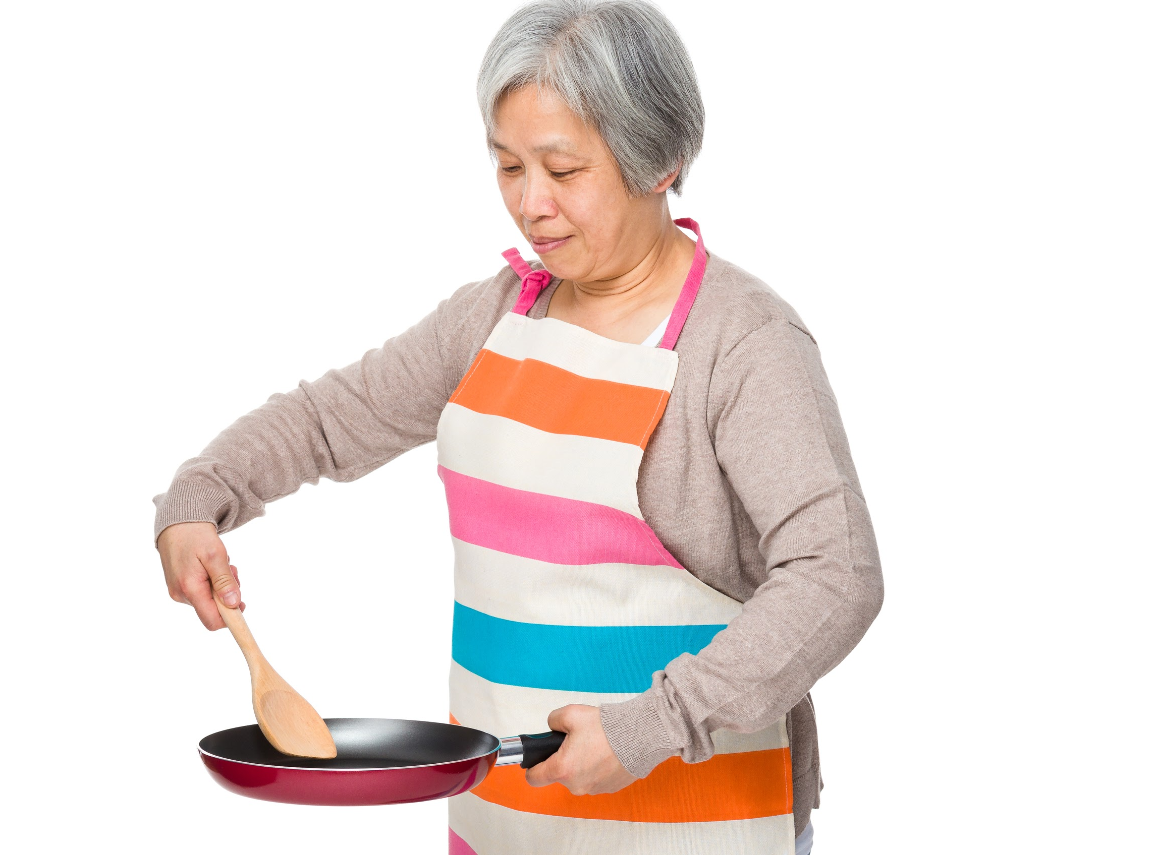
IN THE KITCHEN
TOASTER
FRYING PAN
BLENDER

Slide 9
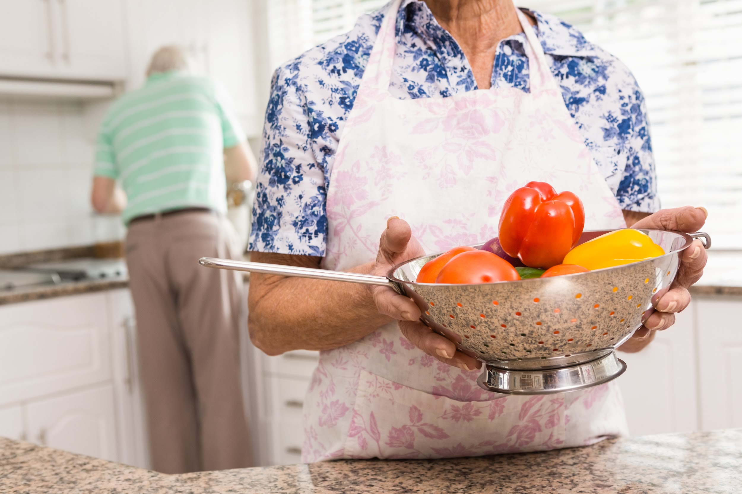
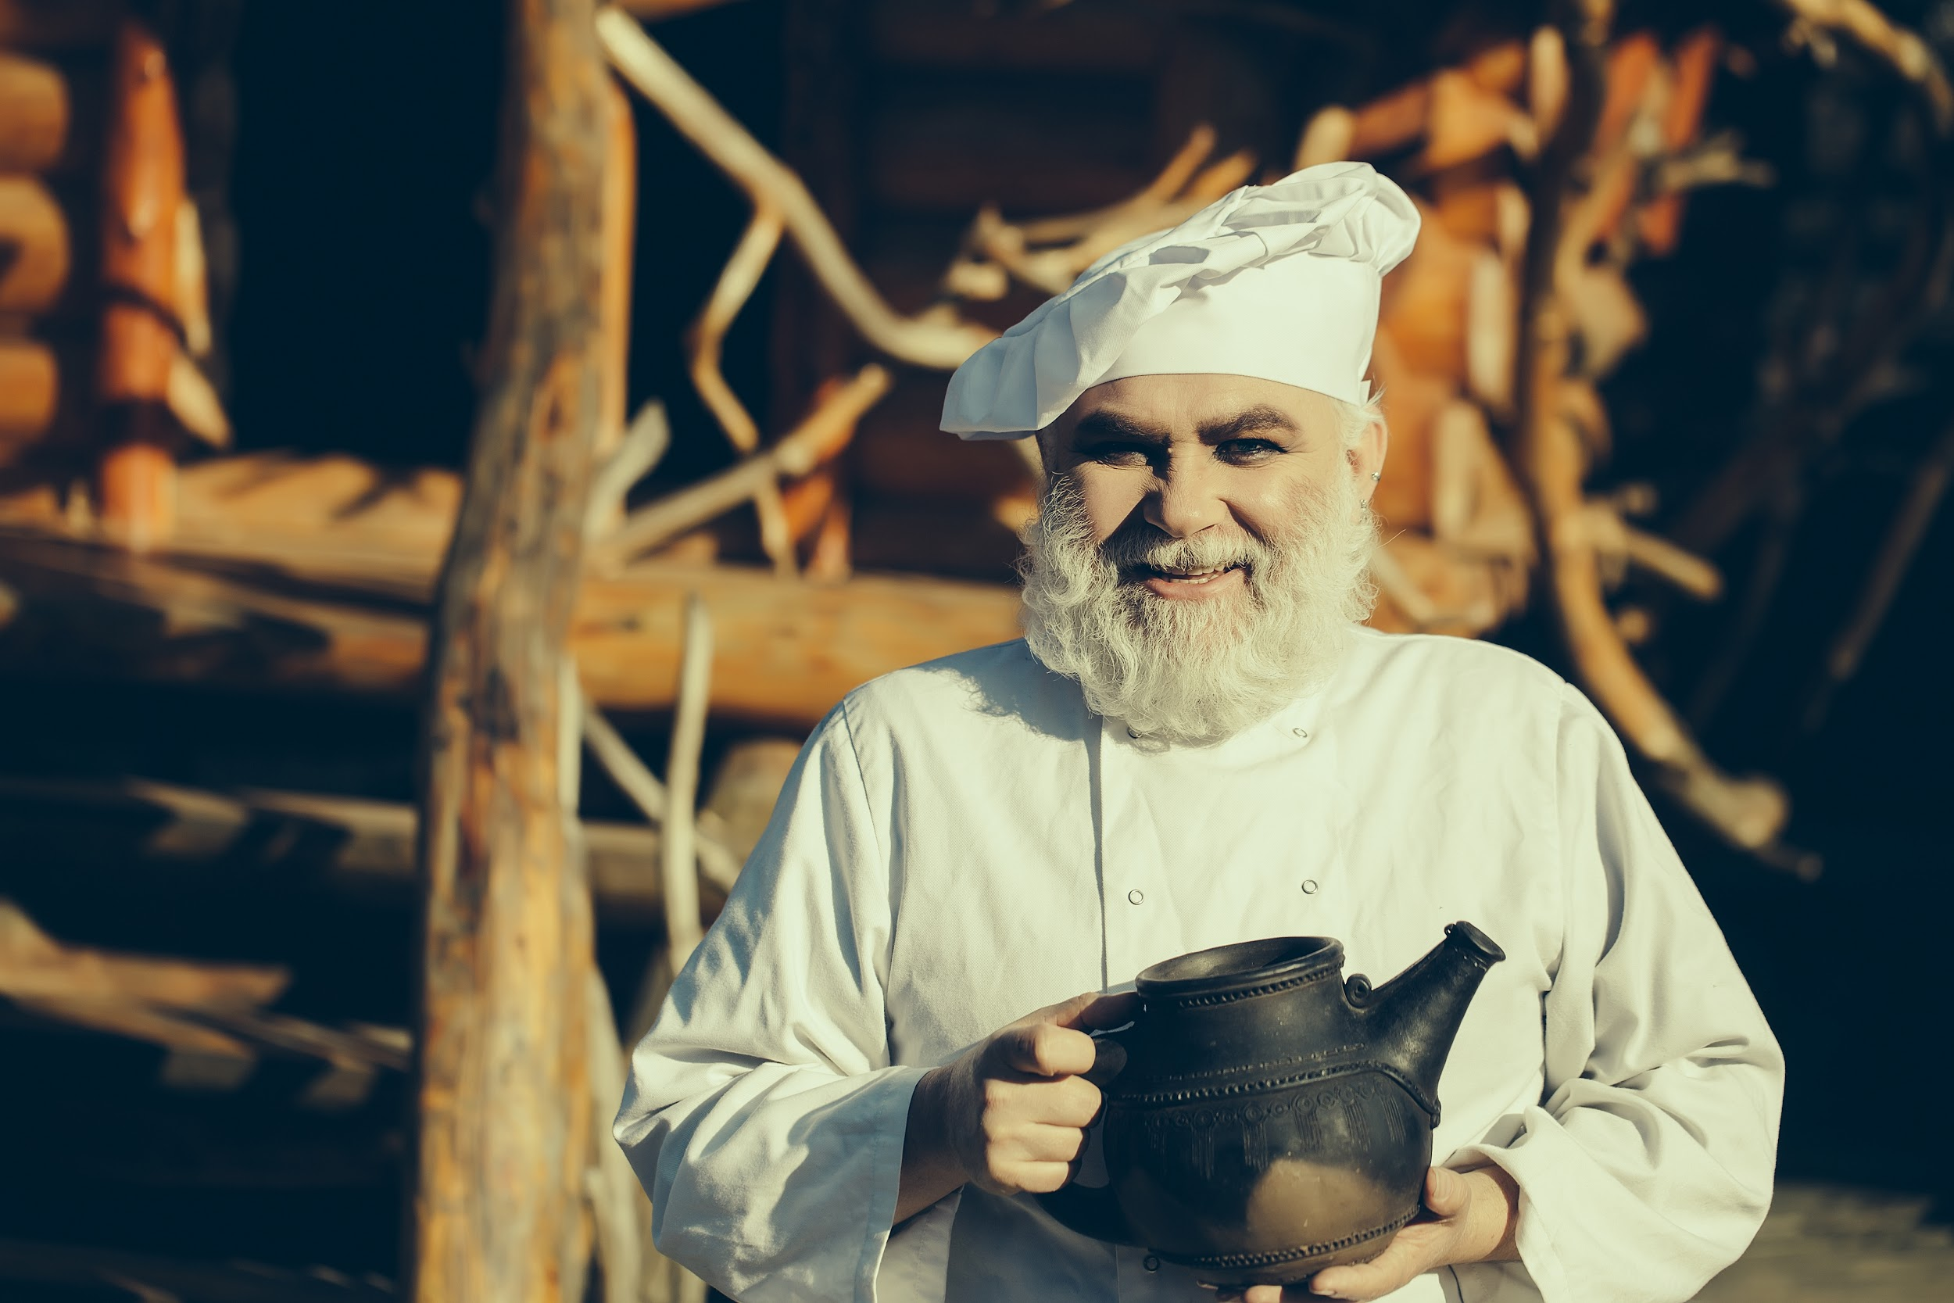
IN THE KITCHEN
COLANDER
KETTLE
POT

Slide 10
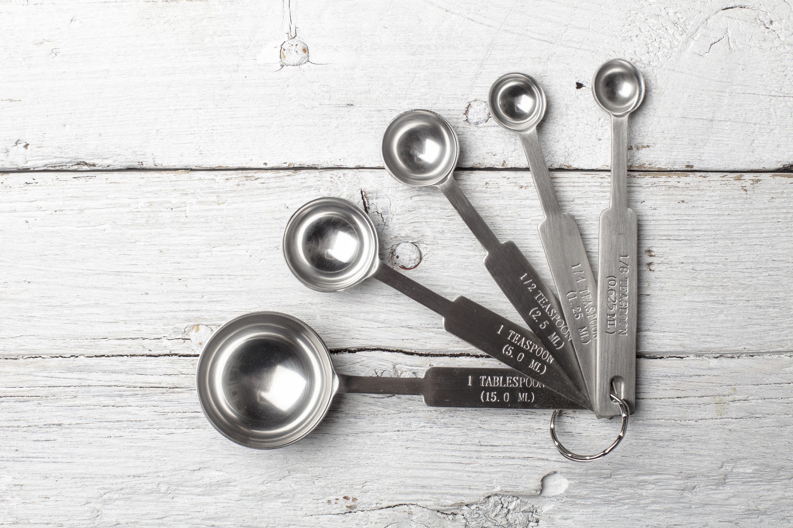
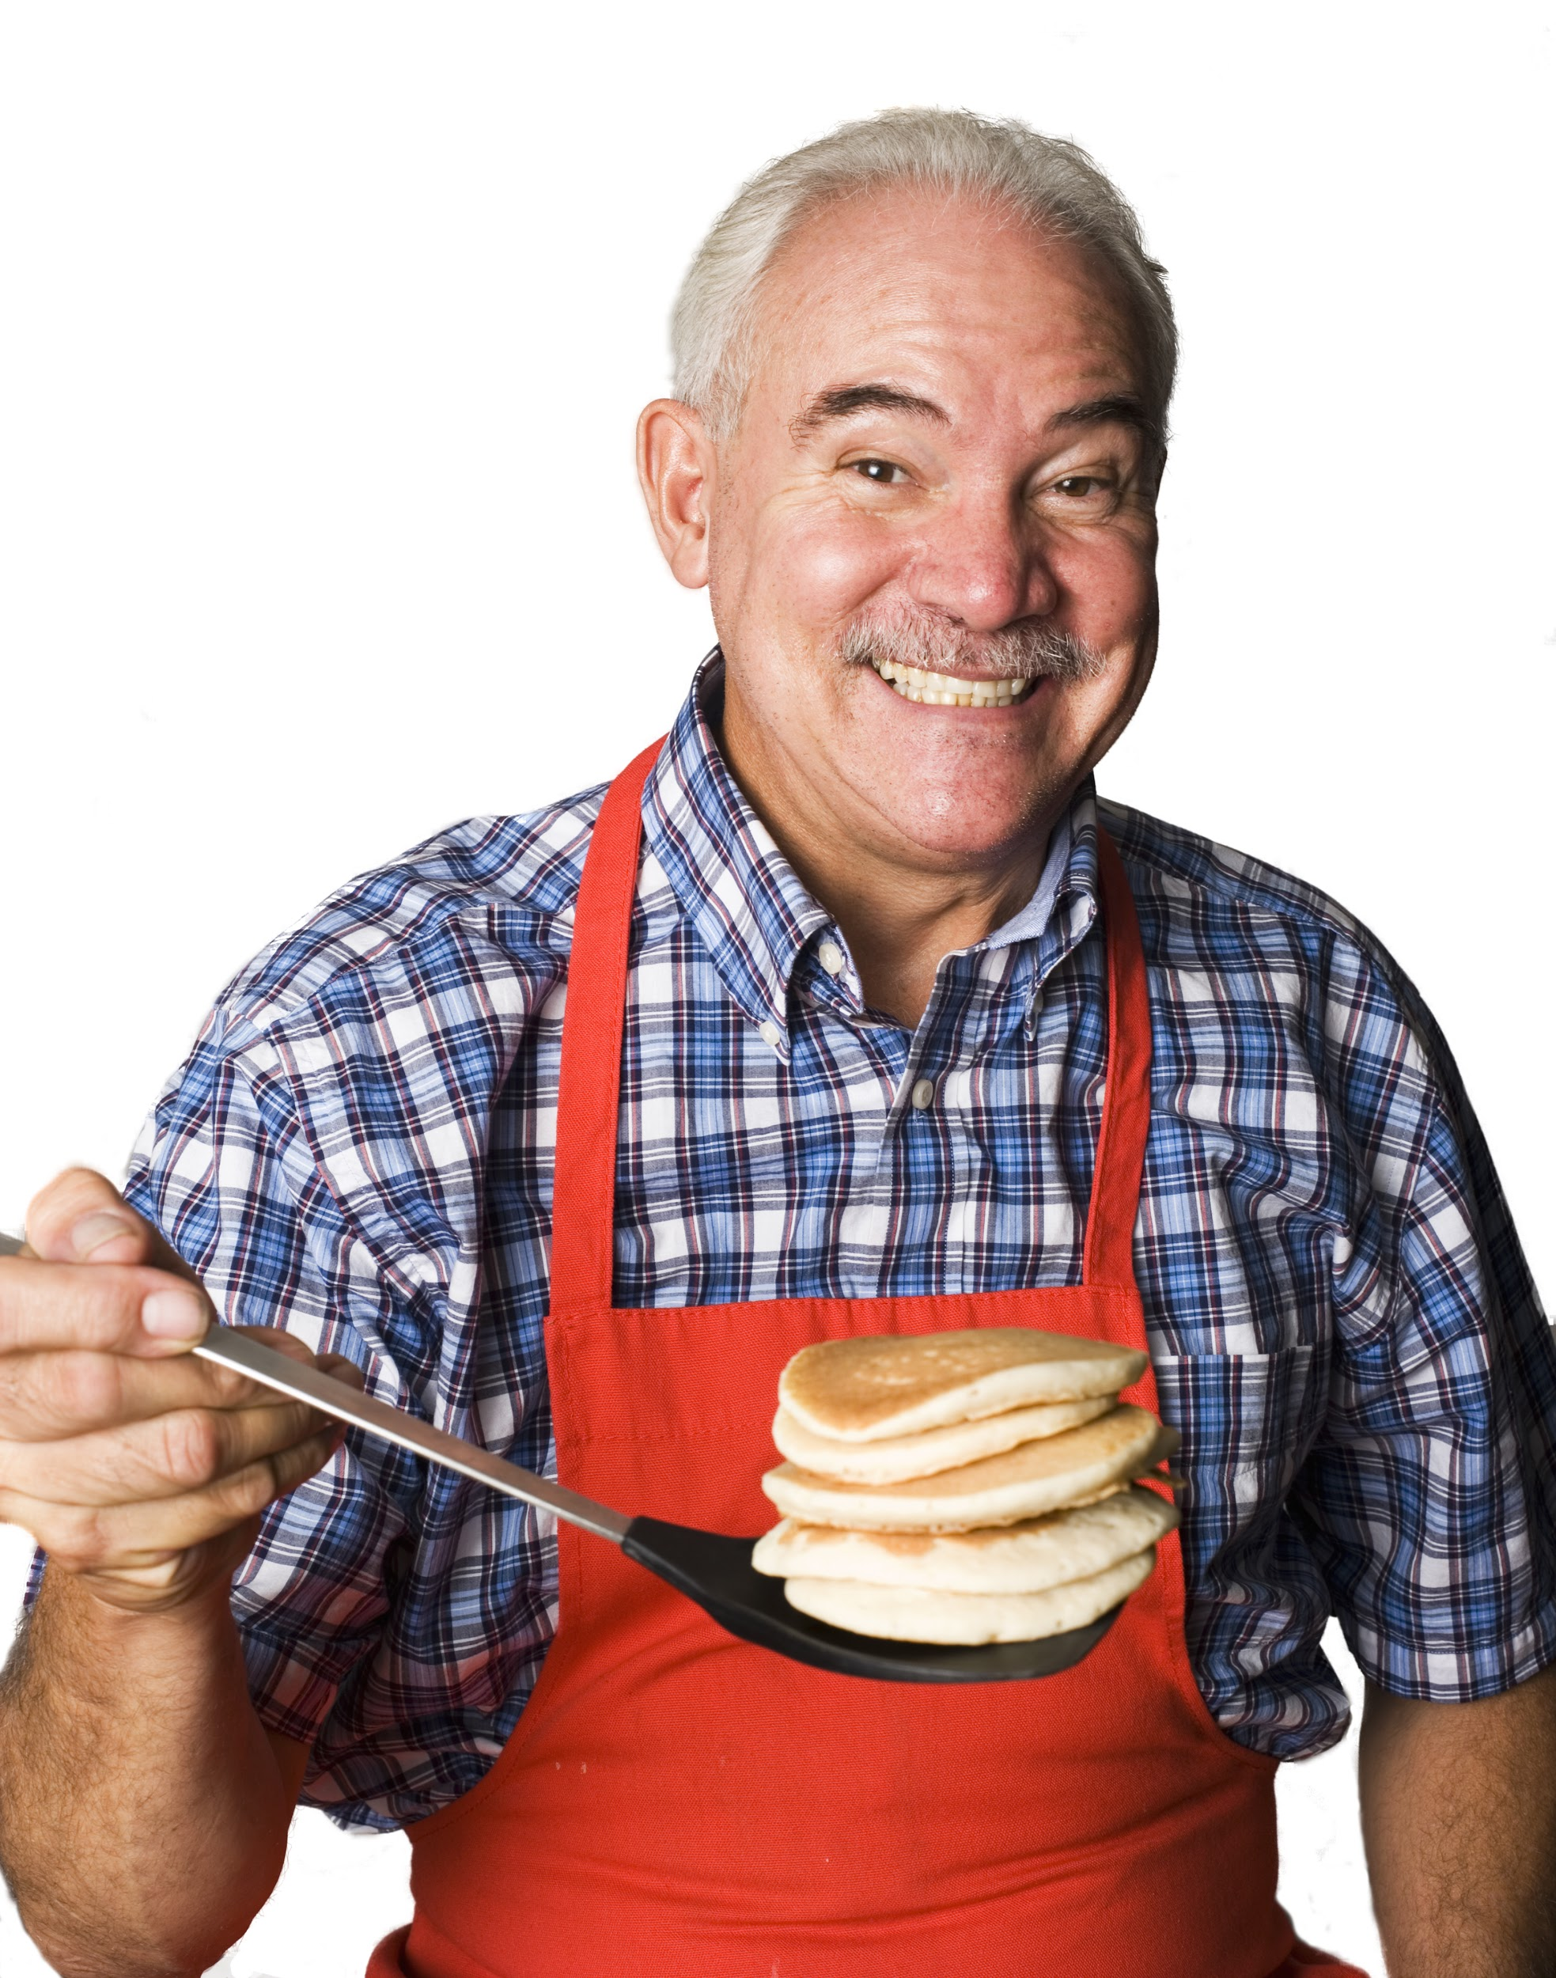
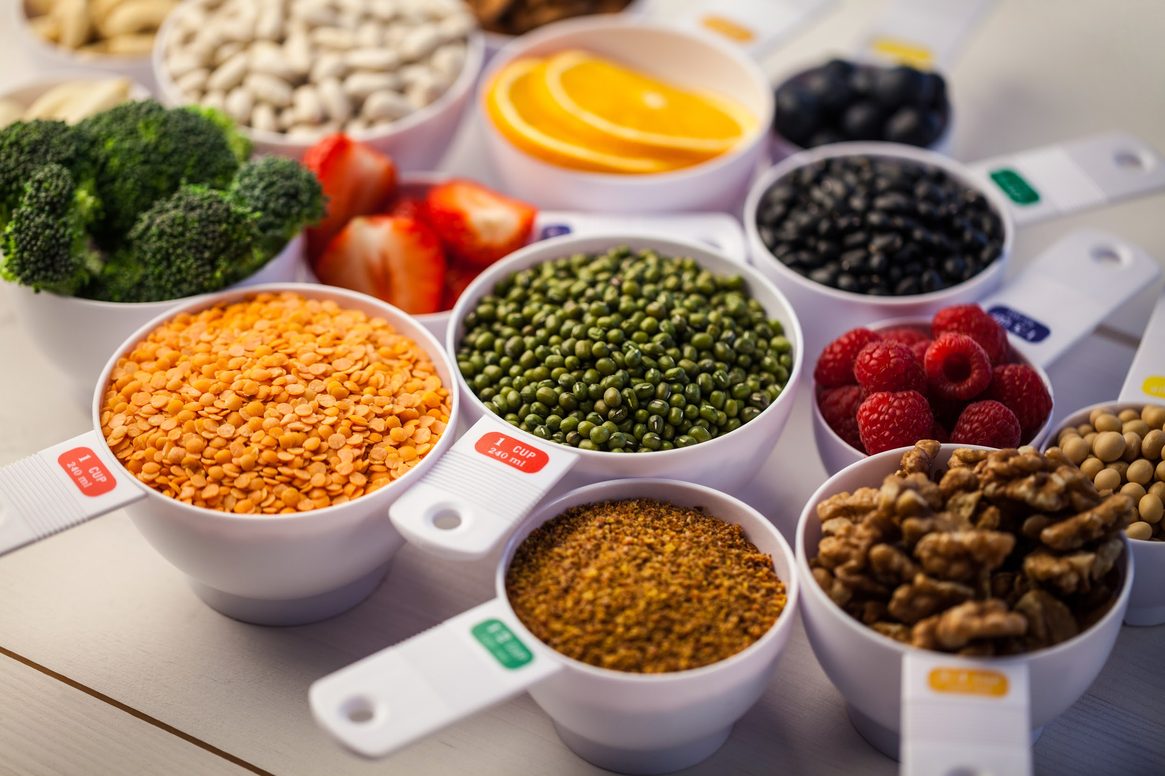
IN THE KITCHEN
MEASURING
SPOONS
MEASURING CUPS
SPATULA

Slide 11
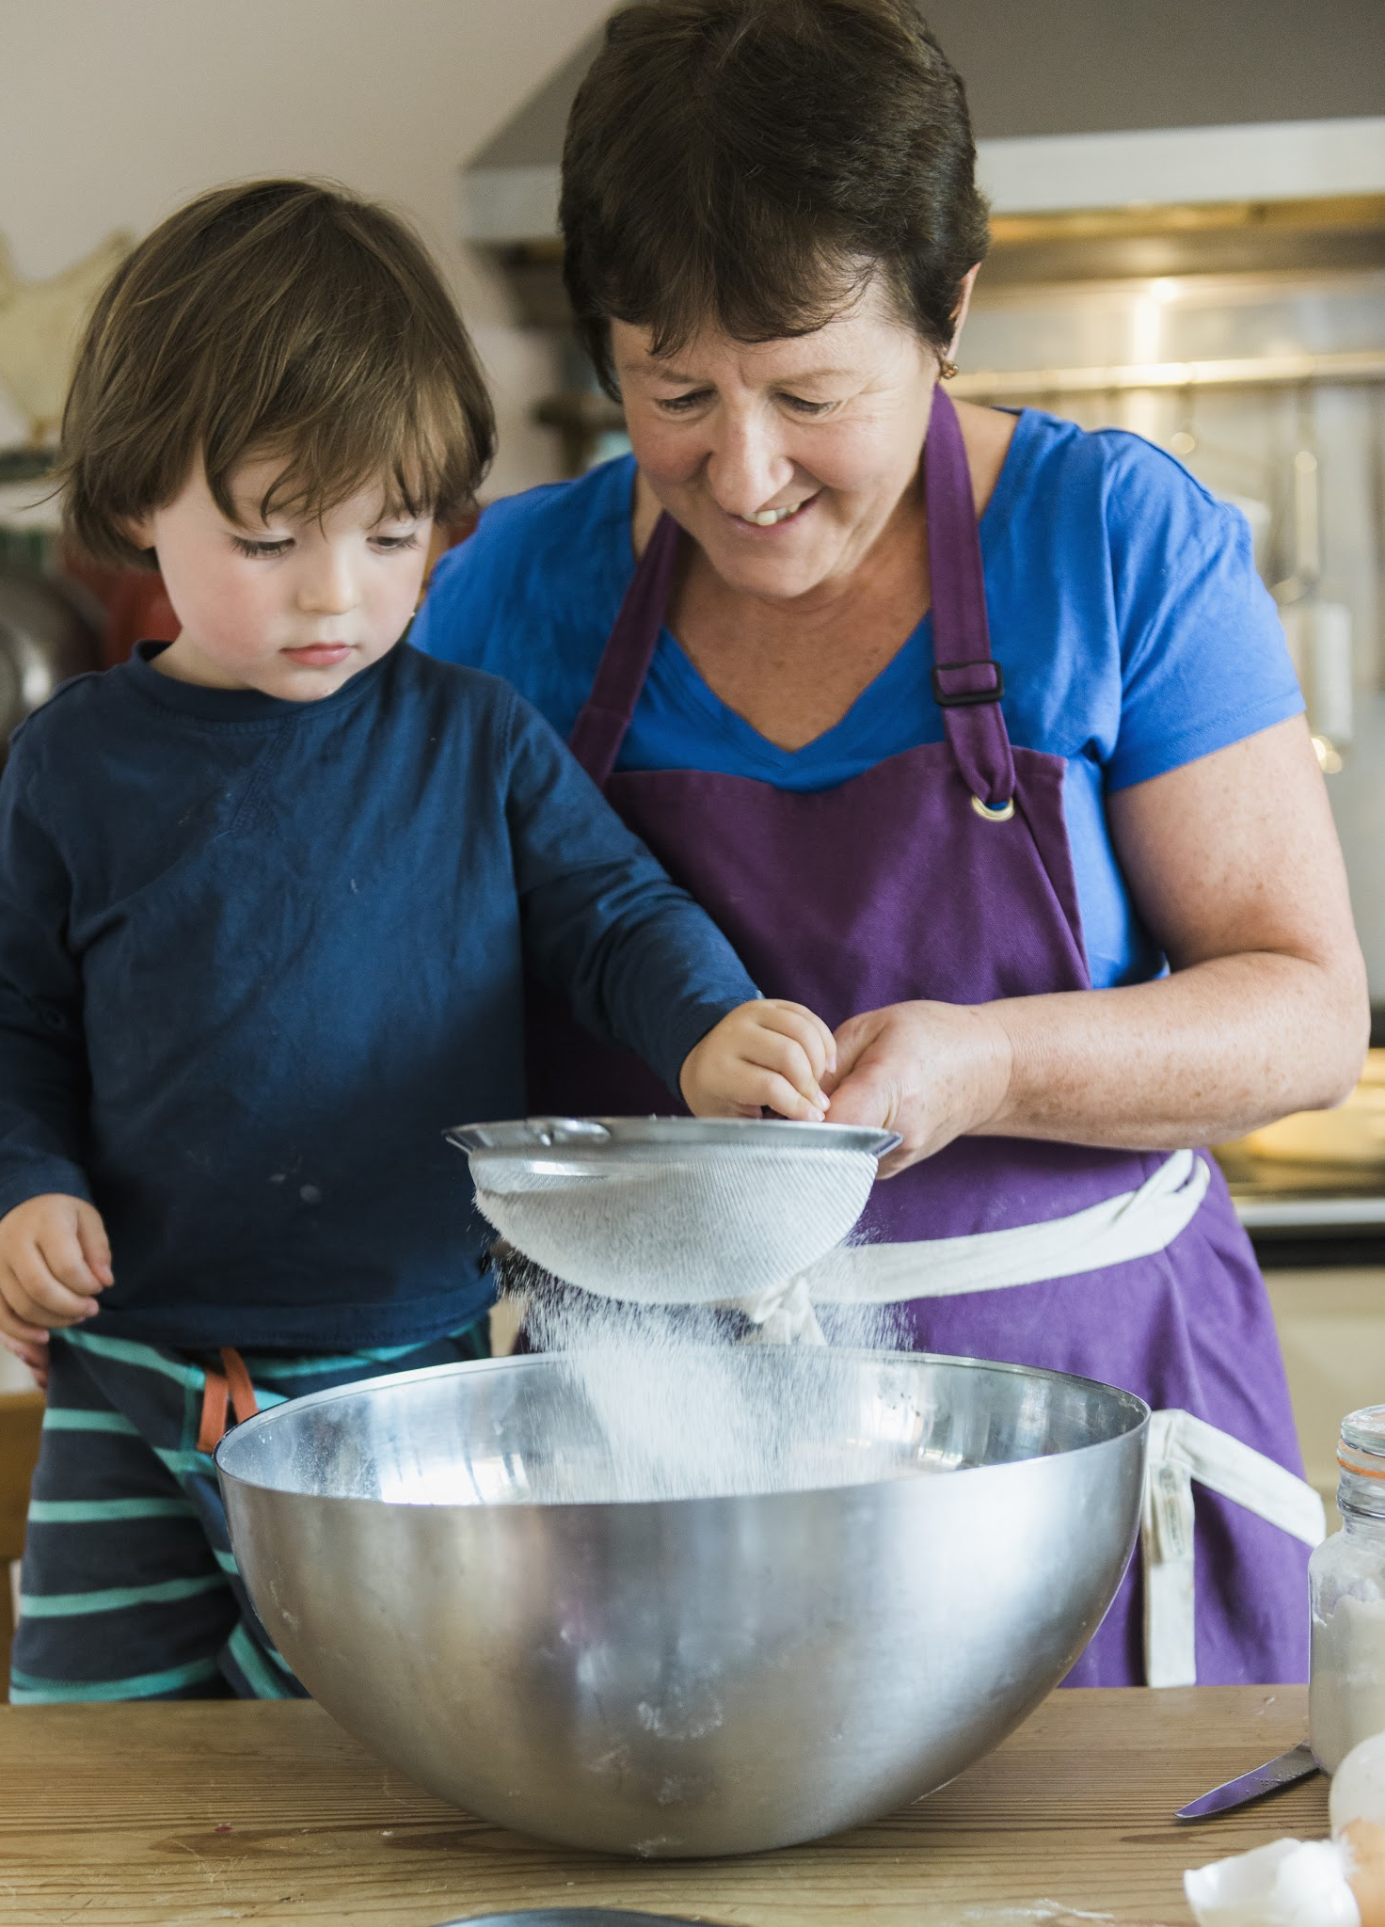
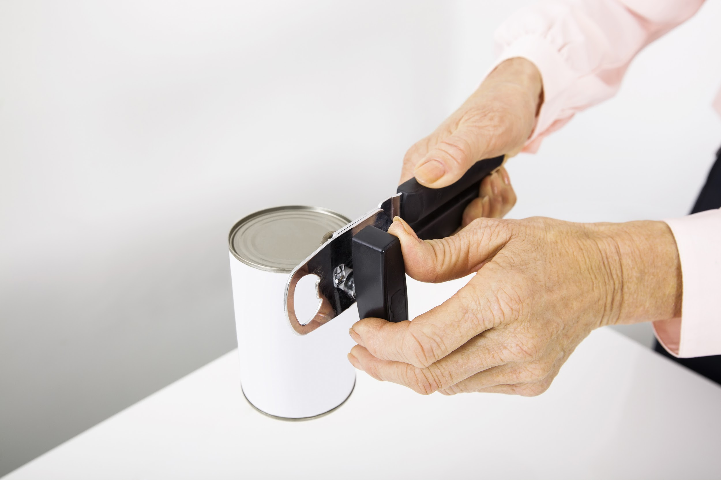
IN THE KITCHEN
CAN OPENER
MIXING BOWL

Slide 12
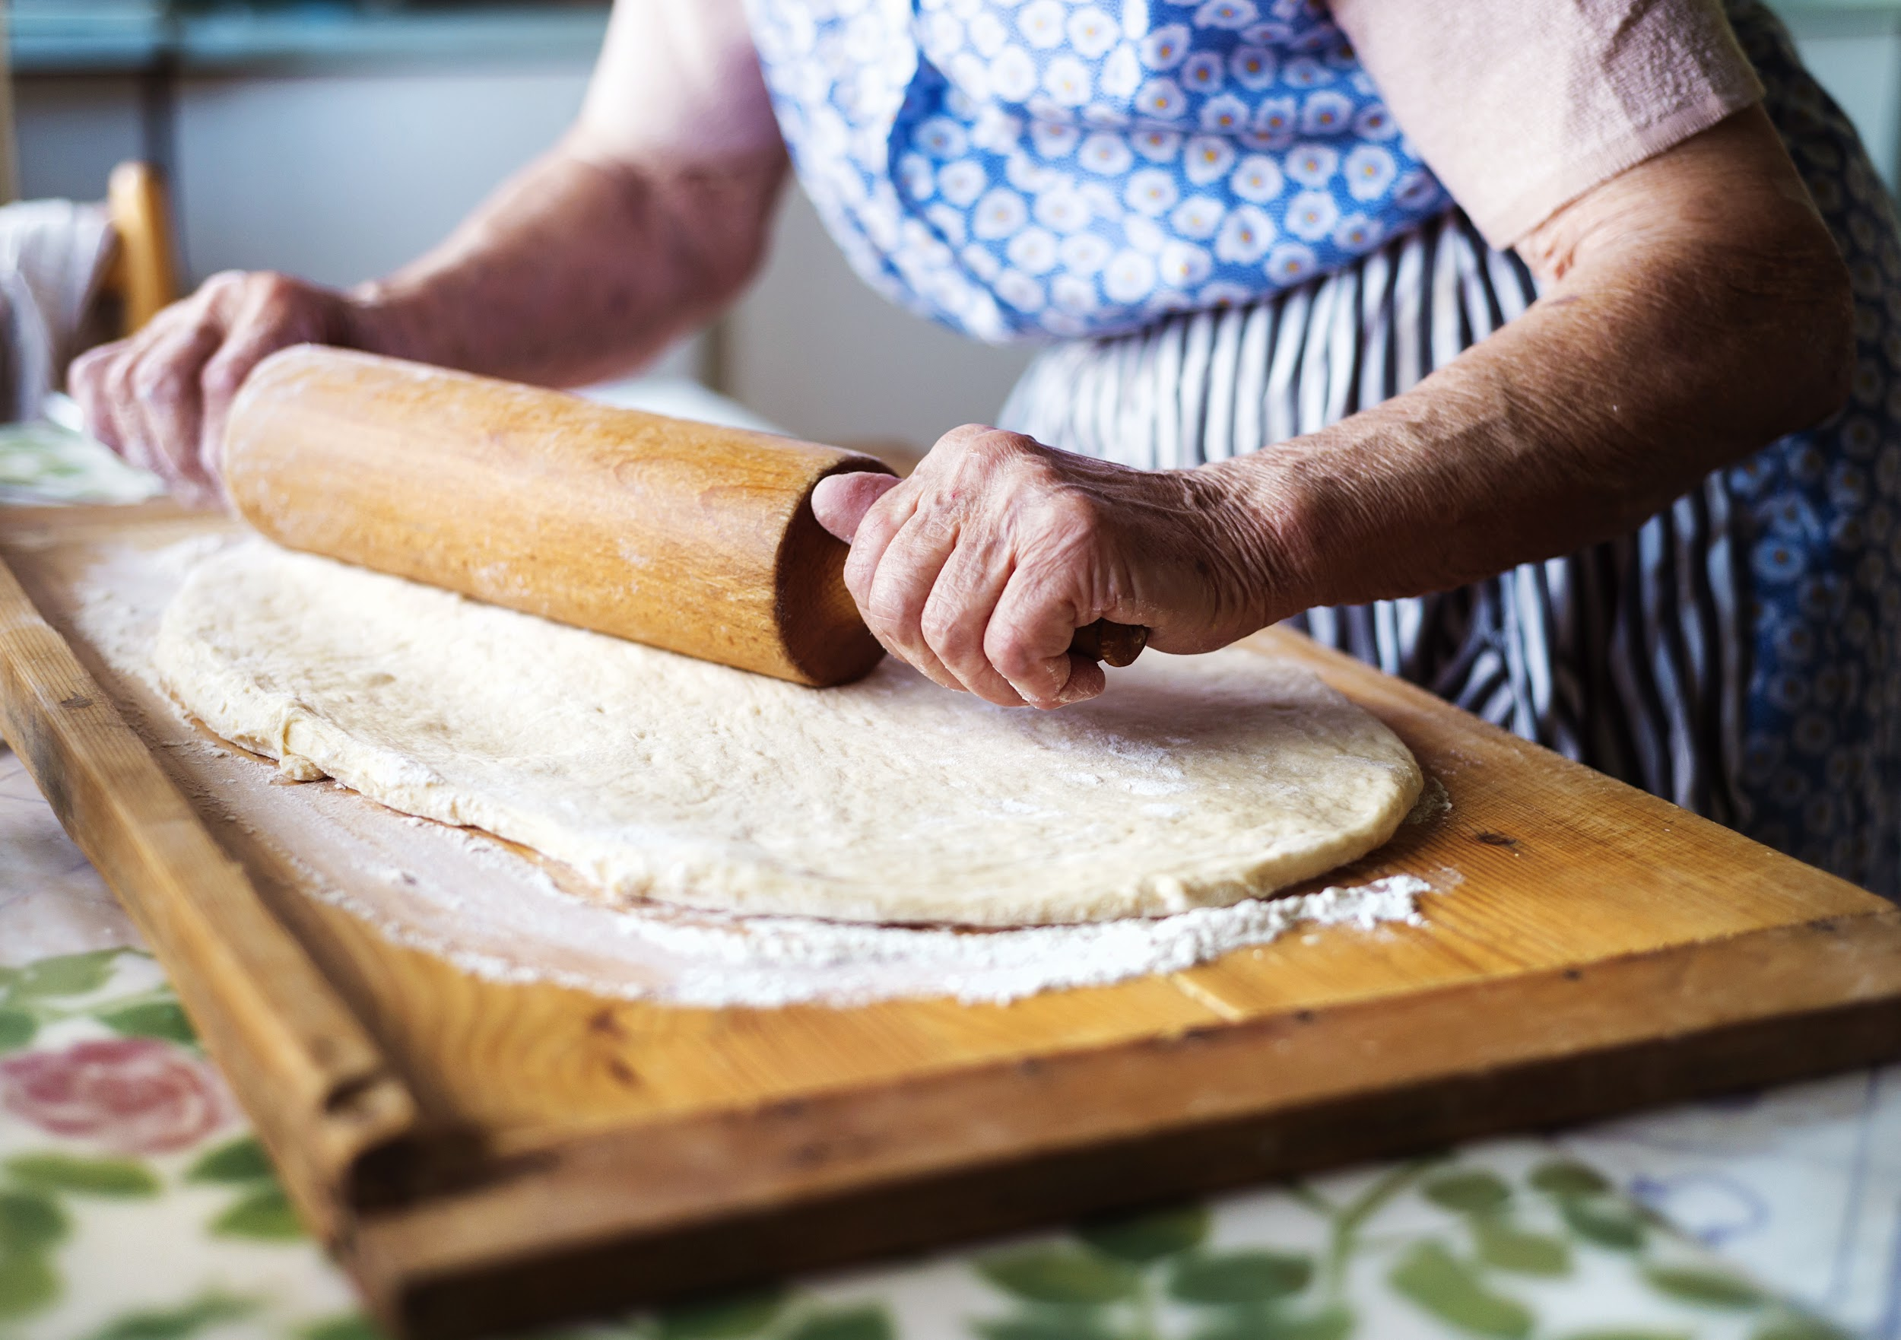
IN THE KITCHEN
Rolling Pin
Cutting Board

Slide 13
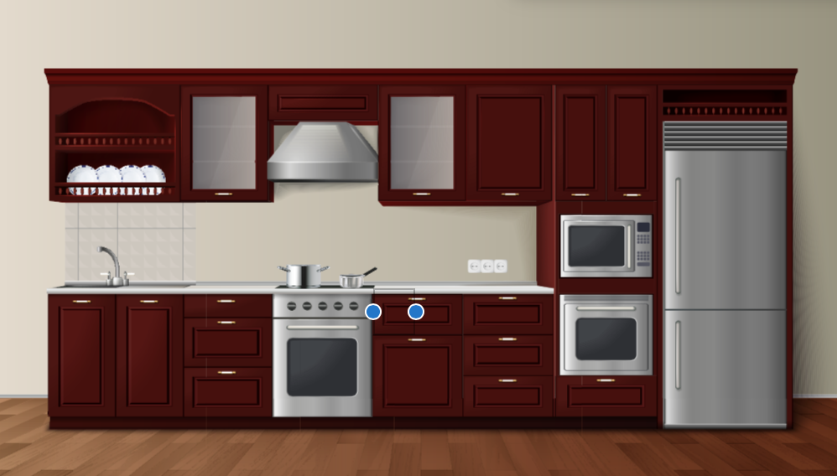
IN THE KITCHEN
REFRIGERATOR
SINK
STOVE
FREEZER
OVEN
MICROWAVE

