Slide 1
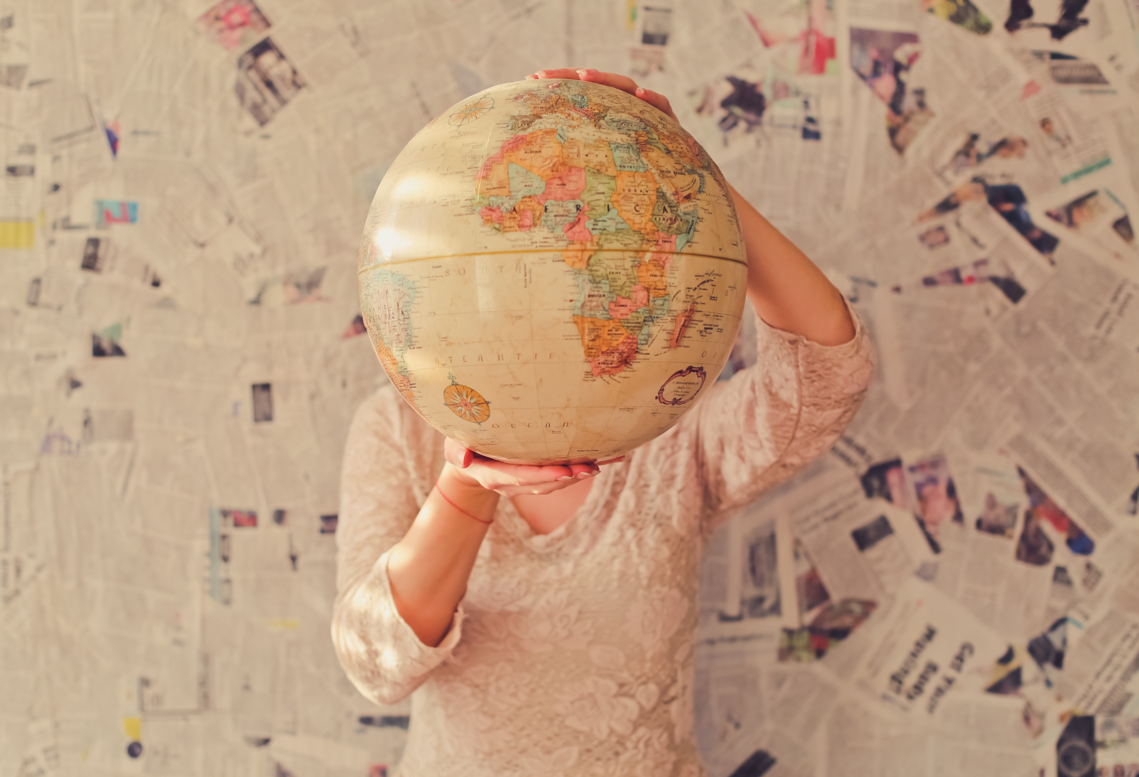
Where in the
world are we?

Slide 2
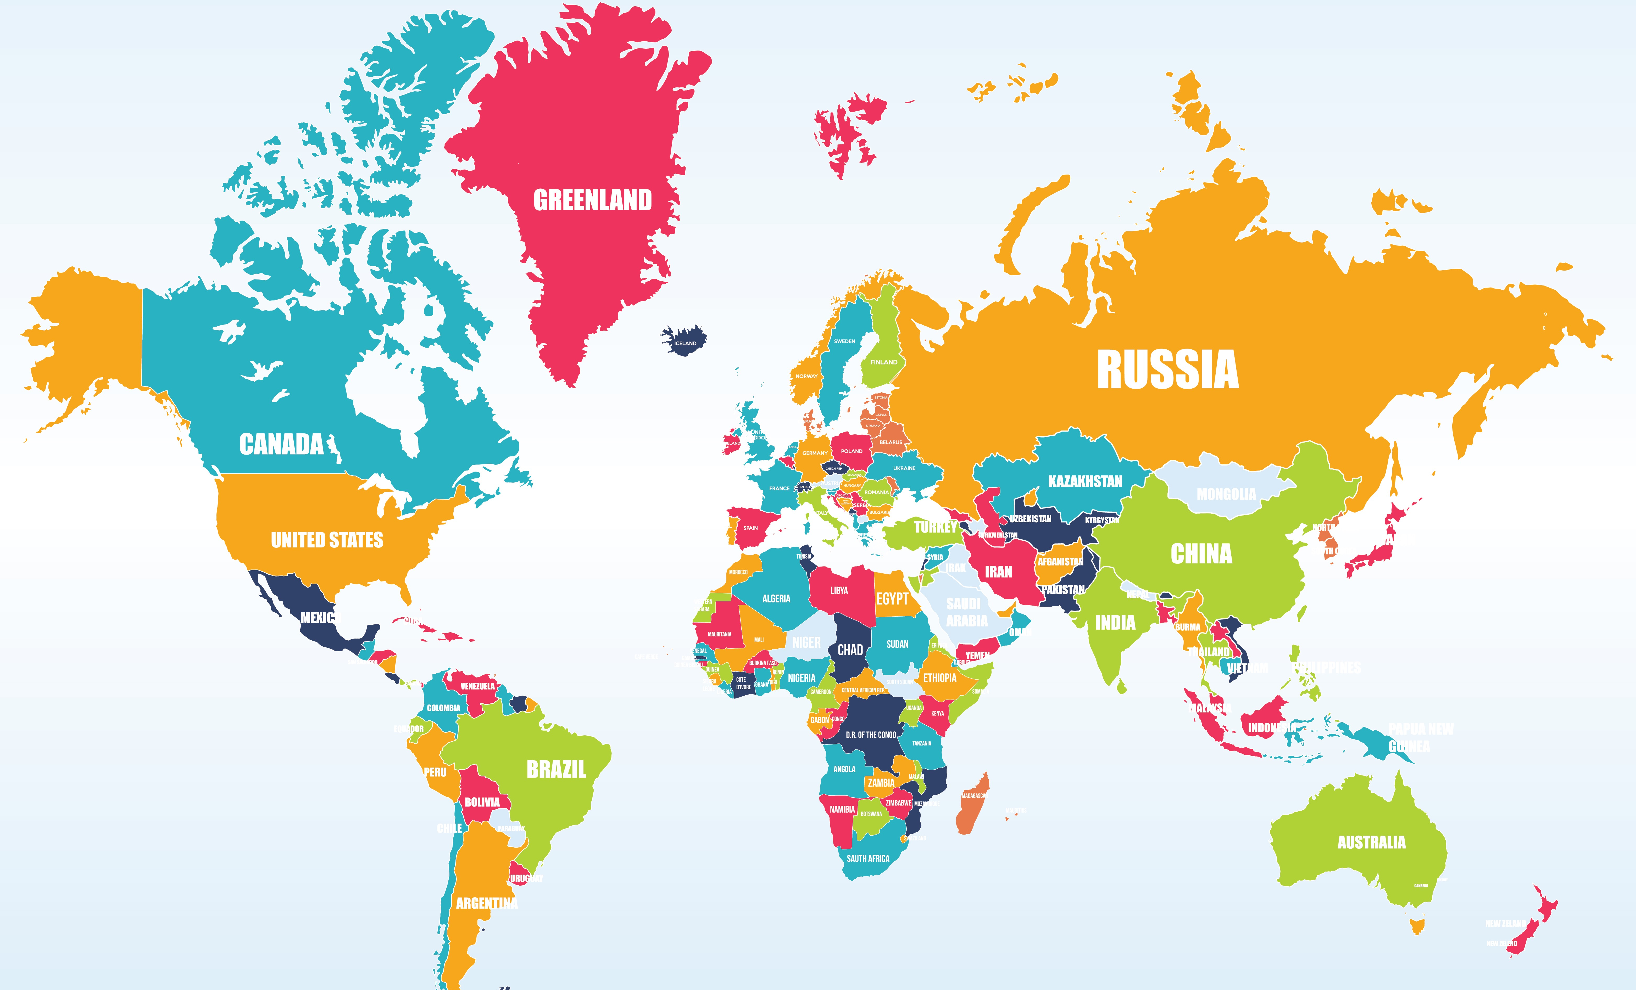
The World
Where are you from?

Slide 3
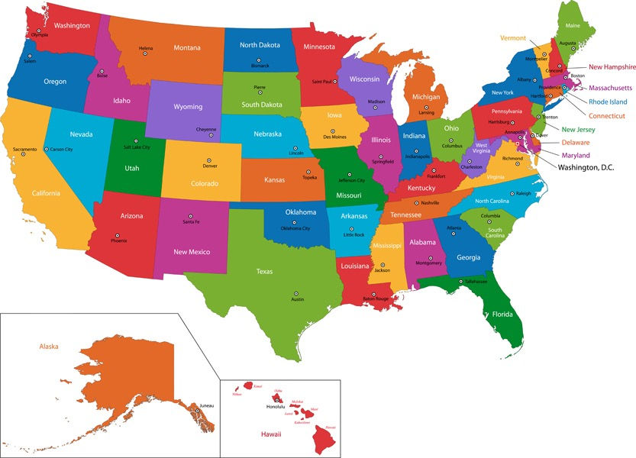
The United States

Slide 4
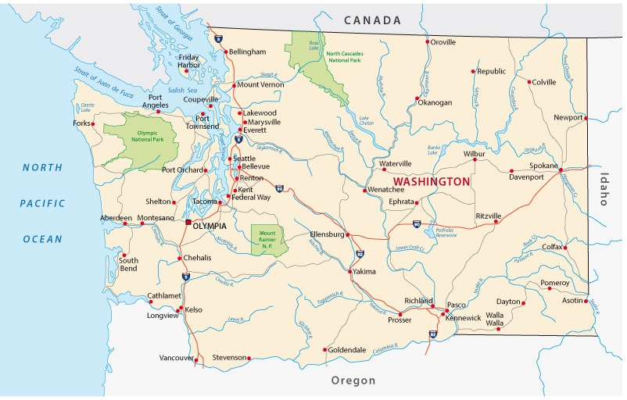
Washington State

Slide 5
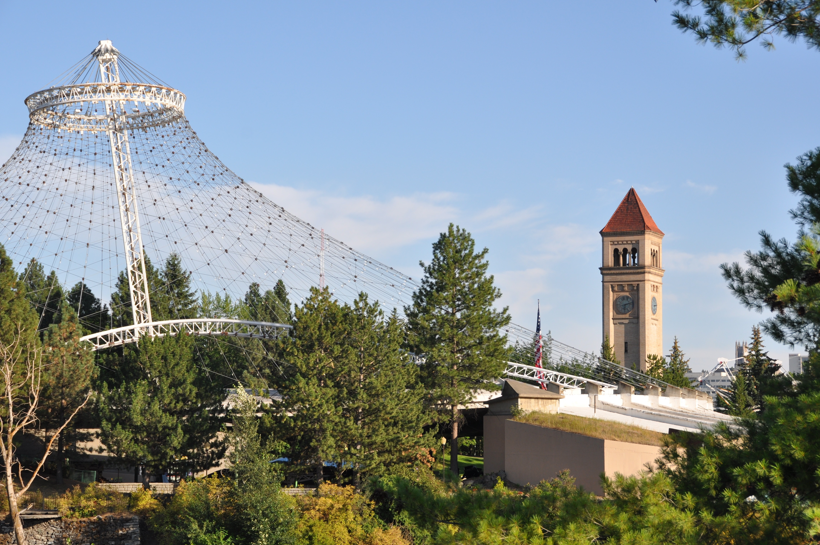
Spokane

Slide 6
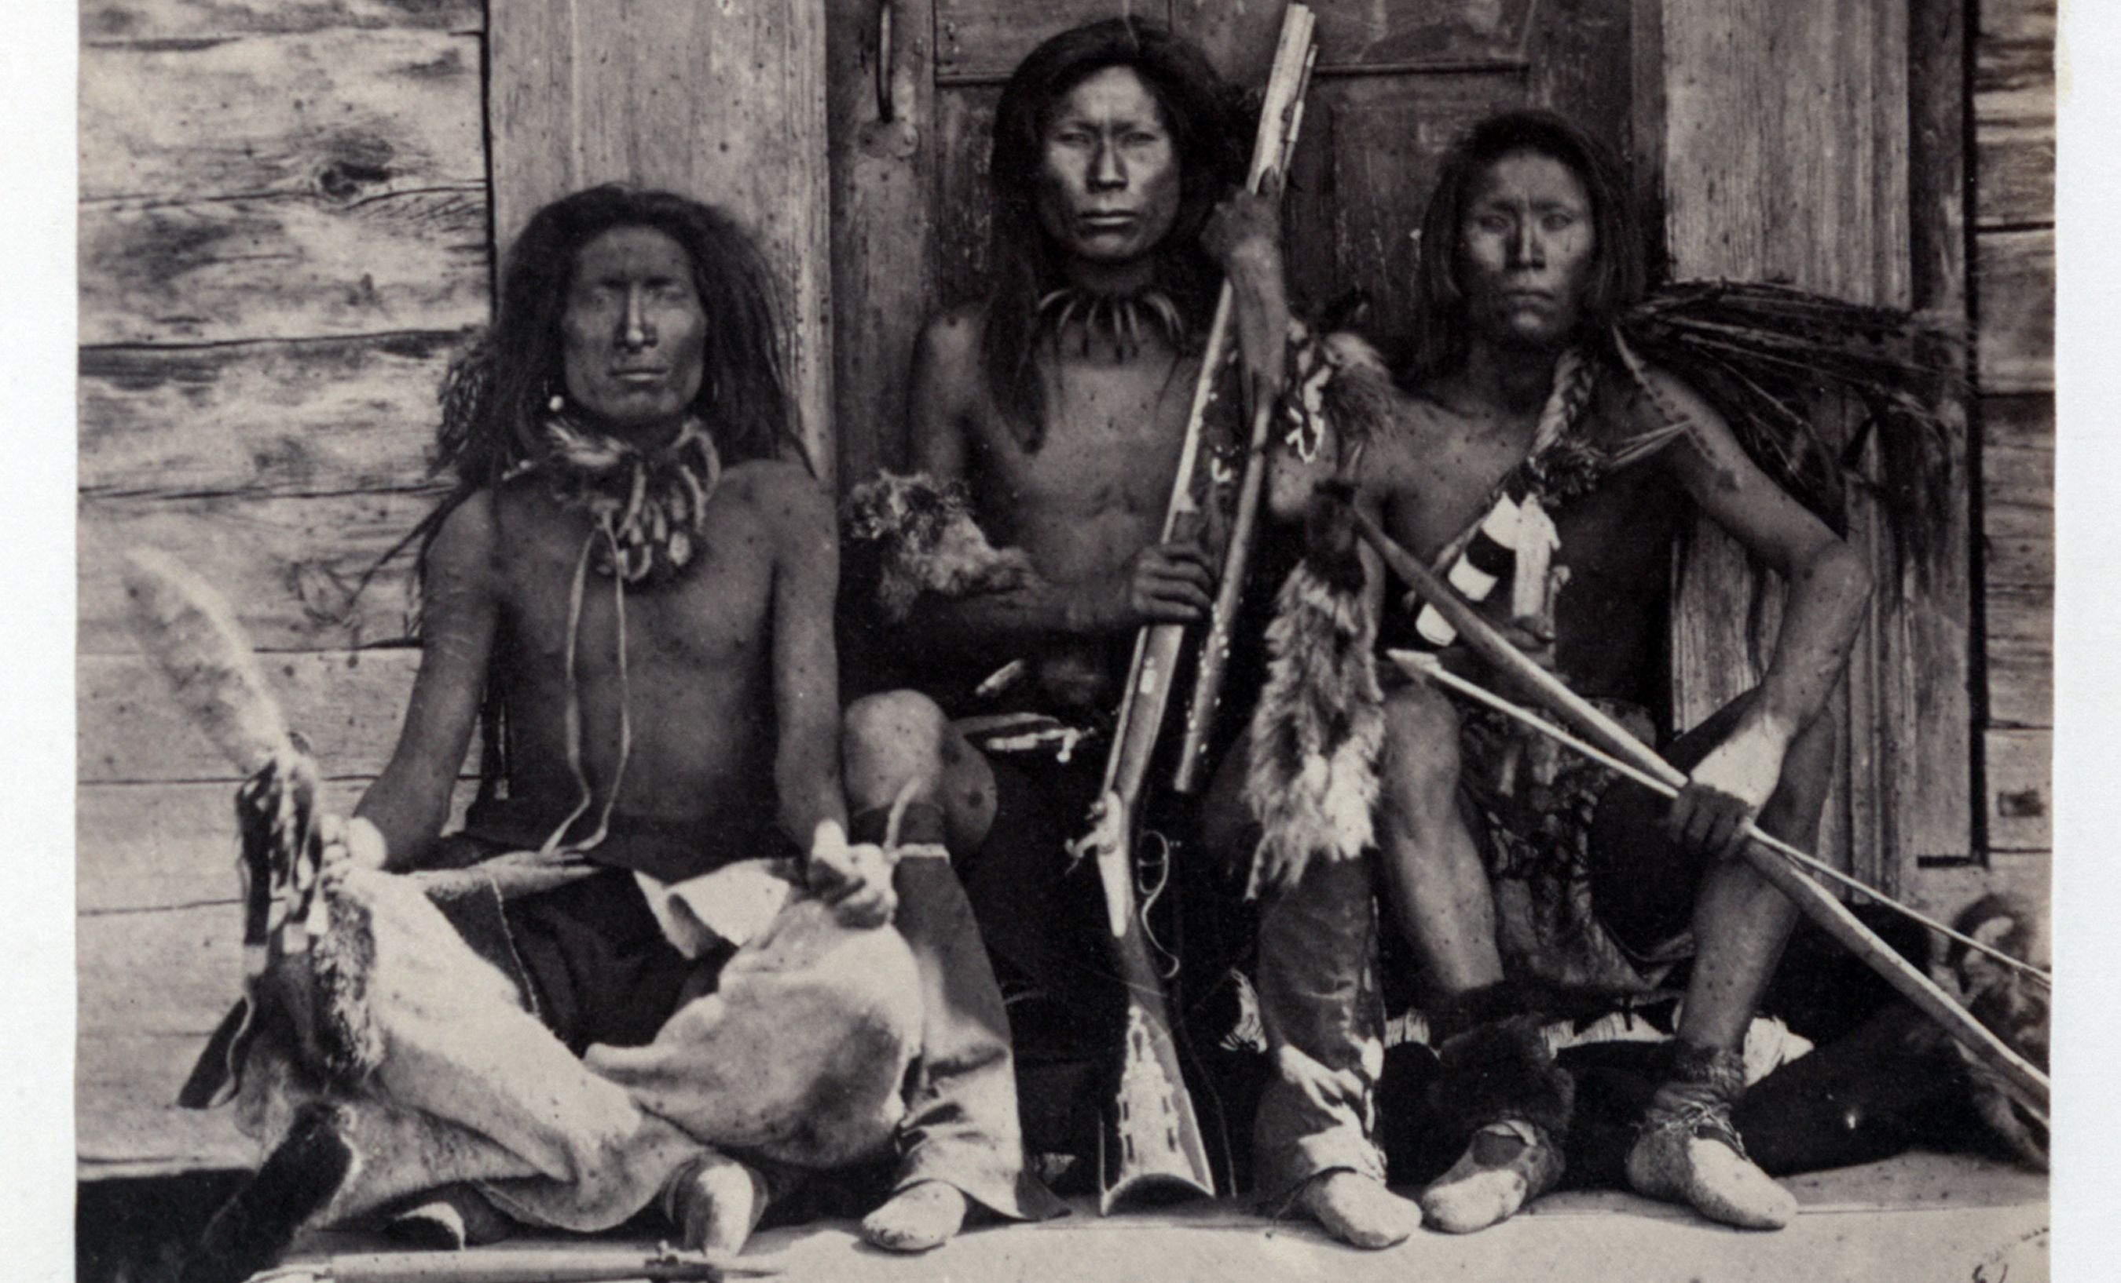
The Native Americans (Spokane Indian Tribe) were the first to live in the Spokane area. They fished, hunted and gathered here.

Slide 7
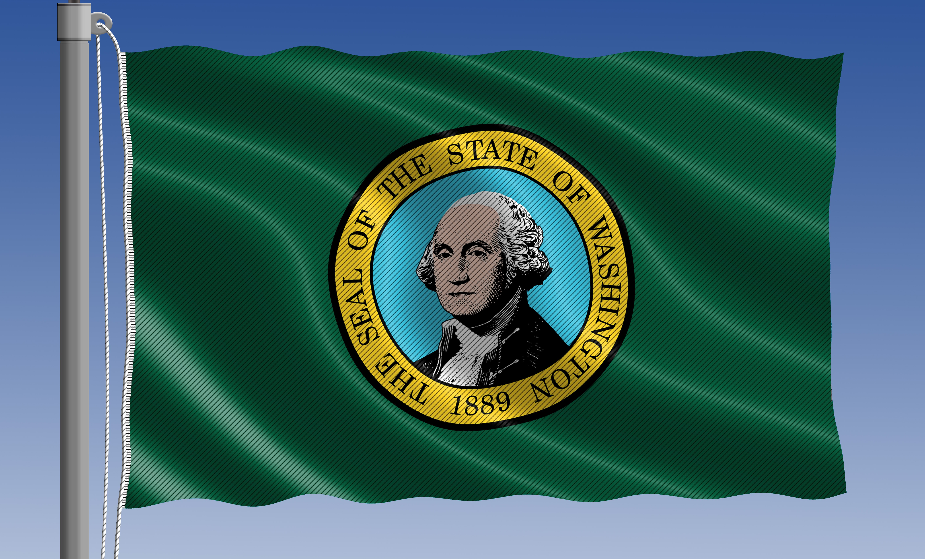
Spokane means “children of the Sun” and it became a city in 1881. Washington became a state in 1889.

Slide 8
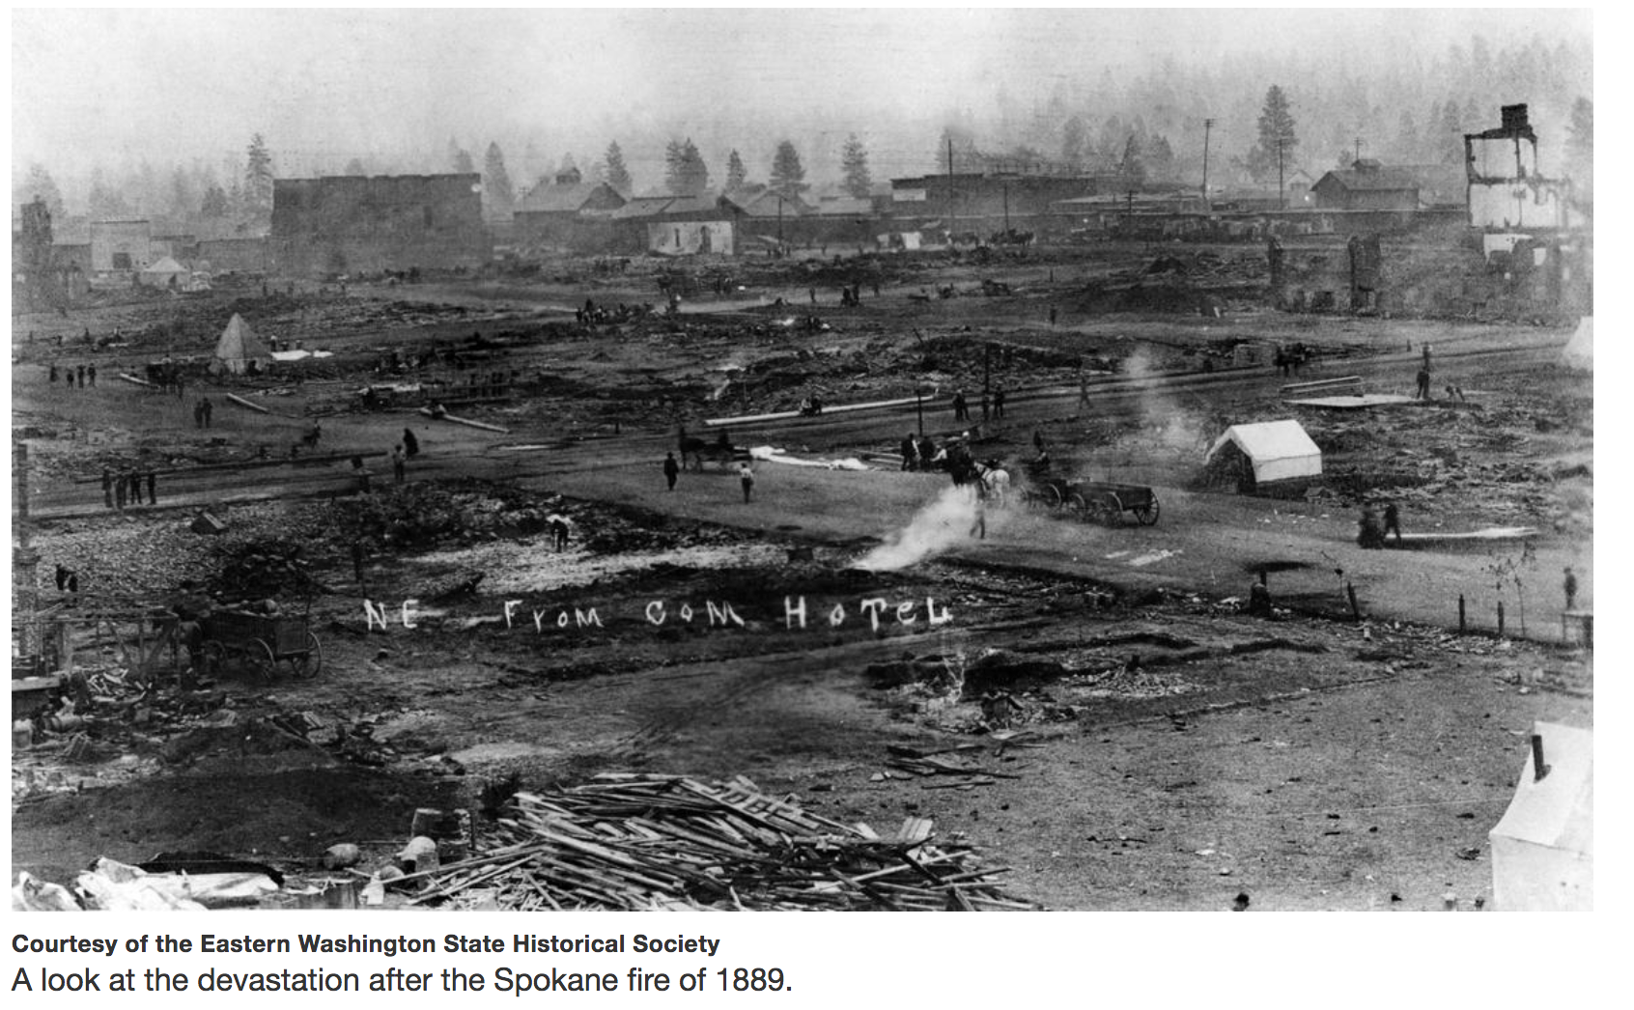
There was a big fire in downtown Spokane in 1889. Most of the buildings were made of wood and 32 city blocks were burned.

Slide 9
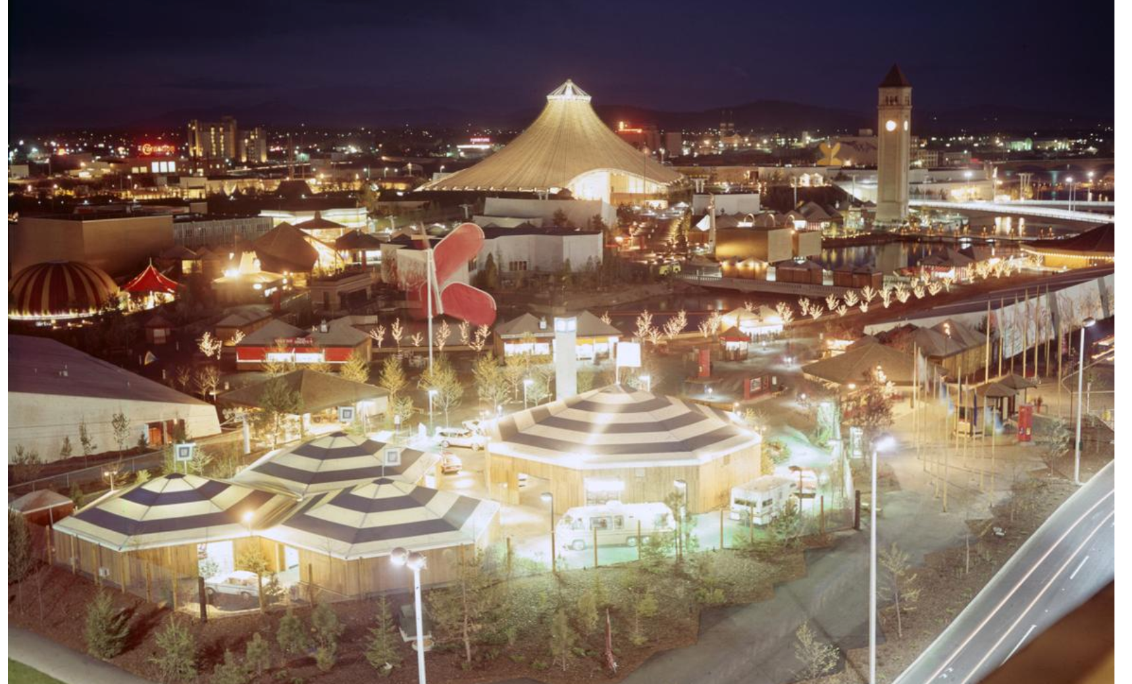
Spokane hosted the World’s Fair in 1974, and Riverfront Park was built after it.

