Slide 1
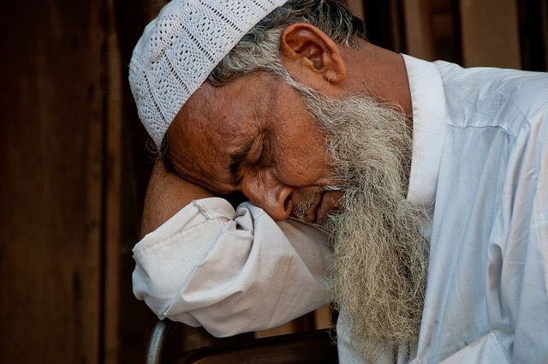
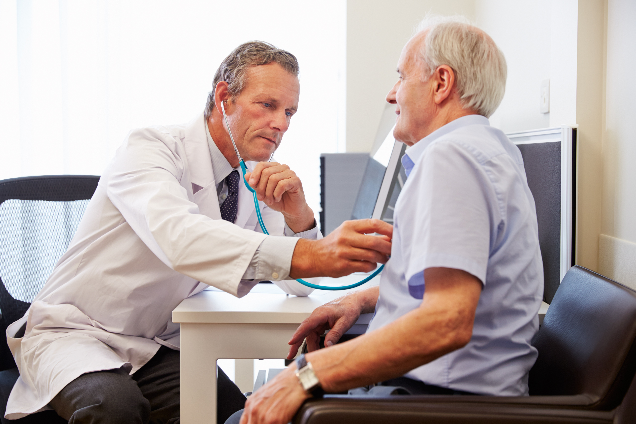
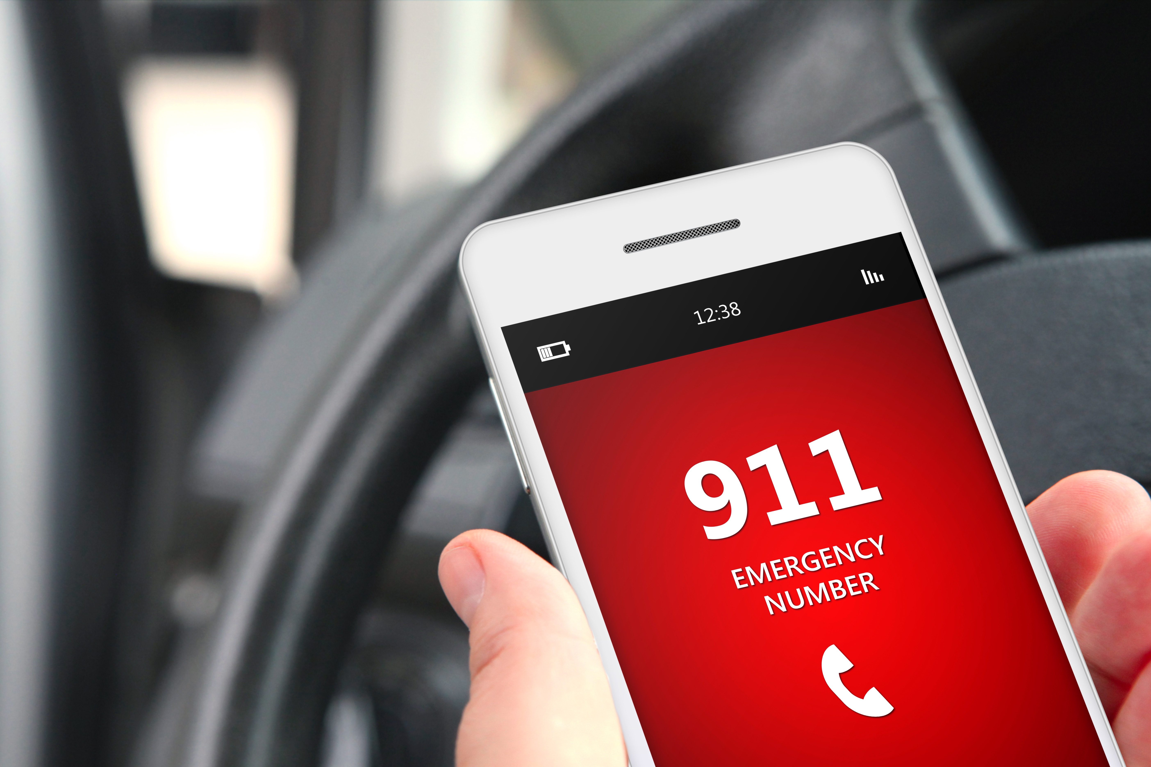
What should you do?
Rest
Call the doctor
Call 911

Slide 2
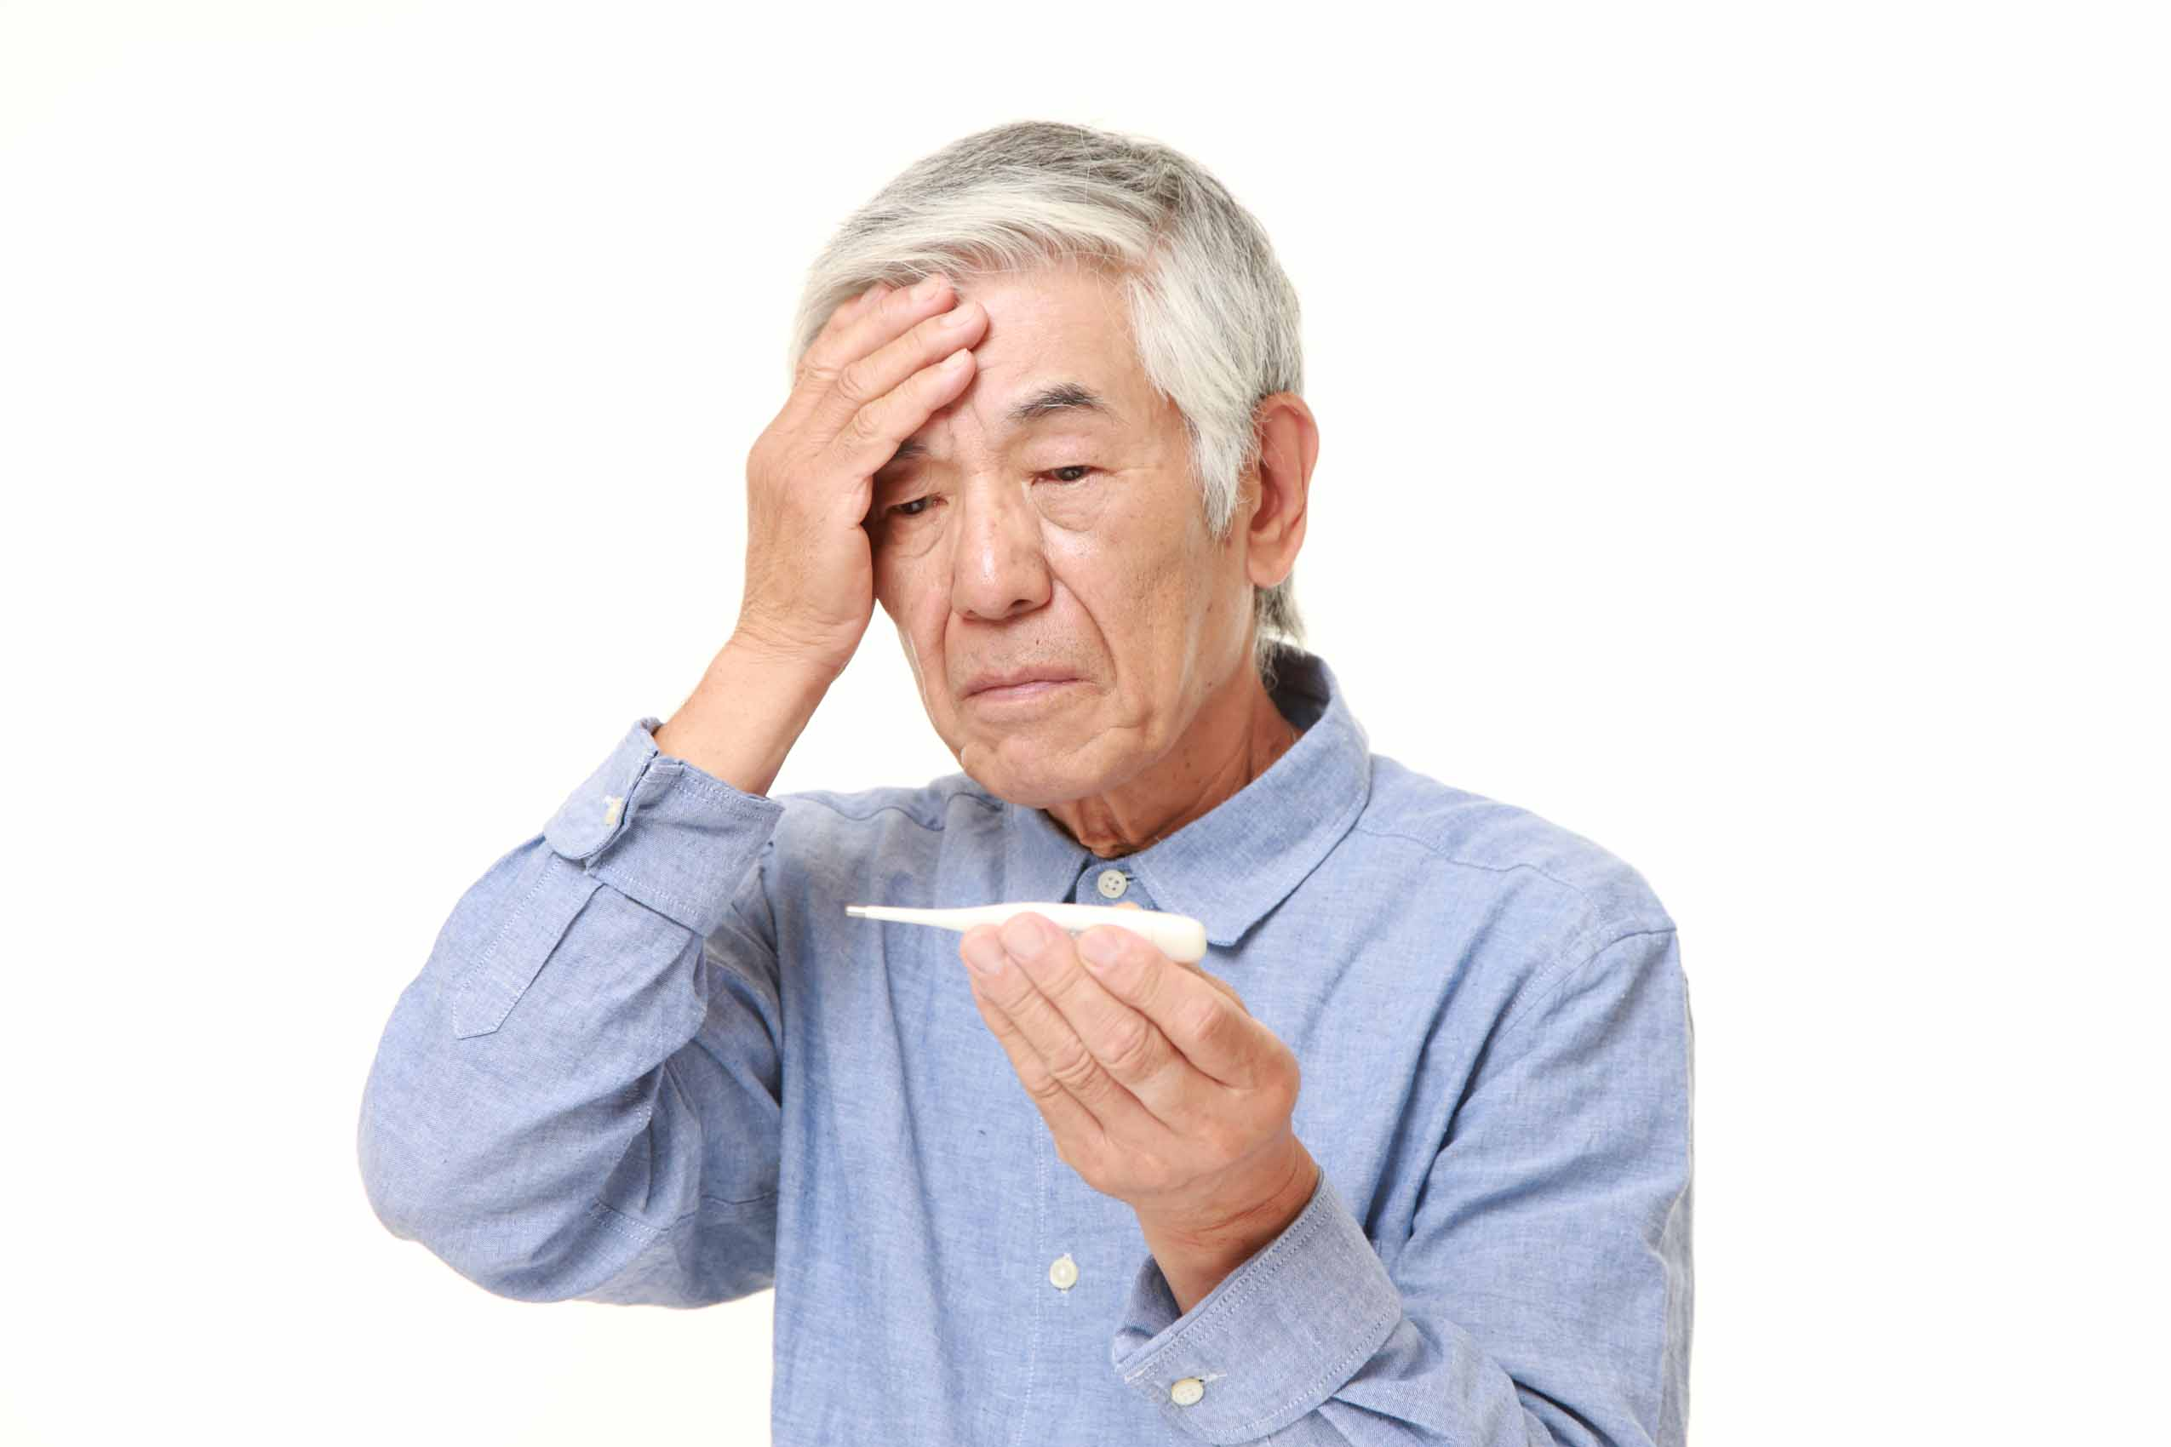

Slide 3
I have a
fever.

Slide 4
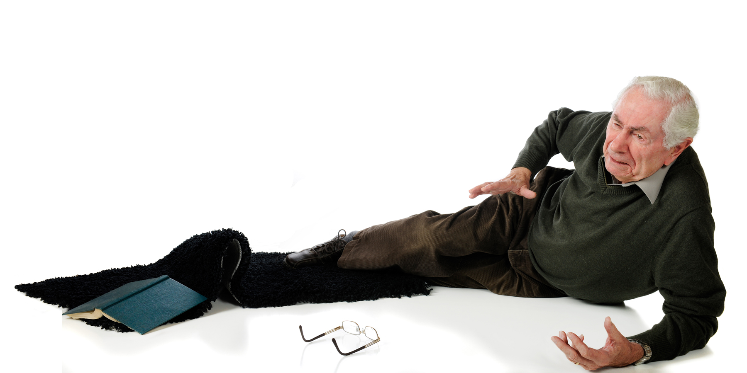

Slide 5
I fell down.

Slide 6
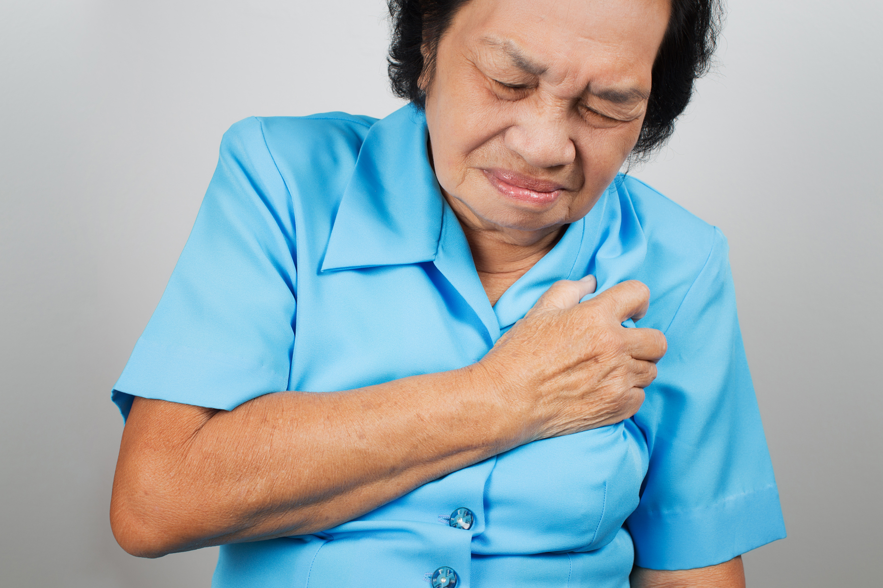

Slide 7
My
chest hurts.

Slide 8
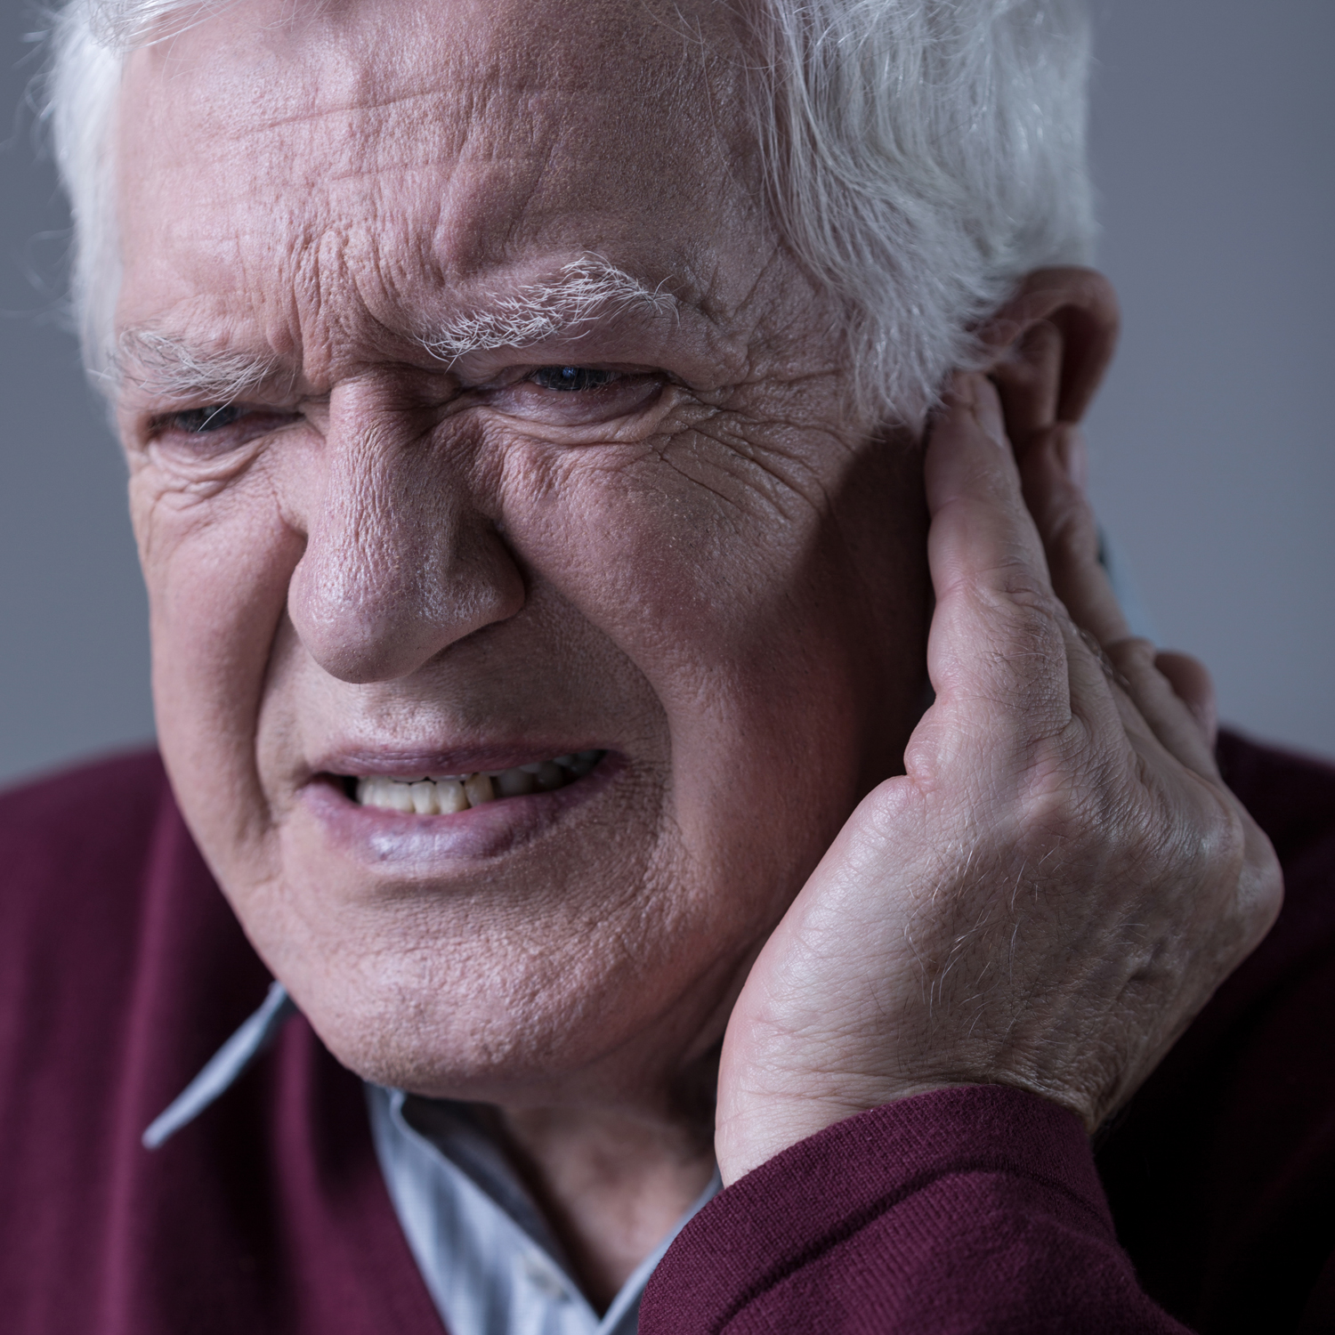

Slide 9
My
ear hurts.

Slide 10
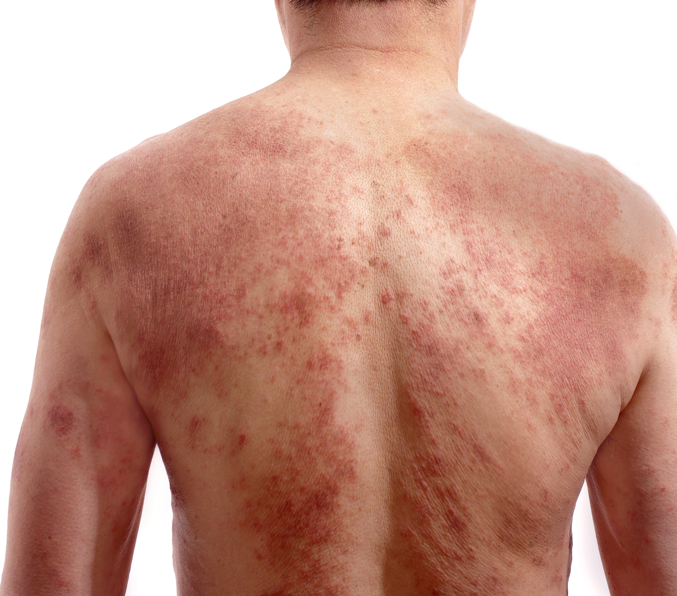

Slide 11
I have a
rash.

Slide 12
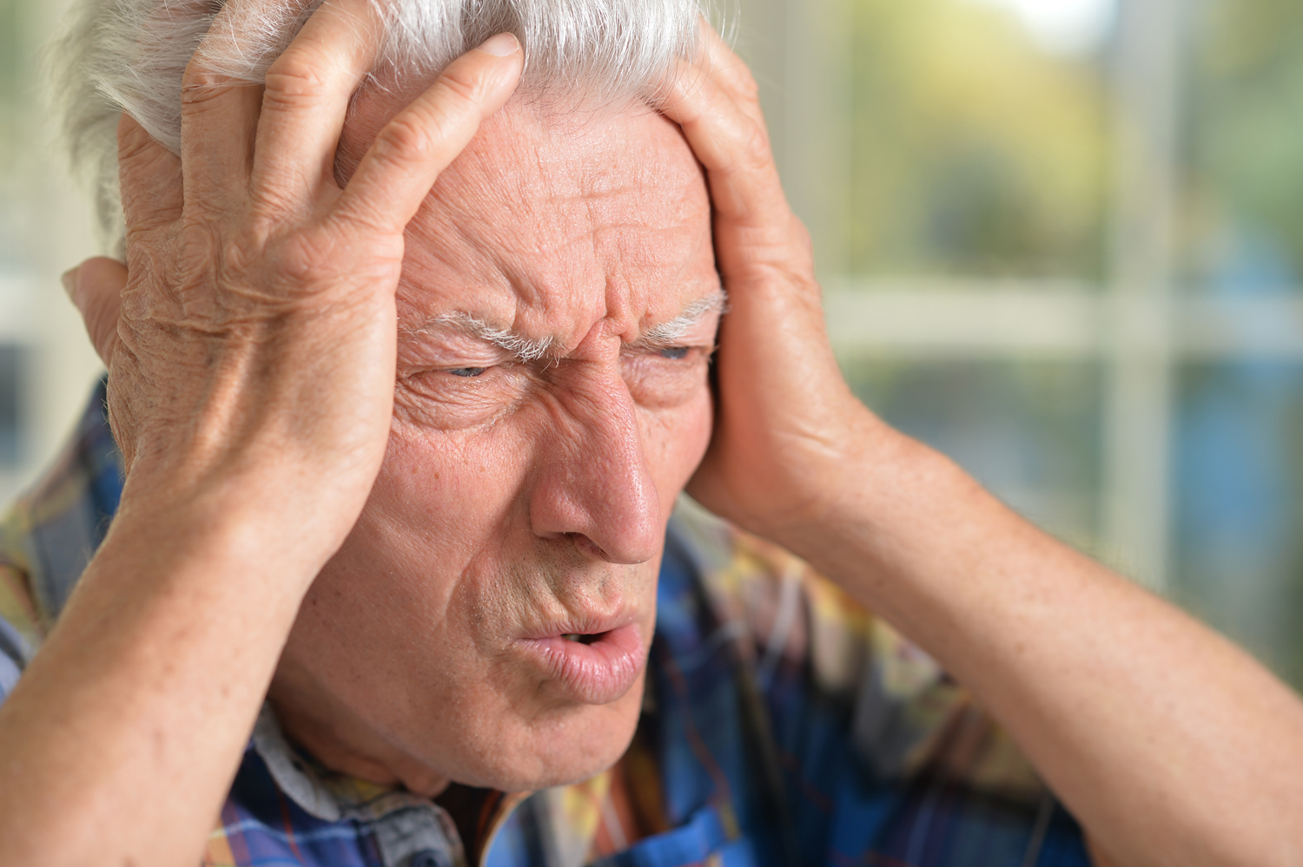

Slide 13
My
head hurts.

Slide 14
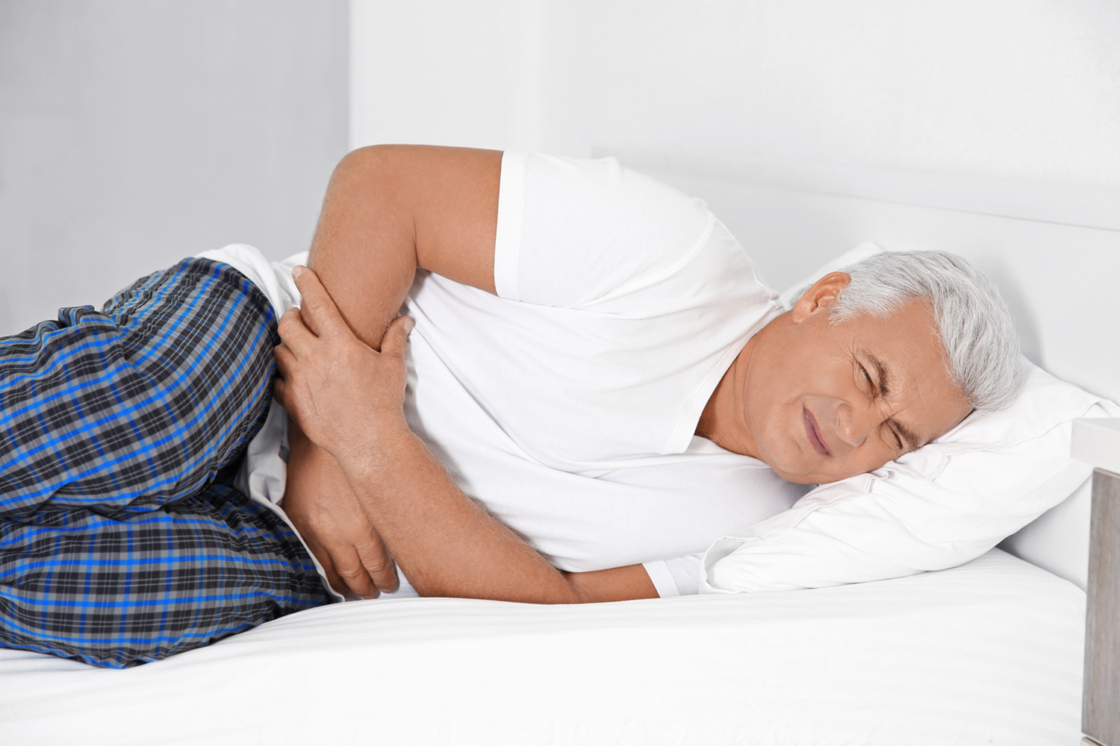

Slide 15
My
stomach hurts.

Slide 17
I’m
bleeding.

Slide 18
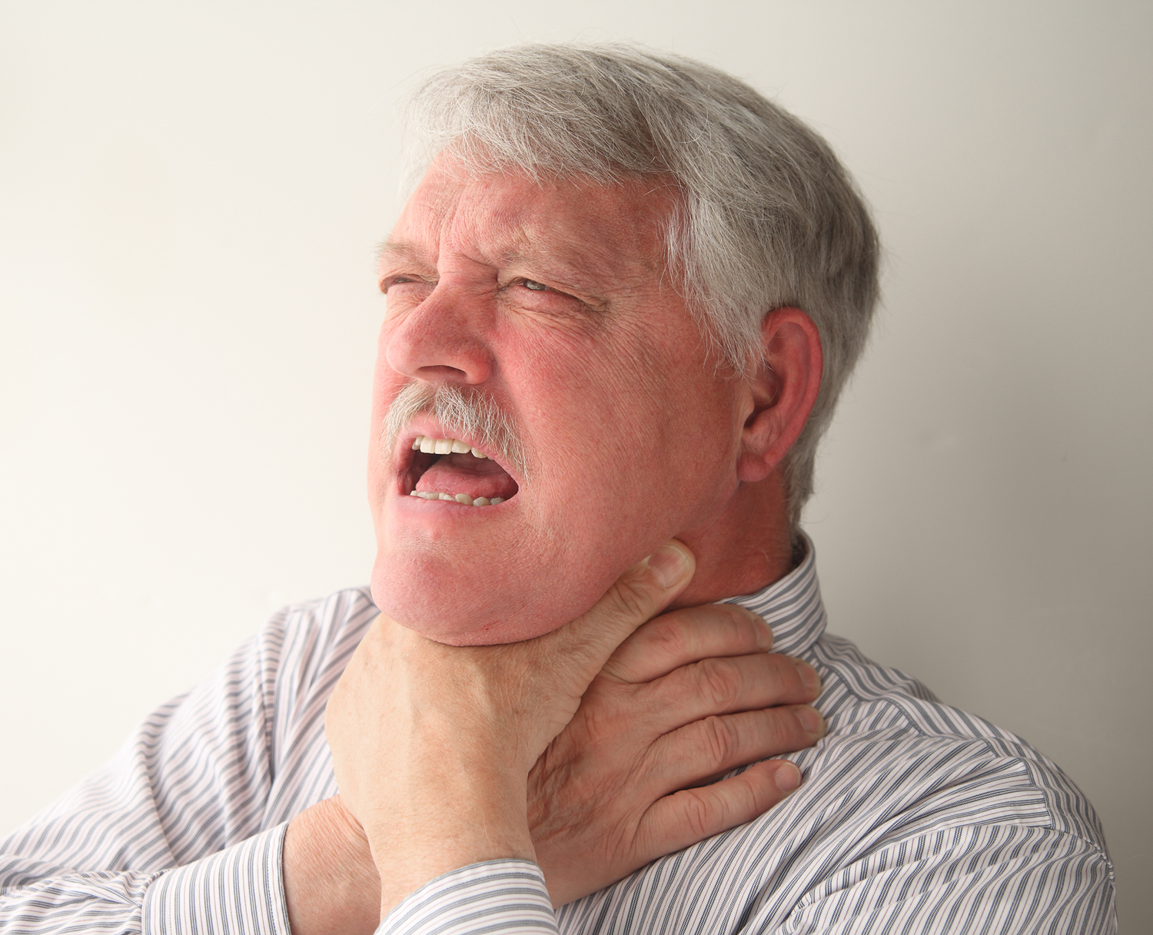

Slide 19
He’s
choking.

Slide 20
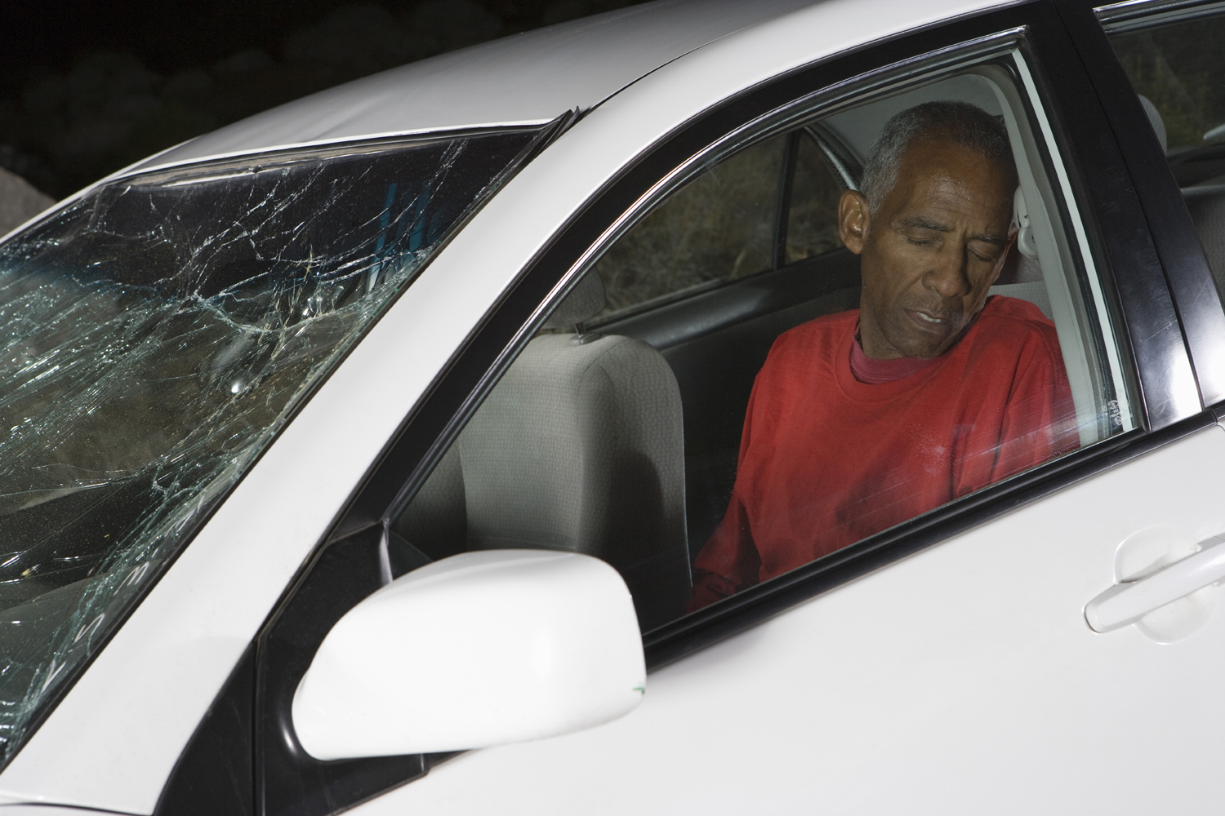

Slide 21
He’s
unconscious.

Slide 23
My
throat hurts.

Slide 24
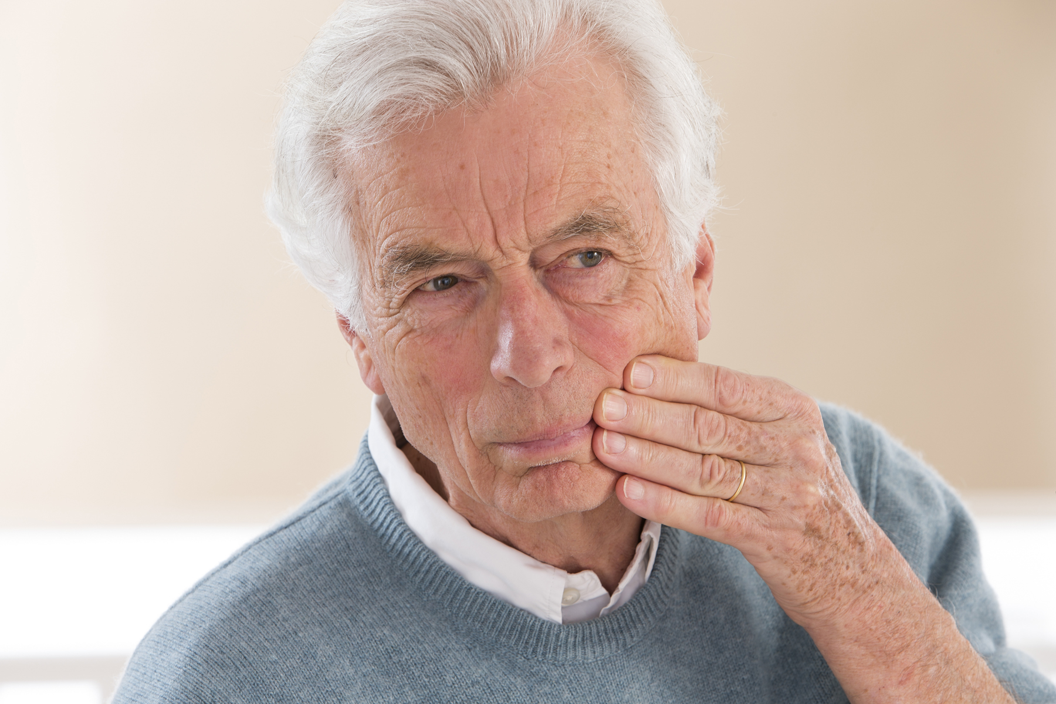

Slide 25
My
tooth hurts.

Slide 26
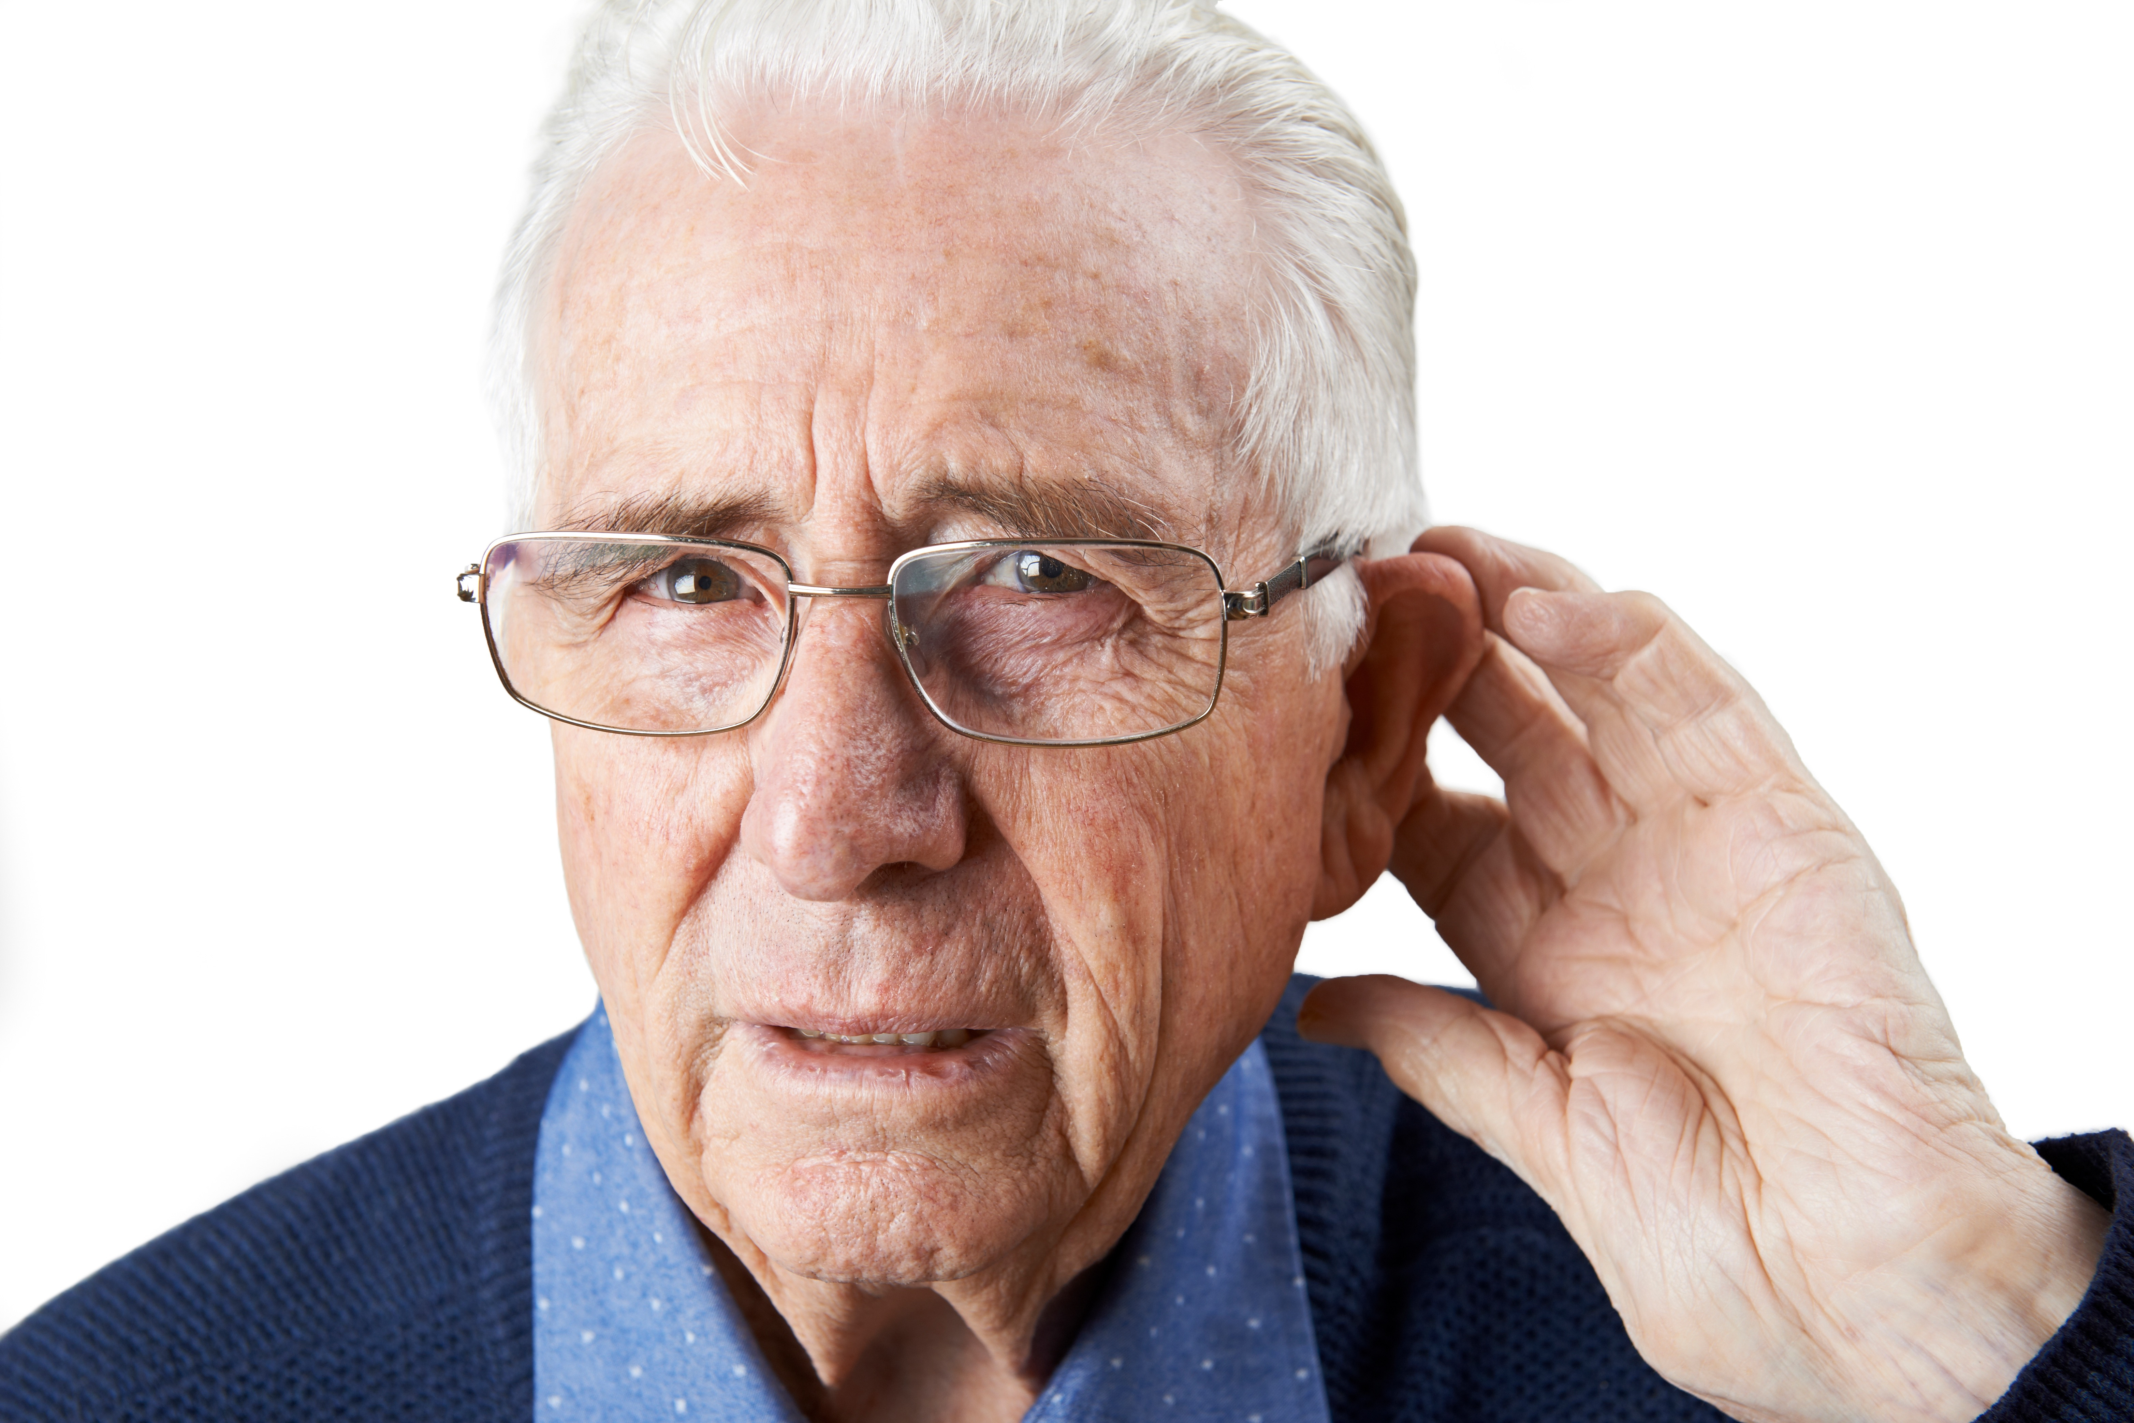

Slide 27
I can’t
hear well.

Slide 29
He
fell down.

Slide 30
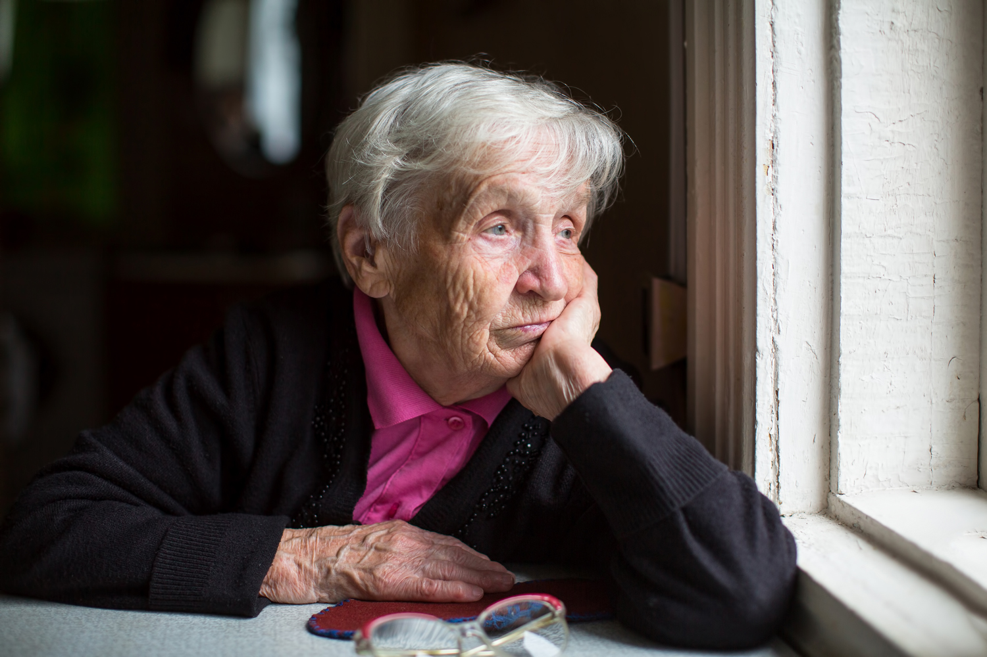

Slide 31
I feel
depressed.

