Slide 1
Not Wrong,
Just Different

Slide 2
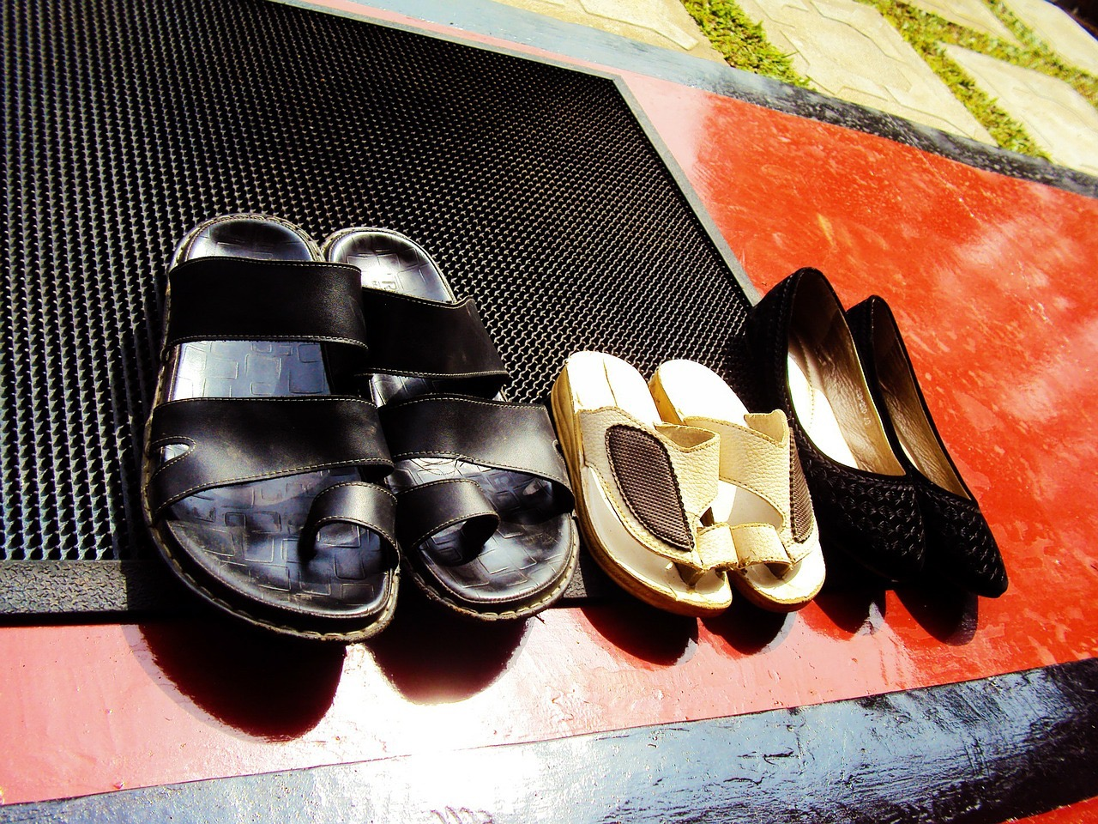
Taking your shoes off when entering a home.

Slide 3
Kissing friends and relative on both cheeks when meeting them.

Slide 4
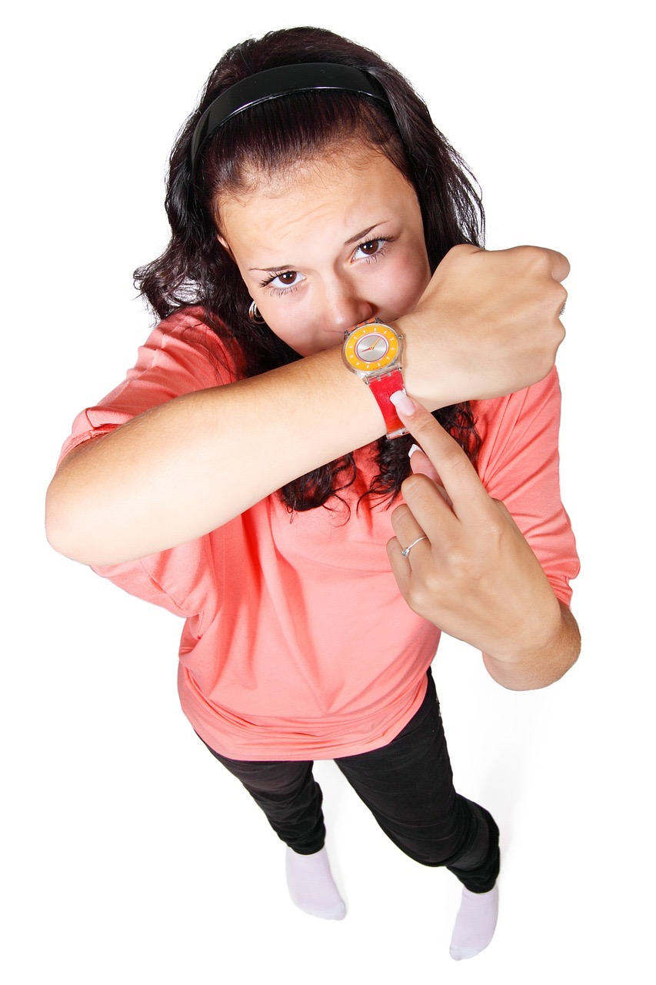
Arriving 30 minutes late for a party.

Slide 5
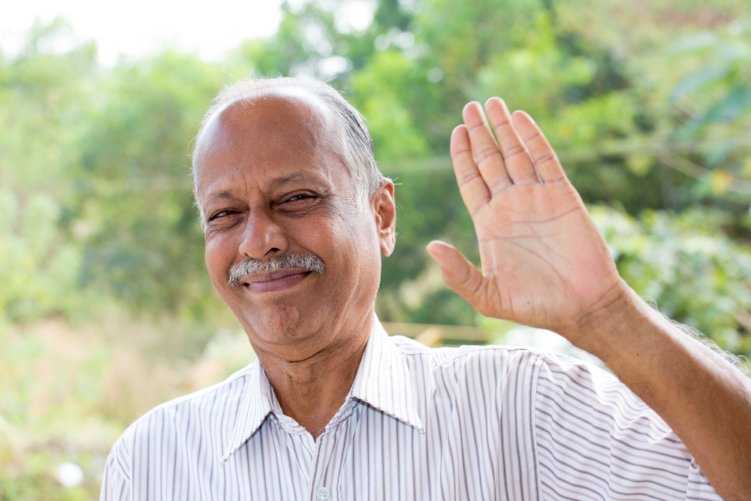
Saying hello to strangers on the street.

Slide 6
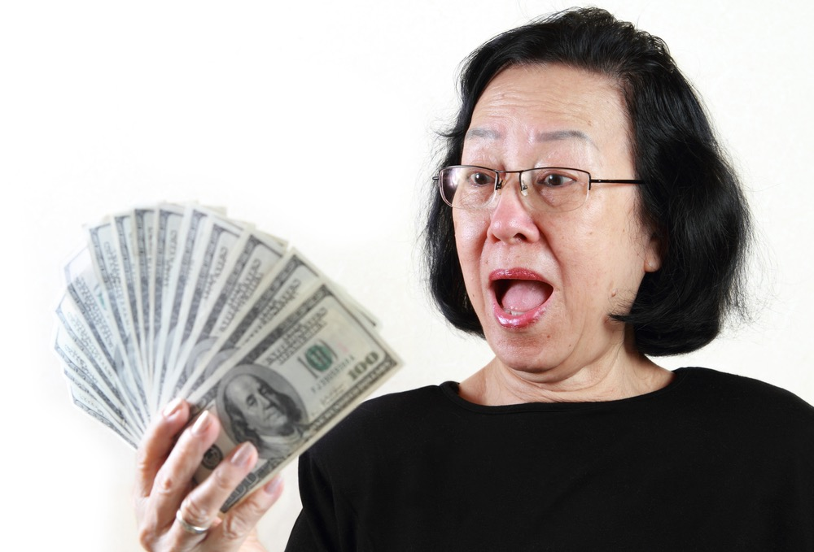
Talking about money.

Slide 7
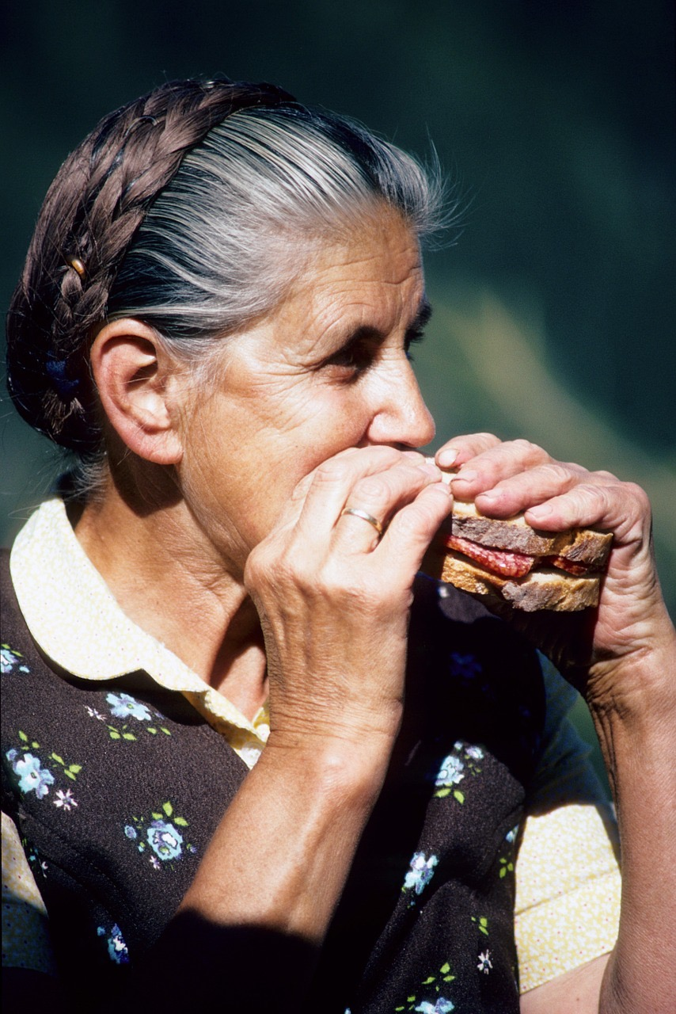
Chewing food with your mouth open.

Slide 8
Opening the door for someone.

Slide 9
Spitting

Slide 10
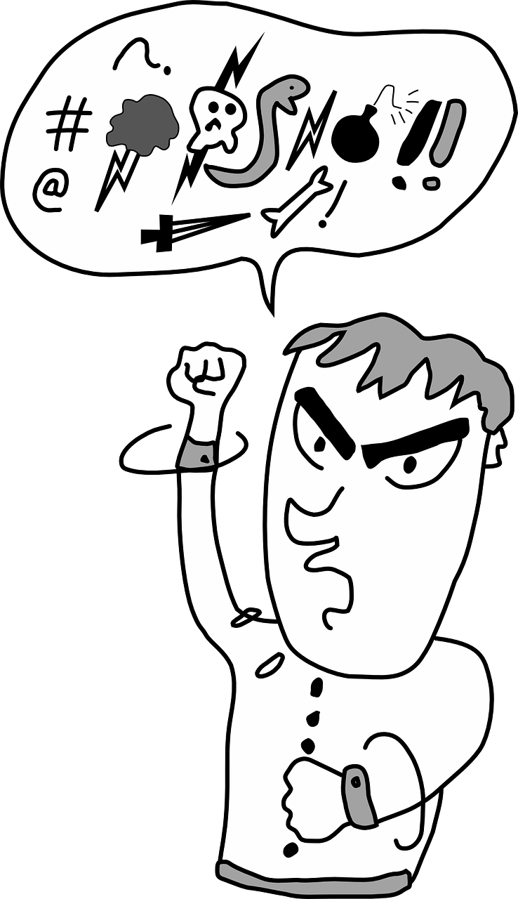
Swearing

