Slide 1
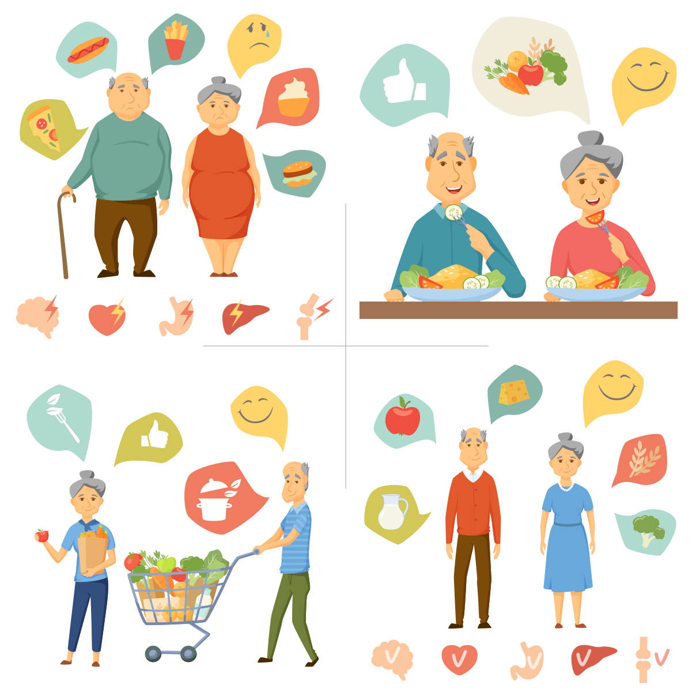
Nutrition
Nutrition

Slide 2
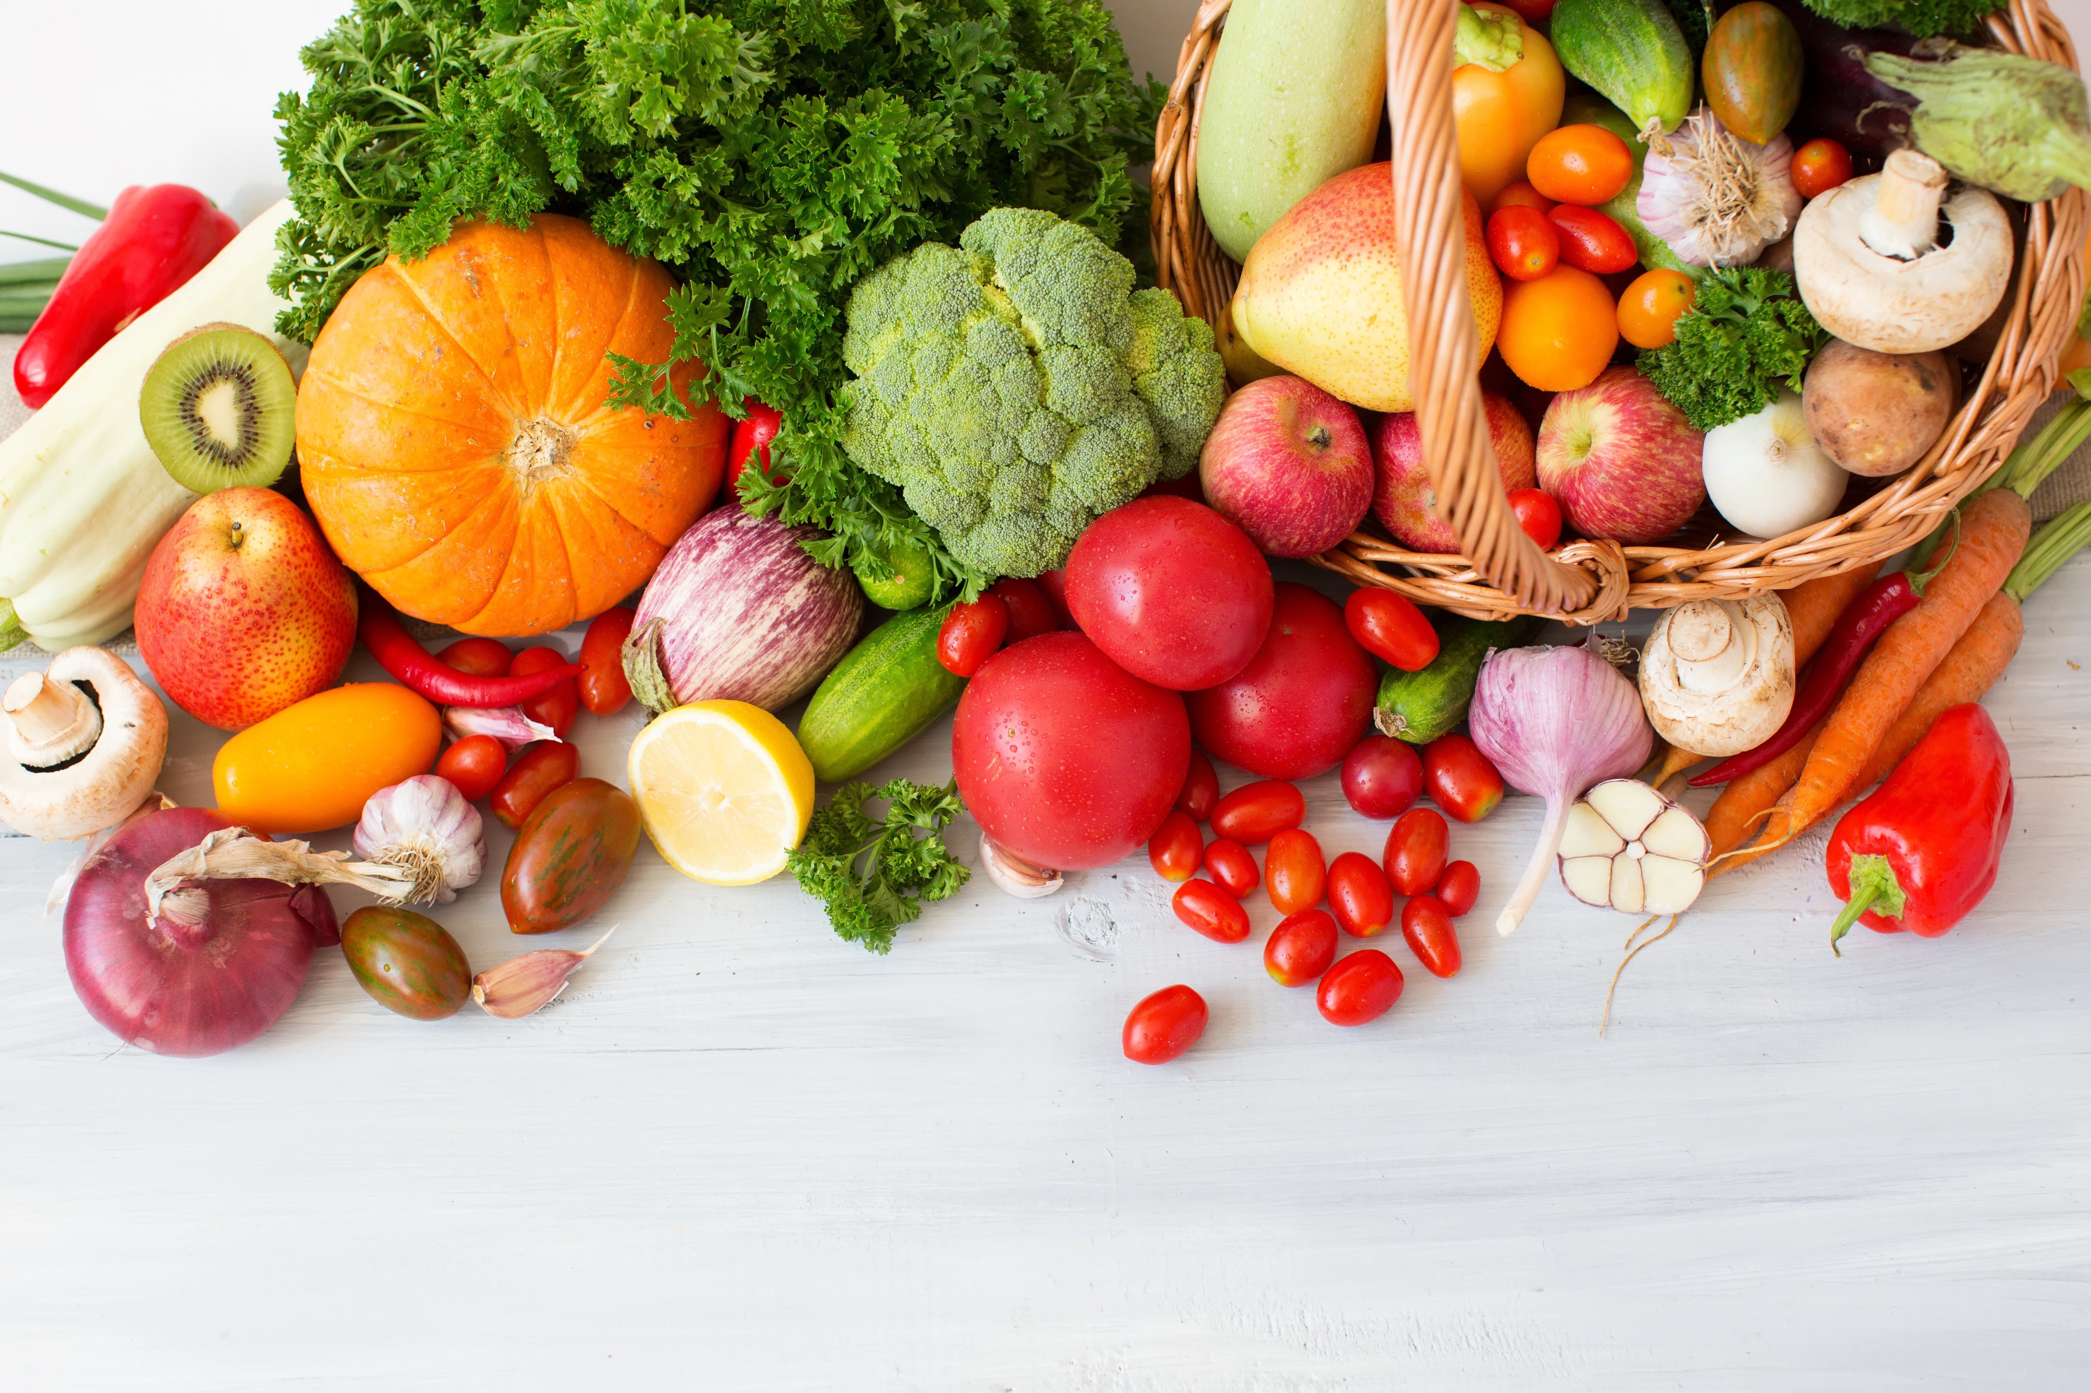
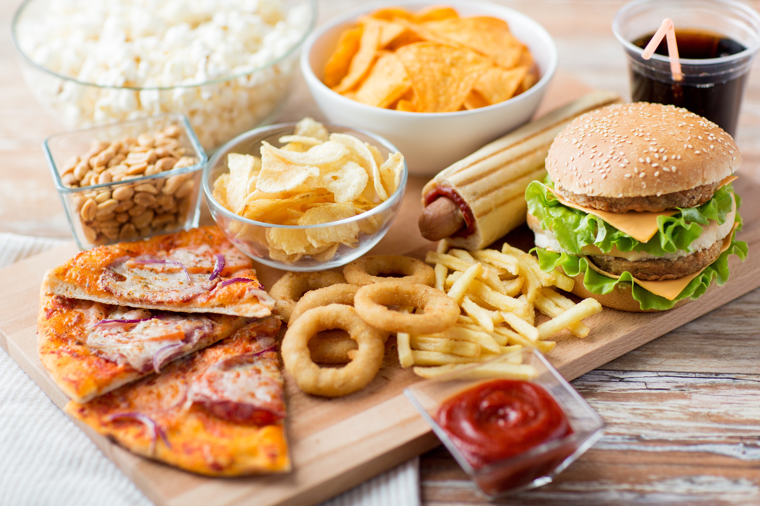
Healthy
Good for you
Unhealthy
Junk food

Slide 3
Food labels
Servings
Healthy Diet
Calories
2,000 calories
Fat
65g
Sodium (salt)
1500g
Sugars
25 g

Slide 4
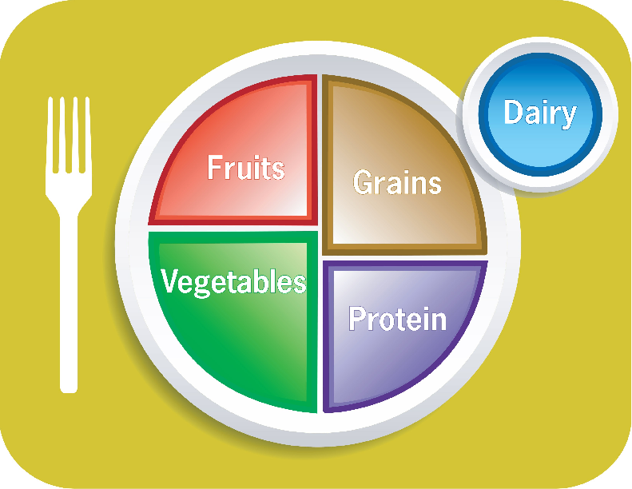

Slide 5
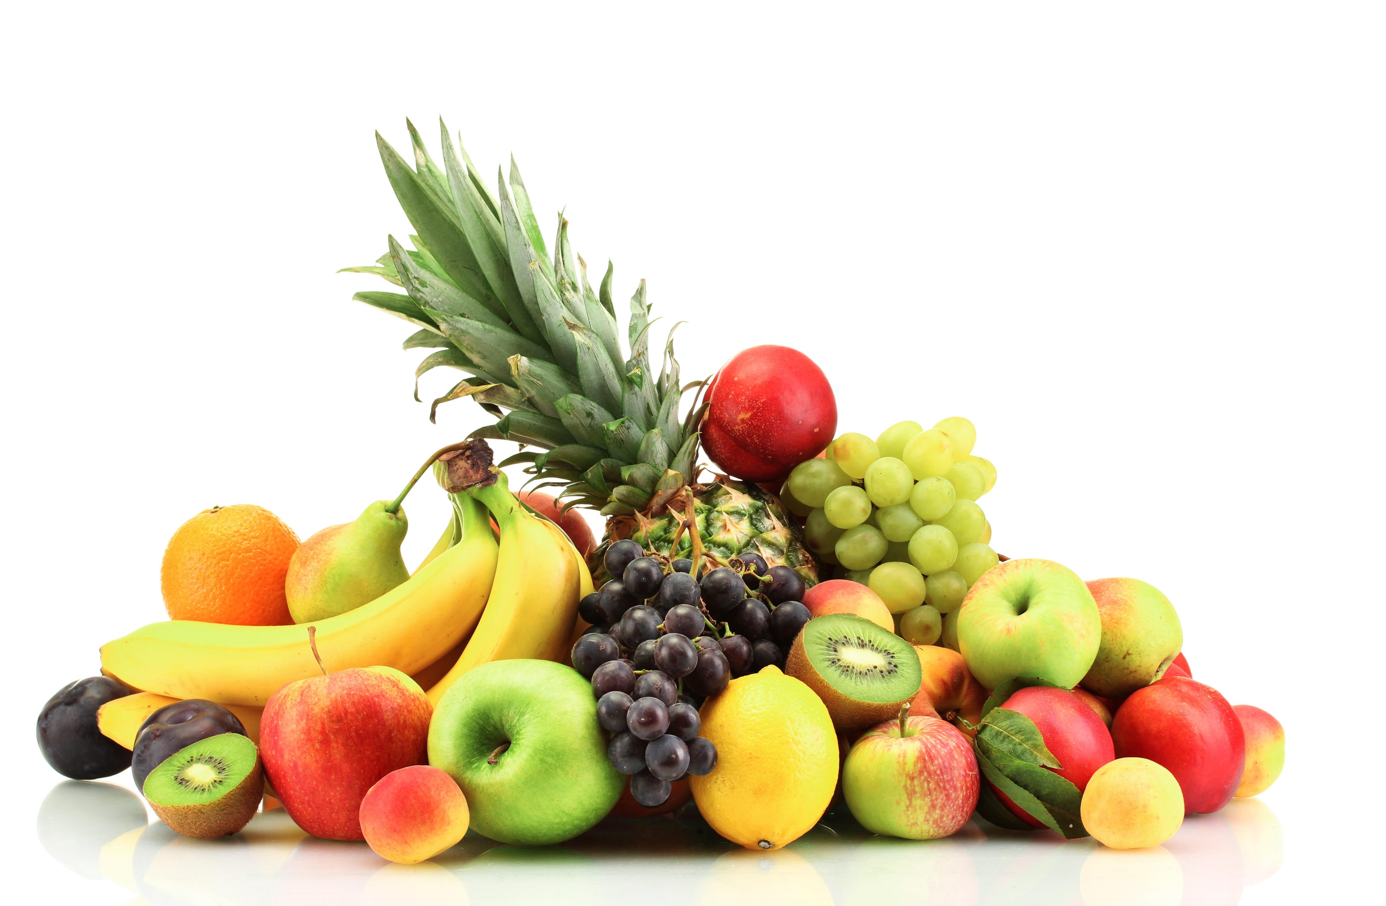
Fruits

Slide 6
Vegetables

Slide 7
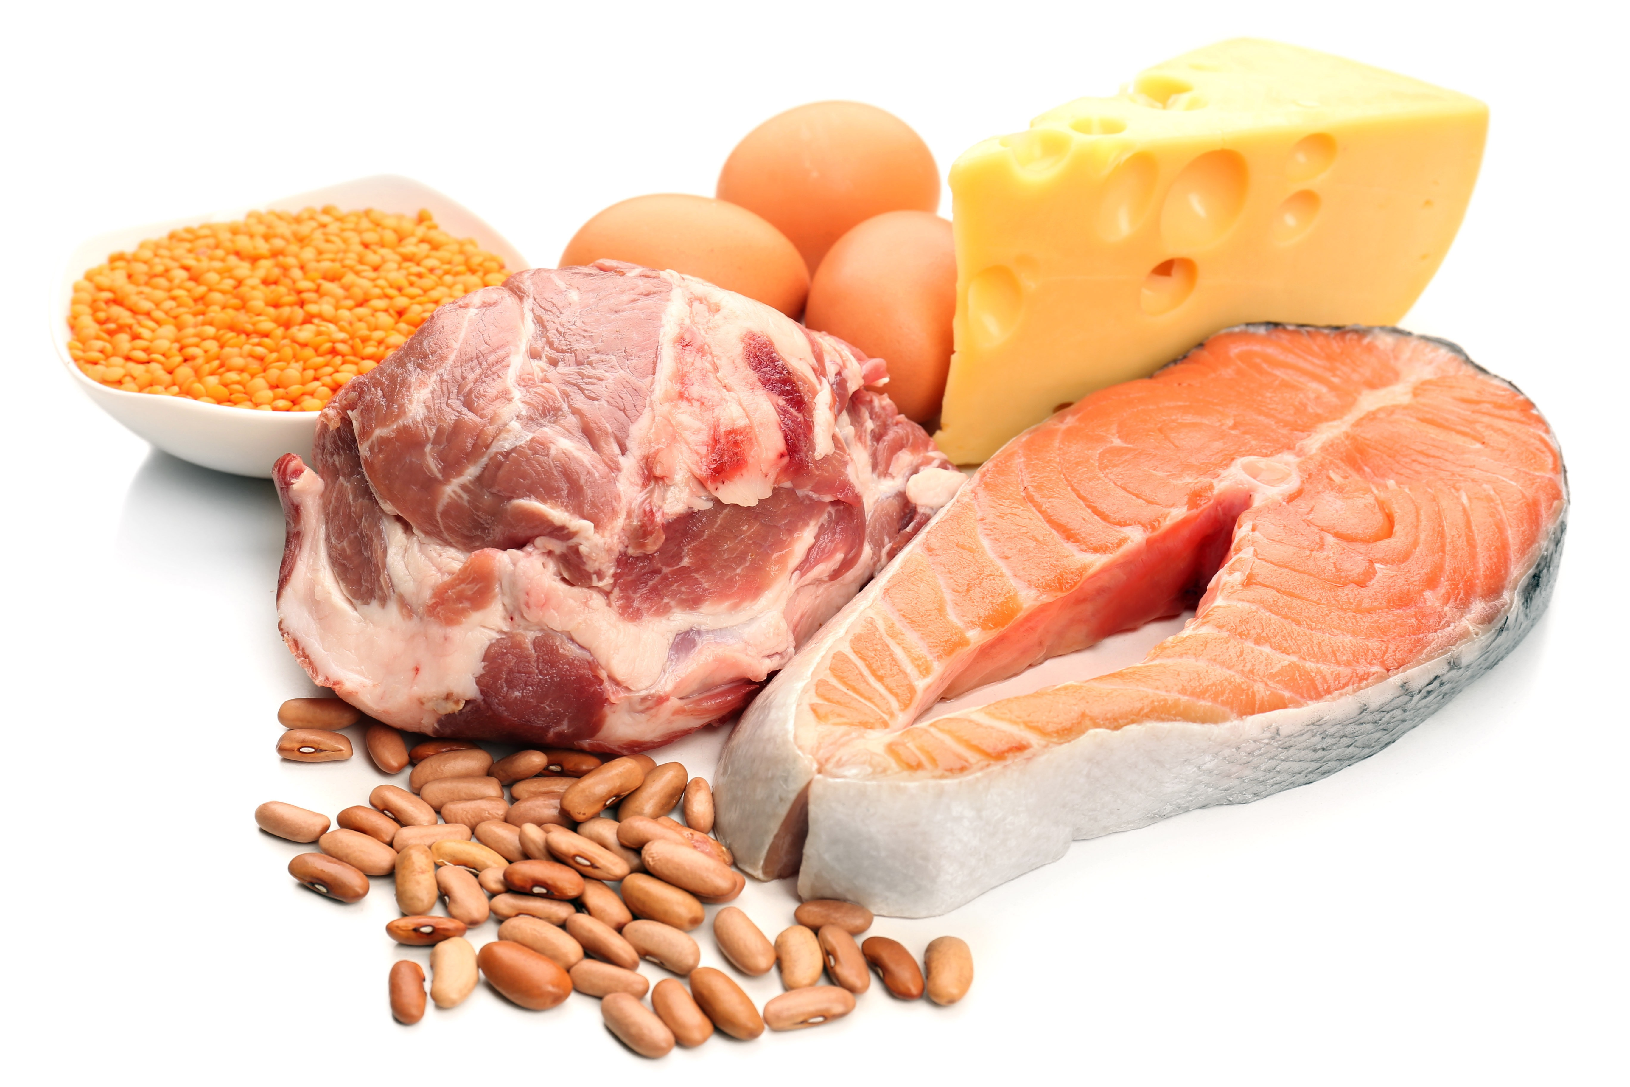
Protein

Slide 8
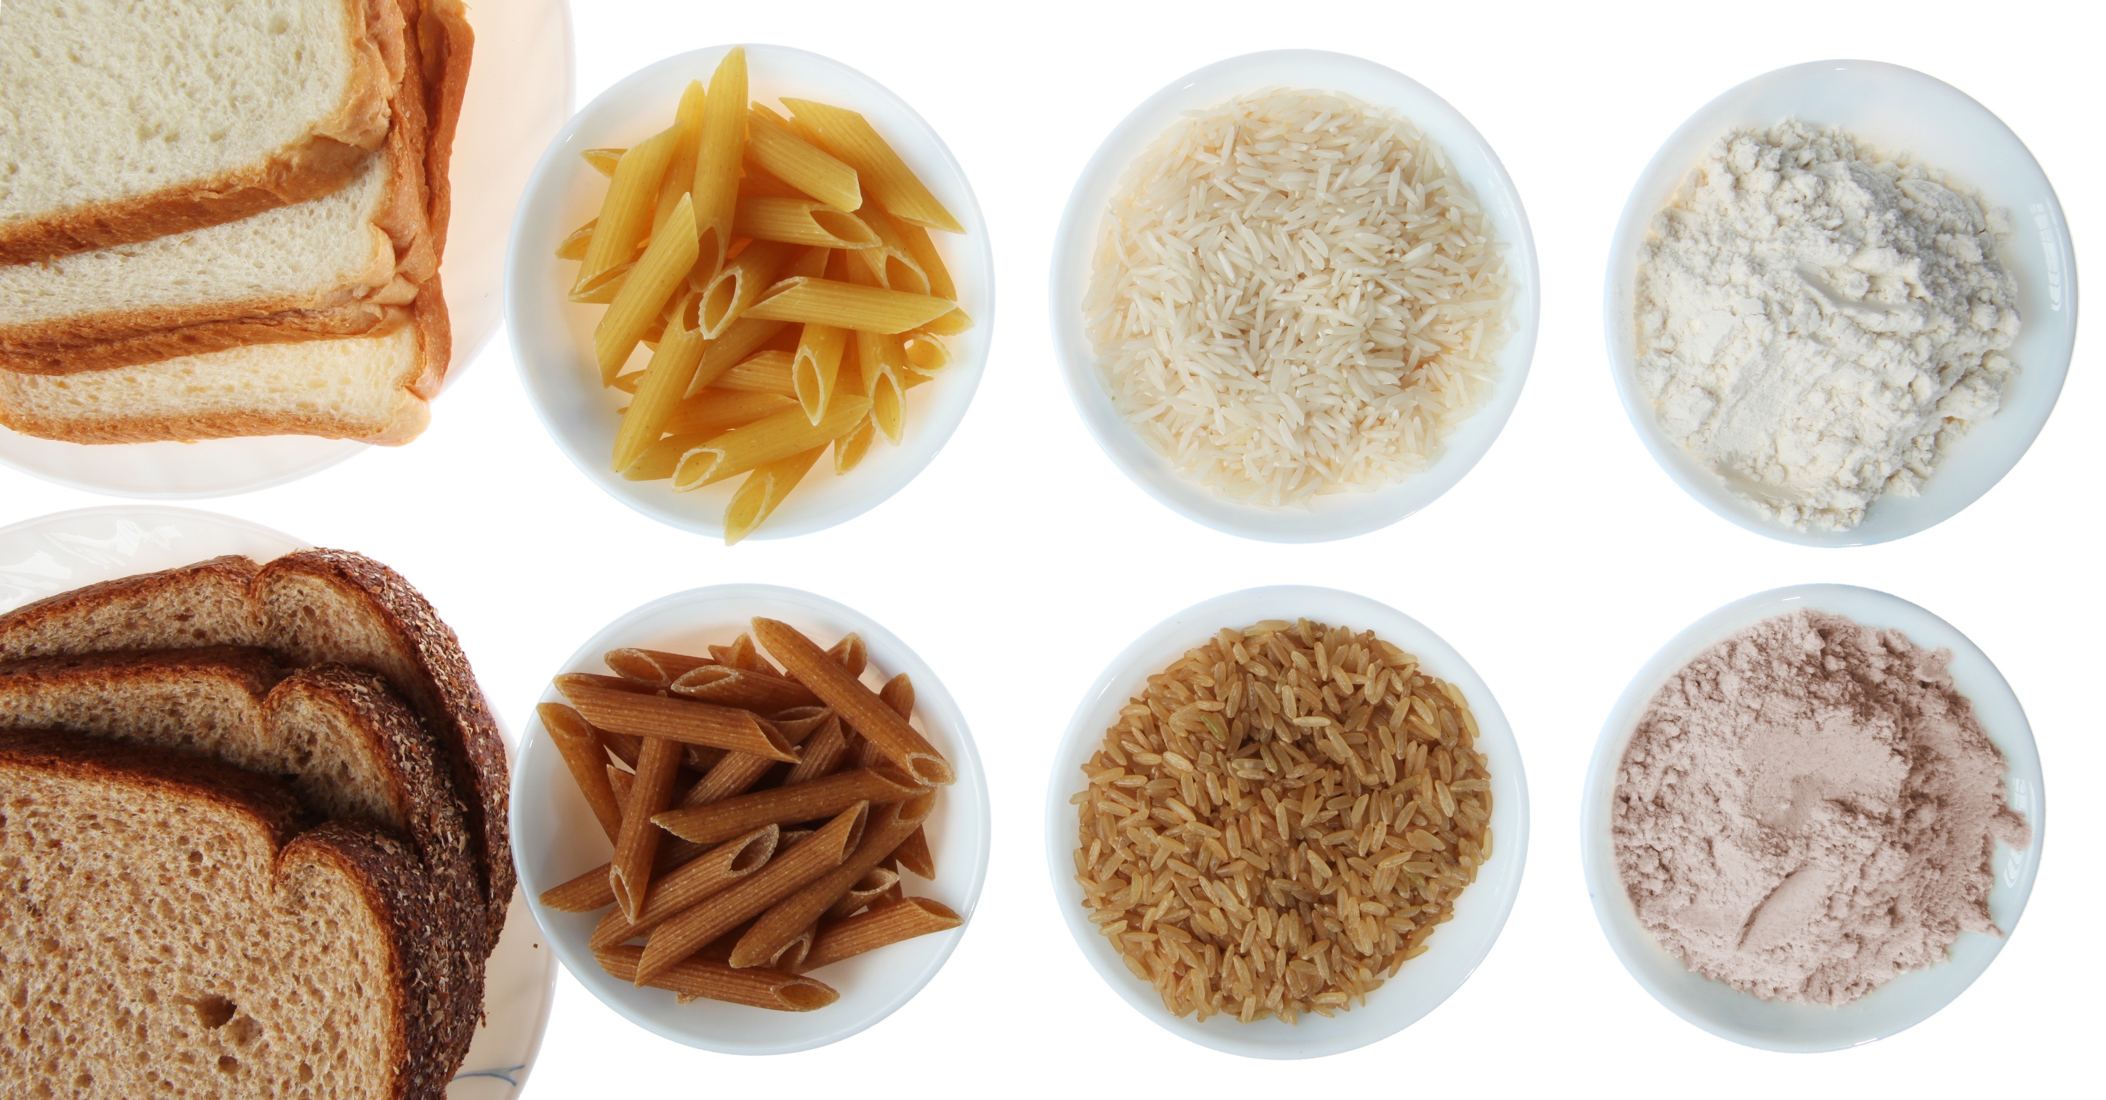
Grains

Slide 9
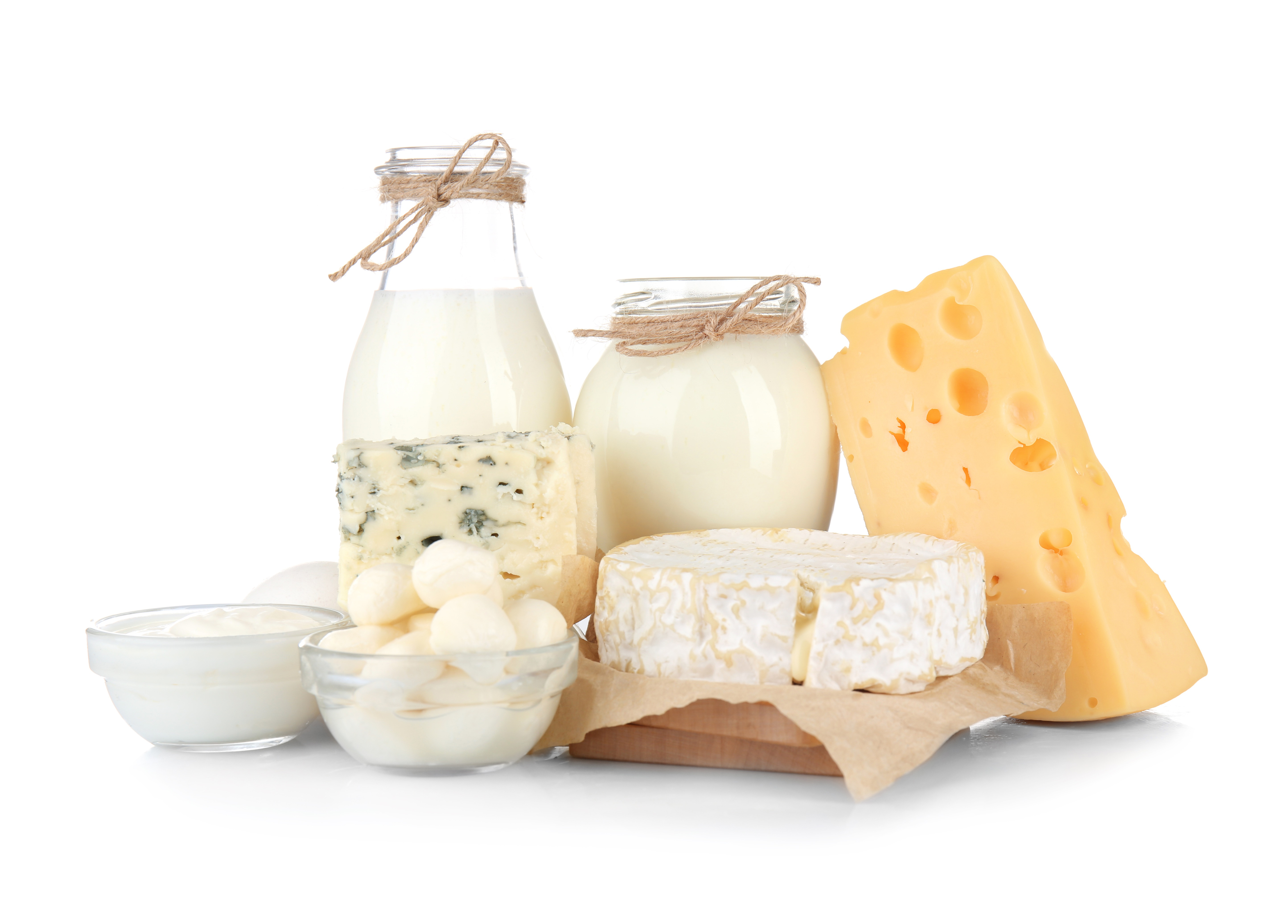
Dairy

Slide 10
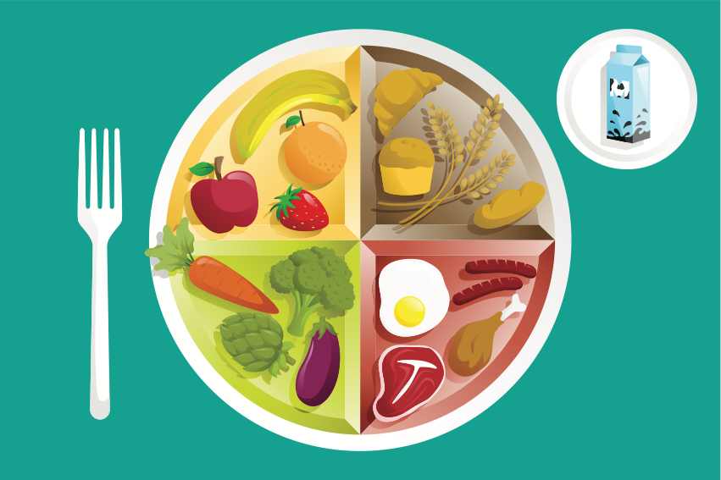

Slide 11
Yes, I do.
Do you like _________?
No, I don’t
Yes, he/she does.
Does he/she like _____________?
No, he doesn’t.

Slide 12
Would you like some ___________?
Would you like a ______________?
Yes, please.
No, thank you.
Yes, I would. Thank you
Not right now. Thank you.
May I have a ____________, please?

